Slide 1
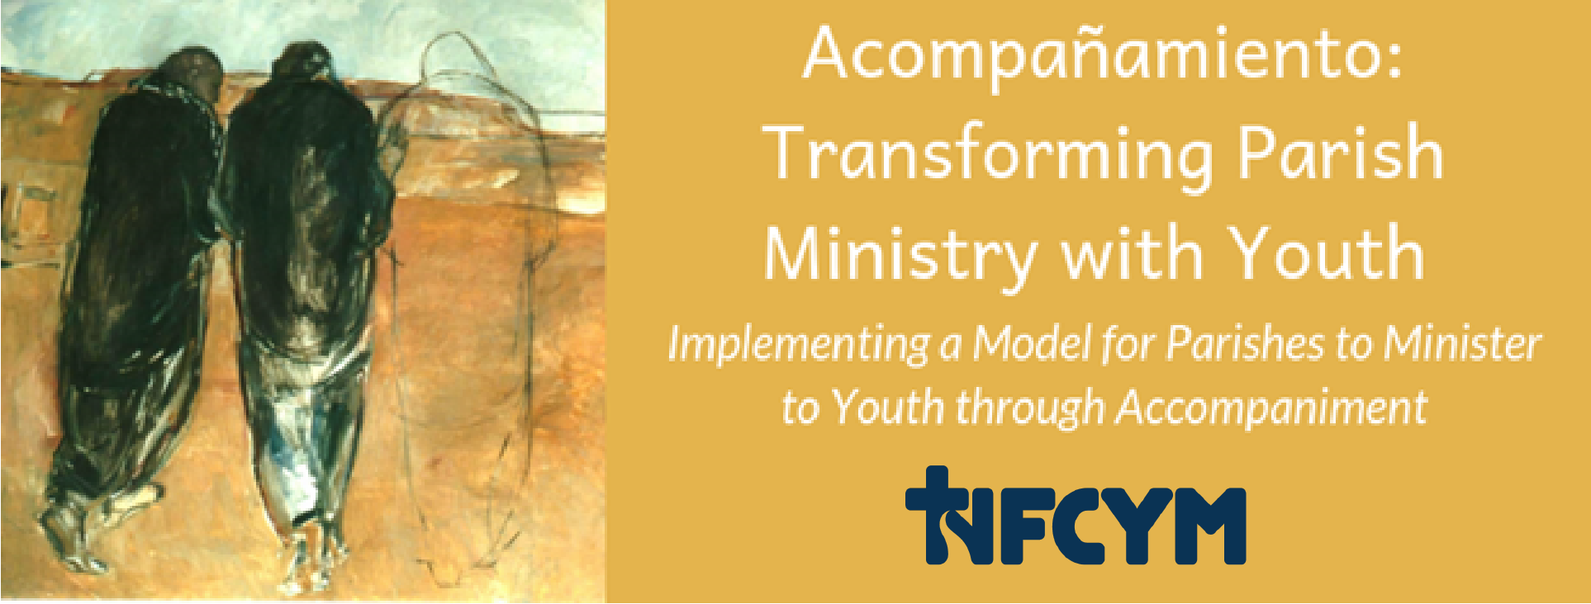
Introduction to Accompaniment
Notes:
Youth today are making big decisions about their lives. They are deciding who to be friends with, where they are going, and how they will prepare for their future. They are also making decisions about their faith. Young people in our parishes need and want someone to accompany them; they need faith companions. As Jesus walked with the disciples on the road to Emmaus, faithful adults are needed to accompany youth, listen to their questions, witness faith, lead them to encounter Jesus, and empower them for mission.
In our conversation today we are going to learn more about the Church’s vision for accompanying youth. We will also take time to talk about our community and begin planning for ways to walk with young disciples.

Slide 2
Notes:
Share a story about companionship:
We are probably all familiar with the story of the young man who was walking with Jesus and looked back over his life. At one point he looked over his shoulder to see two different sets of footprints in the sand. Jesus explained that when there were two sets of prints, he was walking with him. The young man asked, “Why are there just one set of prints during the most difficult moments of my life.” Jesus replied, “because, that’s when I carried you.”
I once saw a cartoon that continued the story further. The young man looked back and asked Jesus a second question, “What was happening when there was one set of footprints and two straight lines.” Jesus explained: “That’s when I dragged you, kicking and screaming.”
Many of us can relate to Jesus walking with us and carrying us, especially during hard times. In providing accompaniment for youth, we are hoping that they experience Jesus as their companion for life. Let us continue in sharing and in prayer for these hopes.

Slide 3
Prayer
A reading from the Gospel according to Luke.
All: Glory to you, O Lord.
Reading, Part 1:
What questions are on the minds and hearts of young people in our community?
Notes:
We begin our prayer in the name of the Father, and the Son, and the Holy Spirit
Amen
Jesus, our Savior.
We are gathered in your name
And journeying together in faith.
Walk with us as you walked with the disciples on the road to Emmaus.
Hear our questions.
Tell us the Good News.
Open our eyes to see your works
And send us out as your witnesses.
We ask this in Your Name.
All: Amen
(After Reading, Part 1) Jesus accompanied the disciples by listening to their questions.
What faith questions do you think are on the minds and hearts of the young people in our community?

Slide 4
Prayer
Reading, Part 2:
Who is someone that has accompanied you in faith?
What do you notice about people who accompany?
Reading, Part 3:
The Gospel of the Lord
All: Praise to you Lord Jesus Christ
Notes:
After Reading, Part 2:
Jesus accompanied the disciples by explaining the scriptures and revealing himself in the breaking of the break.
(Provide a personal story about someone who accompanied you in faith.)
Invite participants to share with a partner:
Who is someone who has accompanied you in faith?
Allow four to five minutes for sharing in pairs.
Ask participants to share:
You heard my story, you shared about someone who accompanied you and you listened to your partner’s story. What similarities did you notice about people who accompany?

Slide 5
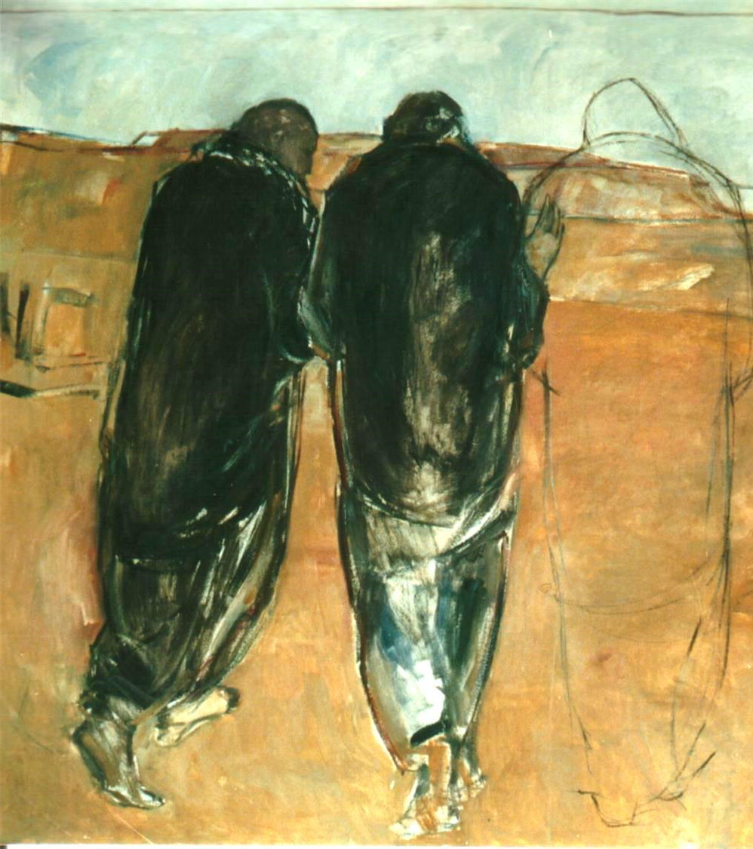
Jesus enters their night…
Jesus walks with two disciples…
He asks them questions and listens patiently to their version of events, and in this way, he helps them recognize what they were experiencing.
Then, with affection and power, he proclaims the word to them, leading them to interpret the events they had experienced in the light of the Scriptures.
Pope Francis, Christus Vivit, 2019, # 237
Notes:
In Christus Vivit, Pope Francis recalls this story and connects it to our journey with young people:
(Read quotation from Pope Francis in Christus Vivit.)

Slide 6
Jesus enters their night…
He accepts their invitation to stay with them as evening falls;
he enters into their night.
As they listen to him speak, their hearts burn within them and their minds are opened; they then recognize him in the breaking of the bread.
They themselves choose to resume their journey at once in the opposite direction, to return to the community and to share the experience of their encounter with the risen Lord.
Pope Francis, Christus Vivit, 2019, # 237
Notes:
(Read quotation from Pope Francis in Christus Vivit.)

Slide 7
Prayer Response
Lord,
Hear our prayer.
Notes:
Let us pray for the youth in our community and for their families:
We pray that young people experience our community accompanying them in faith as Jesus accompanied the disciples. We ask that you give them courage to ask their questions, listen to your Good News, open their eyes and to witness their faith. We pray to the Lord.
All: Lord hear our prayer
We pray for the young person and the family in our community who feels the furthest from your love. Help us to know the obstacles in their way and to compassionately lead them back to your table. We pray to the Lord.
We pray for parents, Confirmation sponsors, godparents, family members, catechists, ministry leaders, coaches, teachers, and for all who accompany youth in faith. We pray that these companions will be strengthened for their role, and will allow you to work through them in loving young people. We pray to the Lord.
All: Lord hear our prayer
For what else shall we pray?
(after collecting petitions from the group, continue with this closing to the opening prayer.)
Loving God, you know our hearts. Bless our meeting and give us what we need to serve you faithfully. We ask all these things in Jesus’ name.
All: Amen

Slide 8
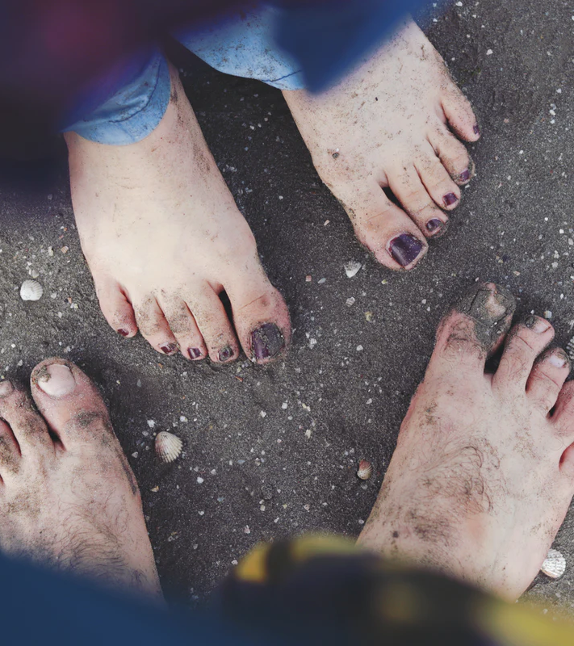
Art of Accompaniment
The Church will have to initiate everyone –
priests, religious and laity
into this “art of accompaniment”
which teaches us to remove our sandals before the sacred ground of the other….
Pope Francis, Evangeli Gaudium, #169
Notes:
In Evangeli Gaudium, Pope Francis describes the art of accompaniment and guides us to be humble and honor the person we accompany.

Slide 9
# 218 Christ is Alive Christus Vivit
“In such places the person to person contact indispensable for passing on the message can happen, something whose place cannot be taken by any pastoral resource or strategy.”
Notes:
In Christus Vivit, Pope Francis describes the person-to-person contact of accompaniment as indispensable for passing on the message of faith.

Slide 10
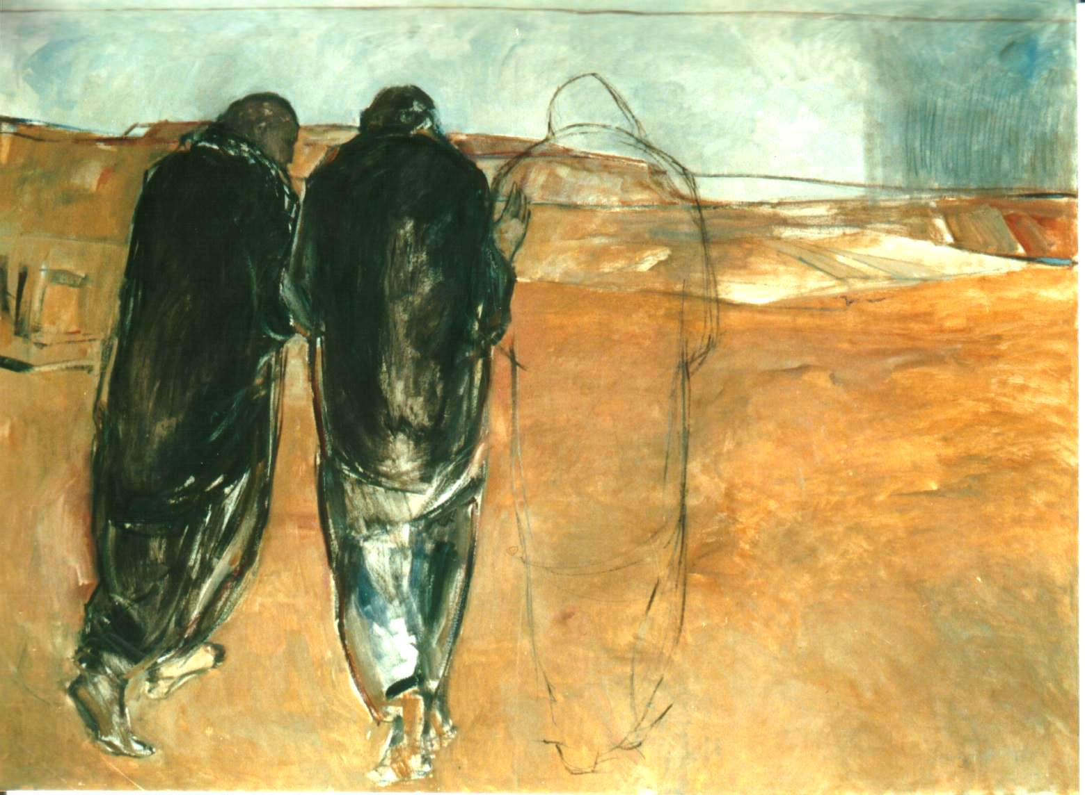
Accompanying Young People
requires going beyond a preconceived framework, encountering young people where they are, adapting to their times and pace of life and taking them seriously.
Preparatory Document for the Synod on Youth, Part 3, #1
Notes:
The preliminary document for the Synod provides a beautiful, but challenging vision of Accompaniment.
We are told to:
Go beyond a preconceived framework
Encounter young people where they are, adapt to their times and pace of life and take them seriously.
These words are intended to wake us up, to challenge us, to help us go beyond the “same old, same old” way of ministry and envision something new.

Slide 11
Listen to Young People and Accompany Them
“…speaks against providing ‘pre-packaged answers’ and emphasizes the importance for pastors to listen to young people and to prepare persons ‘to accompany’ them.”
Quotations from Synod Final Document October 27, 2018
Notes:
To accompany, we imitate Christ, and we listen with empathy.

Slide 12
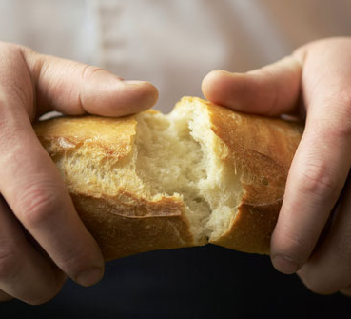
Accompaniment
We share bread with
We don’t judge
We walk along side (not pulling or pushing)
We listen to questions
We recognize where God is working – lead others to the holy
Notes:
What does it mean to accompany?
Just looking at that word – a comp pan, we see the “with bread” – this is a Eucharistic vision for ministry.
We share bread with those we accompany
We don’t judge
We walk along side (not pulling or pushing)
This reminds me of a keynote address I once heard at a conference. The speaker reminded us that if some of us are at point “C” and others are at point “B” or “A” in our journey of discipleship, that where we are in the journey is probably not very important to our loving God who knows we need to get to point “Z”.
We walk with those we are entrusted to care for.
We listen to questions
We recognize where God is working in a young person’s life and help them to align their lives with their faith.
We help those with whom we are companions to see the holy all around us.

Slide 13
Accompaniment
A perspective not a program
We can develop strategies and programs that promote accompaniment
It’s about “Immanuelization”
Notes:
Accompaniment then is not a specific program; it is a perspective we bring to all our ministries
We can intentionally develop strategies and programs that help strengthen relationships of accompaniment.
It’s about “Immanuelization” which is a term used by Frank Mercadante.
This is a way to think about evangelization – Immanuel means God with us. We know that Jesus promised that when two or more are gathered, he is in our midst. To “Immanuelize” is to allow Christ’s presence to be revealed in our relationships. This is at the heart of accompaniment.

Slide 14
The Church Goes Where Youth Are
We accompany youth where they are and take them seriously
Making a choice for faith requires… a journey beyond our ordinary means of ministry
Because accompaniment involves the freedom of young people, communities must learn to engage them in creative, and personal ways.
Notes:
The documents on accompaniment remind us to go where youth are. In the past, we have been a “come” ministry believing young people must come to us. Now, we are being challenged to truly become a “Go” ministry. We are being asked to “Go” beyond our usual way of doing things and to really engage young people in creative, personal ways so that they will make a choice for faith.

Slide 15
Going Out and Beyond Our Usual
Avoid everything that makes the Church feel outdated or makes people feel hemmed in
Accompanying youth as they face challenges
Going where youth are – technology, sports…
See: Instrumentum Laboris, #144
Notes:
Going out means avoiding everything that makes the Church feel outdated or feel dissatisfied. It means being good news to youth and being there as they face challenges. Accompaniment requires the church to go where youth are including meeting them through technology, sports, and other typically nonchurch environments. We go to the places where youth are, and then we faithfully walk with them.

Slide 16
A Young Person’s Calling
Awakening youth’s curiosity about their faith
Allowing youth to ask questions without pre-determining the answers.
Notes:
To be with another, is also to be with them in their call.
We join in echoing God’s call by awakening youth.
We ask questions without pre-determining the answers.

Slide 17
Which young people to Accompany?
“All young people without exception”
Instrumentum Laboris, #109
Youth already joined the faith through baptism
The Church is geographic
We have a special call to reach marginalized youth
Notes:
Which young people do we accompany? – Here is where it gets especially challenging.
(animation transition) We accompany “all young people without exception”
(animation transition) Youth who are baptized have already “joined.” Beyond that, we recognize that as Catholics, our parishes are not congregational, they are geographic. That means we aren’t just responsible for those who join, who get envelopes, or who show up. The pastor (and by extension the community) have a responsibility for the souls within the territory of their parish. This really calls us to Go Out! We have a special call to reach marginalized youth, those youth who, for whatever reason, have been pushed to the margins, and who someone because of their needs, their situations, their backgrounds, have not felt welcome.

Slide 18
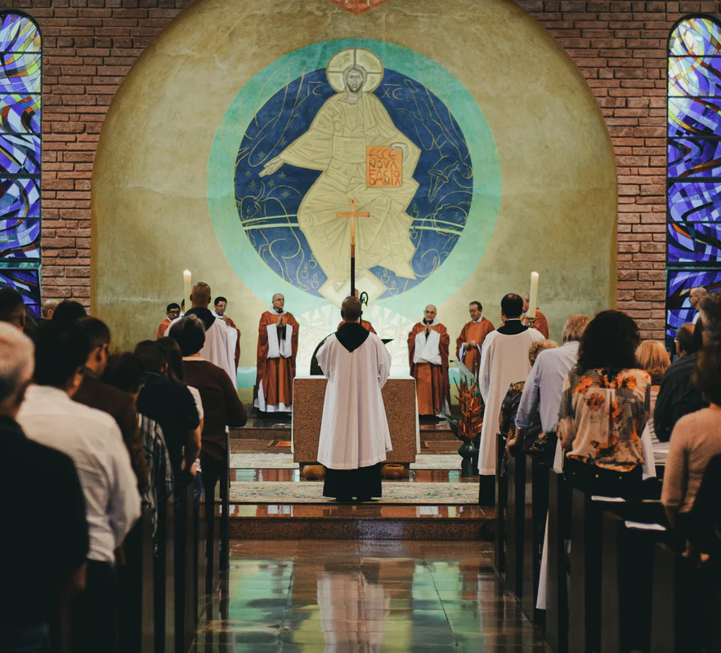
Who Accompanies?
A responsible community
The family
Pastors, Bishops, and Vocations ministers
Teachers
Adults who work with and mentor youth
Notes:
How could any one of us hope to accompany all young people?
It’s about a responsible community. The document uses the term “People of Reference” describing different ways that we work with young people. This also includes the family and people who are described as “Shepherds of souls – pastors, bishops, and vocation ministers. Teachers and all adults who work with youth.

Slide 19
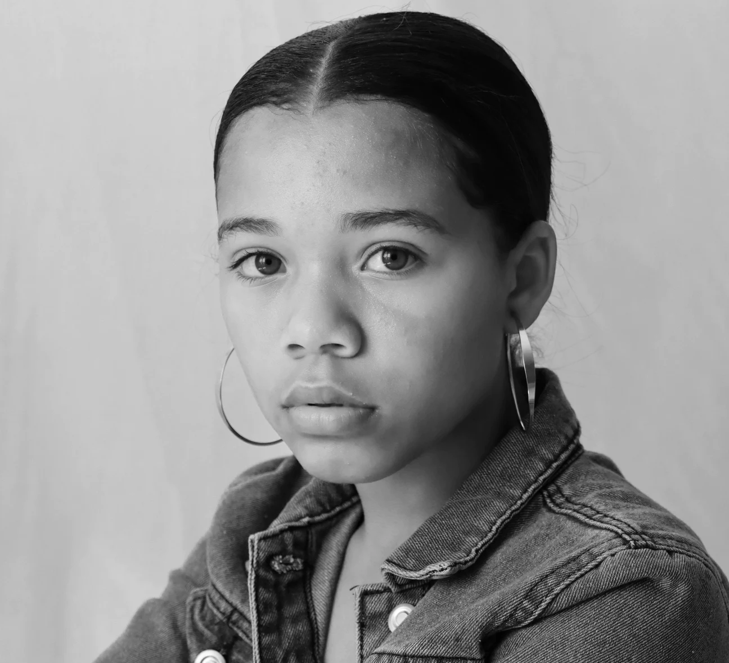
Be Intentional
We (church) need to reimagine our roles and see young people in new ways
Notes:
It’s time to reimagine our role – to see young people in new ways and to be intentional.

Slide 20
Notes:
How is this different? It is all about stance. Let’s examine a typical story of a youth minister. l have an experience of faith which leads me to becoming a youth minister. I work to create programs where young people can experience faith and I try to get as many youth as possible to join in those programs. This process relies upon the personality of the ministry leader and the convergence between young people’s interests and the programs that are created. In this model, we must initiate a relationship with a young person, help them trust us, and sell them on joining a program. Unfortunately, we lose a lot of youth in the process, not necessarily because youth aren’t interested in faith or God, but maybe they don’t relate to our faith journey and the programs we have created.
The direction for ministry in Christus Vivit and the Bishops Synod is different. It is telling us that accompaniment is our model for ministry with youth and their families which means we need to start by paying attention to the conversation that God initiated with a young person.
We remember that God has been dreaming of this young person and longing for them from the moment of their conception. God has been constantly telling this young person how much they are loved. God is engaged in constant conversation, even if at times, it is a monologue. So, our job is to align ourselves with this conversation.
We help young people notice what God is doing and notice their choices to see the possibilities for their life and for their life in Christ.
It all starts with listening. Because we love young people and we long for them to experience the embrace of Christ as disciples, we focus our attention on helping youth listen to God with their “inner self.”

Slide 21
Bigger Picture
God is calling each young person to the fullness of life.
God has been dreaming of each young person.
God began a conversation.
Our job is to align ourselves with this conversation.
We do this by accompanying the young person.
Notes:
This is the big picture of accompaniment.
God is calling each young person to the fullness of life.
God has been dreaming of each young person.
God began a conversation.
Our job is to align ourselves with this conversation.
We do this by accompanying the young person.

Slide 22
Notes:
Imagine the possibilities for growing in faith when a prepared, and faith-filled companion is walking with a young disciple.
Imagine your community, your parish, your school, filled with faith companions who are walking with each young person.

Slide 23
What Are You Hearing? What Are You Thinking?
What are the implications of Accompaniment?
For you personally
For parents and families
For ministry and catechesis with youth
For our parish…
Notes:
What are you hearing and what are you thinking?
Let’s take this chance to consider the implication of accompaniment.
Turn to page __ in your handouts and take a few minutes to reflect.

Slide 24
Working towards Change
How can we share vision?
How can we build structures that serve accompaniment?
How to we develop the practices of accompanying?
Notes:
Some of these reflections lead us to think about how we can change and grow. Consider these important questions:
How can we share vision?
How can we build structures that serve accompaniment?
How to we develop the practices of accompanying?

Slide 25
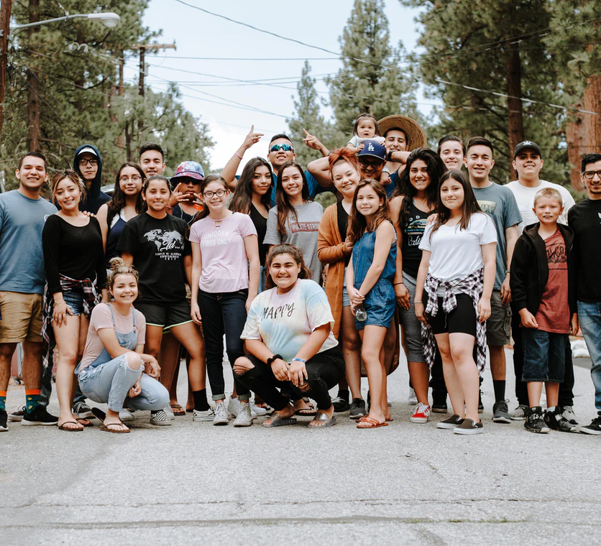
Becoming a Community Who Accompanies
Empowering the parish to accompany young disciples
Equipping Parents and Faith Companions
Transforming ministries to provide accompaniment
Notes:
To become a community who accompanies, we begin to take steps in this direction.
These are three important steps to help our parish grow:
Empowering the parish to accompany young disciples
Equipping Parents and Faith Companions
Transforming ministry to provide accompaniment

Slide 26
Accompaniment in My Parish
RESOURCES
CHANGE
What are the resources of our parish for accompanying youth in faith ?
Think of the people, the communities, the traditions, practices, patterns, and possibilities for youth involvement.
What needs to change in our parish to better accompany youth in faith?
Think about… the policies, the communities, the practices, the challenges and tensions.
Notes:
Now let’s begin to think strategically about our parish. Please turn to page __ in your handouts and consider these two questions: Resources:
What are the resources of our parish for accompanying youth in faith?
Think of the people, the communities, the traditions, practices, patterns, and possibilities for youth involvement.
Change:
What needs to change in our parish to accompany youth in faith?
Think about the policies, the communities, the practices, the challenges and tensions.
Reflect on these questions and then work in pairs and write your ideas on the large sticky notes, then post them here on the wall.

Slide 27
Next Steps
Innovation . Future . Ideas . Dreams . Hopes . Strategies . Input . Plans . Changes
Notes:
Share with the group some practical next steps for this process in your community, which could include ways to become involve or dates for future meetings and conversations.

Slide 28
Be New!
…the task involves learning to allow for something new and not stifling what is new by attempting to apply a preconceived framework.
Preparatory Document for the Synod on Youth, Part 3, # 1
Notes:
We are called to be new!
The task of being new and creative means to allow for something new to happen and not stifling it by trying to force fit the ideas in to a “preconceived framework.”
Thank the participants and invite the community to close in prayer.
Loving God, you call us to be new in the ways that we walk with youth in faith. Strengthen us as a community. Open our ears to hear your voice. Open our eyes to see you. Open our hearts to follow your call and love young people in your name.
We ask this in Jesus' name.
All: Amen

