Slide 1
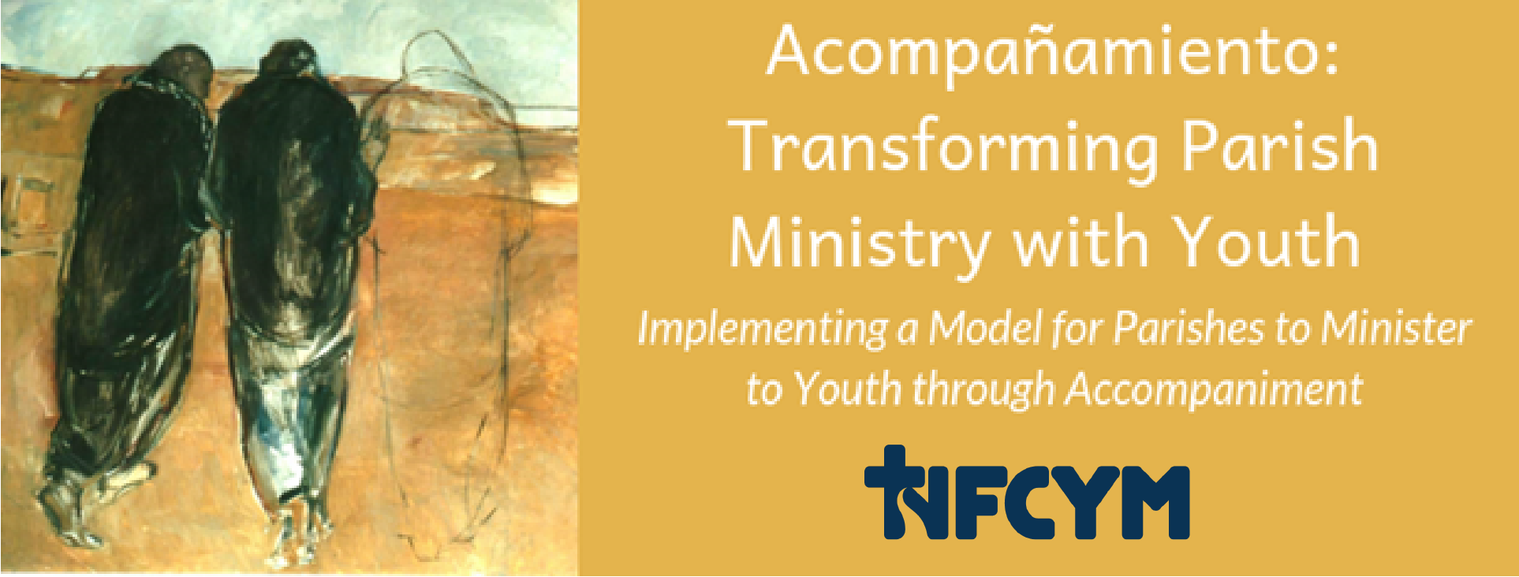
Being a Faith Companion Accompaniment Project Conversation #2
Notes:
Introduce yourself and the workshop. Share the purpose for our gathering:
Parents and all adults who care about and work with youth have an opportunity to talk with and walk with young people to connect faith and life. Youth today are making big decisions about their lives. They are deciding who to be with, where they are going, and how they will prepare for their future. They are also making decisions about faith. Young people in our parishes need someone to accompany them; they need faith companions. This is a big job! You deserve support and tools to help you make the faith connection. As Jesus walked with the disciples on the road to Emmaus, we can accompany youth, listen to their questions, witness to faith, lead them to encounter Jesus, and empower them for mission.

Slide 2
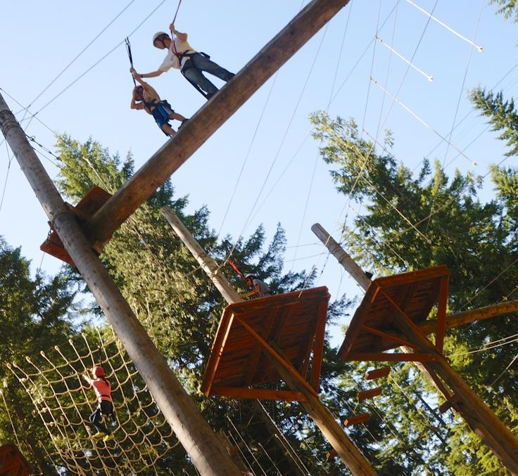
Journey of Adolescence
Notes:
Begin by sharing a story of accompanying youth in their journey of life and faith. Consider this story: Kristen, a High Ropes specialist for a Catholic summer camp shared this story. During one of the camp weeks, one of the youth had attention issues and some counselors were nervous about allowing him on the apparatus. Kristen kept her eyes on him. Persons on the apparatus always have two clipped connections to their harness. When they move from one section to the next, they are instructed to keep one harness clipped to the place they are moving from, while they move one clip to the new section. At one point, she noticed that the young man had both clips off while he was moving. She realized that the worst thing to do was to yell and startle him. She walked over to him and told him to clip himself before moving. She let him know what he did and the risk he was taking, then she supervised him in moving one clip at a time.
This story is a lot like the adolescent journey. Youth are making choices about faith and identity and friendships and their future all of the time. Sometimes they unclip their harness. They need us, parents, caring adults, loving communities to guide them (without startling them) to move safely to the next step.

Slide 3
Parents have been told:
Back off
Let the culture and peers raise youth
Turn your young people over to experts
You have nothing in common with your adolescent child
Notes:
This can be challenging because we hear a lot of messages that tell us to stay out of it.
Parents have been told by many sources in our media and culture to:
Back off
Let the culture and peers raise youth
Turn your young people over to experts
You have nothing in common with your adolescent child

Slide 4
Adults who care about youth have been told:
Youth don’t like adults
It’s not natural for adults to spend time with youth
It’s unsafe to be a mentor
Notes:
Caring adults also experience negative feedback. We are told:
Youth don’t like adults
It’s not natural for adults to spend time with youth
It’s unsafe to be a mentor

Slide 5
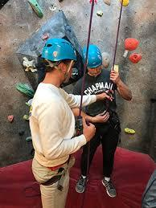
The Truth: Youth Need Guides
When youth are isolated, and without caring adults in their life, they are more vulnerable.
Humans were created to guide each other. It’s the nature of family and community.
We can care about young people, allow them to grow, and keep them safe.
Notes:
The truth is: Youth Need Guides in this Journey!
When youth are isolated, and without caring adults in their life, they are more vulnerable.
Humans were created to guide each other. It’s the nature of family and community.
We can care about young people, allow them to grow, and keep them safe.

Slide 6
Springtide – Belonging Research – March 2020
Nearly 40% of young people don’t have anyone to talk to
Attending religious groups or gatherings doesn’t have any affect unless they have a relationship with an adult who cares
20% of young people who attend a religious service at least once a week feel completely along
The secret is in the relationships.
Young people are more disconnected then ever from their communities
Notes:
Springtide Research is a ministry of the Christian Brothers that focuses on listening to youth and helping those who care about young people understand and address the loneliness and isolation that many youth feel. In their recent research, they reported that nearly 40% of young people don’t have anyone to talk to. This number is true whether or not a young person is attending religious groups or gatherings unless youth have a relationship with an adult who cares.
20% of young people who attend a religious service at least once a week feel completely alone.

Slide 7
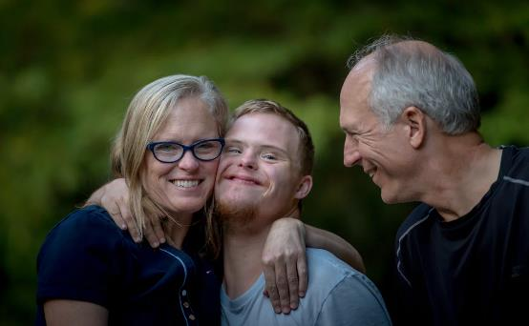
Youth Need Us More Than Ever
Notes:
Youth’s needs are not as obvious or simple now as when they were a baby, toddler, or in grade school.
Youth need us now more than ever!

Slide 8
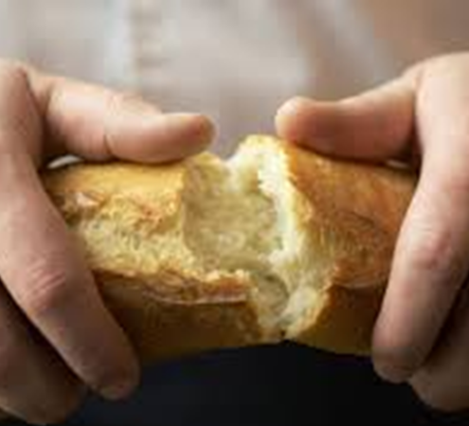
Companion
To name a friend as a companion is to quite literally name another as “the one who brings to you, or who is bread for you.” It is the highest compliment you can bestow upon a person. This is a person who sustains you.
John Flaherty
Catholic Collective
Notes:
Present this image about being a Companion by John Flaherty. Read the quotation and then invite participants to think about someone who is their companion, who is bread for them.
Take a moment of silence to prepare for prayer.
Presider:
Let us gather, as we always gather, in the Name of the Father, the Son and the Holy Spirit
All: Amen
Generous God, You Care for us, You comfort us.
You are our Bread, You are Our Hope.
Open our eyes to see you.
Open the ear of our hearts to truly hear your word.
Help us to follow you without hesitation.
We ask this as we will continue to listen and pray in Jesus name.
All: Amen

Slide 9
Notes:
Luke 24:29-31
A reading from the Gospel of Luke
But they urged him, “Stay with us, for it is nearly evening and the day is almost over.” So he went in to stay with them. And it happened that, while he was with them at table,

Slide 10
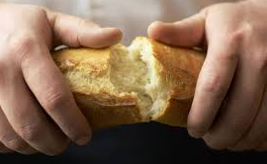
Notes:
he took bread, said the blessing, broke it, and gave it to them. With that their eyes were opened, and they recognized him; and he vanished from their sight.

Slide 11
Companion
“the one who brings to you, or who is bread for you.”
Notes:
Reflection
Provide a brief reflection about Christ as our bread and the companions who lead us to him.

Slide 12
Reflecting on Companions
Share with your partner about someone who is your companion, someone who is bread for you. How does this person lead you to Christ?
Notes:
Faith Sharing
Share with your partner about someone who is your companion, someone who is bread for you. How does this person lead you to Christ?
After several minutes for sharing, invite a few people to share responses with the large group about ways that we are led to Christ by our companions.

Slide 13
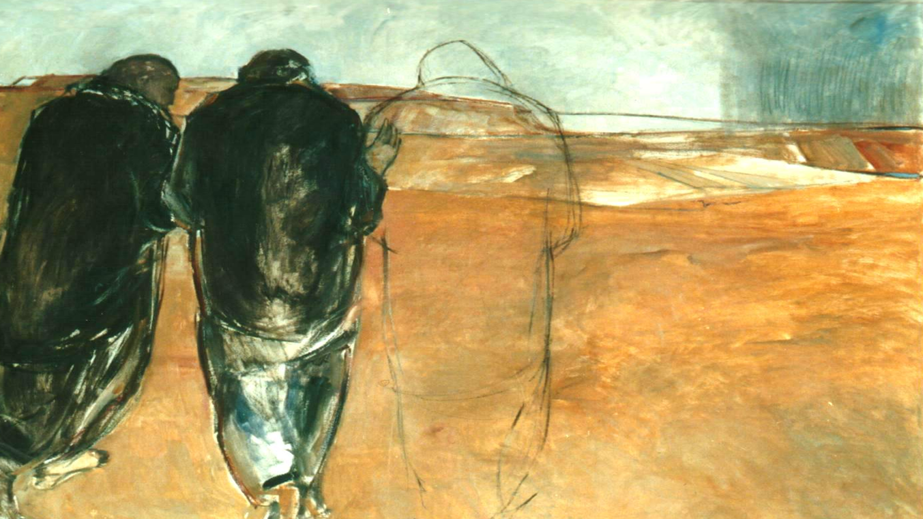
Prayer Response: Nourish Us Loving God
Notes:
Petitions
Our response is: Nourish Us, Loving God
Generous God, you feed us and call us to be bread for each other. We pray now for those who are our companions. Fill their hearts with your peace and give them strength for their journey. For this we pray.
All: Nourish Us, Loving God
For what else shall we pray?
After each petition from the community, join in the response:
All: Nourish Us, Loving God

Slide 14
Notes:
Closing Prayer
Triune God, as many grains of wheat become one bread, may our communities always strive to become one, as a witness to Your unity. May we continue to accompany others in our mission to serve You—May we be companions who lead others to you. May we be a witness to Your Kingdom. May we become bread for a hungry world.
We ask this prayer in the name of Jesus, our bread.
All: Amen

Slide 15
What do you hope for youth and their faith?
Notes:
Ask participants to reflect on this question. Collect some responses with the large group.
The vision for accompaniment tells us that the way to achieve this hopes is by surrounding youth with faith companions.

Slide 16
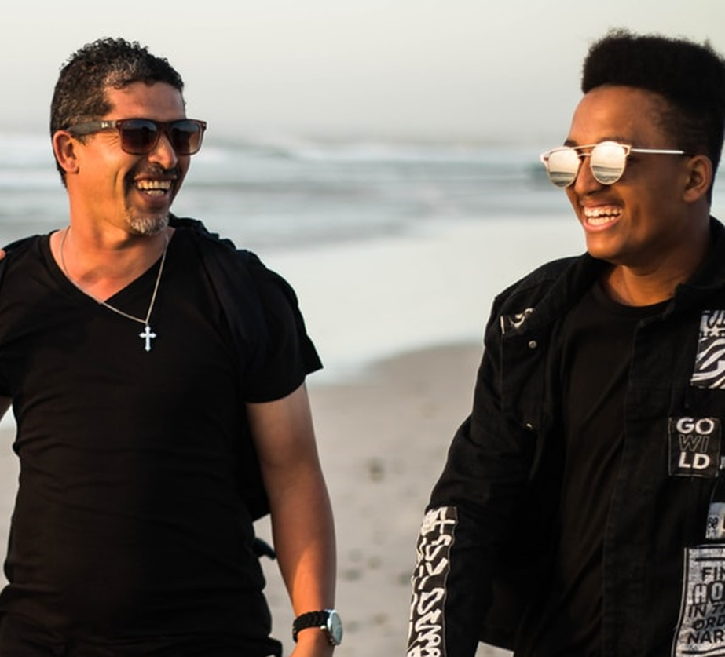
Be a Faith Companion for Youth
Notes:
We are called upon to be a faith companion for youth.

Slide 17
In such places…the person-to-person contact indispensable for passing on the message can happen, something whose place cannot be taken by any pastoral resource or strategy.
# 218- Christ is Alive – Christus Vivit
April 2, 2019
qqe
Notes:
In Christus Vivit, Pope Francis describes the person-to-person contact of accompaniment as indispensable for passing on the message of faith.

Slide 18
What are the qualities of someone who accompanies youth?
Notes:
Ask the group to respond to this question: What are the qualities of someone who accompanies youth?

Slide 19
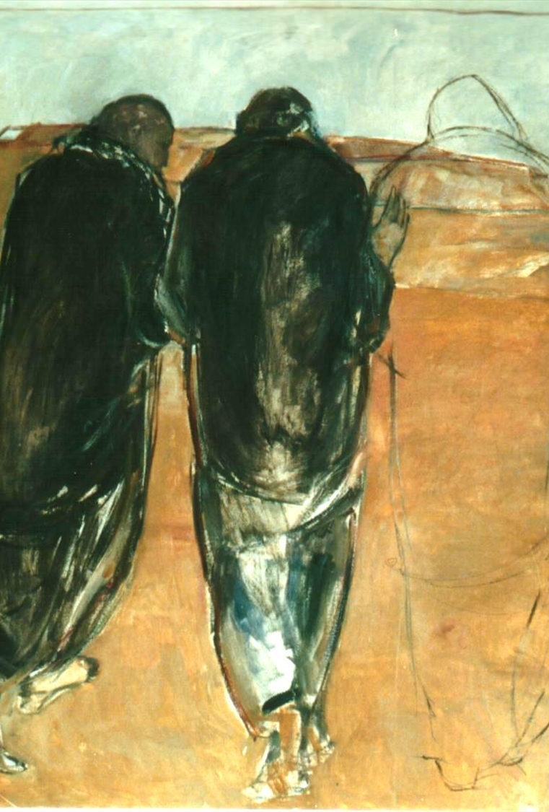
A good accompanier
is a person who is balanced, a listener, a person of faith and prayer, who has the measure of his own weaknesses and frailties. Hence, he knows how to be accepting of the young people he accompanies, without moralizing and without false indulgence.
Final Document for the Synod on Young People, the Faith, and Vocational Discernment, # 102
Notes:
Share this description of an Accompanier and connect to the responses from the group sharing.

Slide 20
Seeing
Spend time with youth
Listen to them
Respond to their experience, their story
Empathize
Notes:
“Seeing” young people happens when we spend time with them, listen to them, and are responsive to their experience and their story. Seeing a young person with empathy allows us to enter their experience without controlling it, without bringing our agenda to it.

Slide 21
Notes:
What does empathy mean? Brene Brown explains that empathy is a skill that strengthens with practice and encourages people to both give and receive it often. By receiving empathy, not only do we understand how good it feels to be heard and accepted, we also come to better understand the strength and courage it takes to be vulnerable and share that need for empathy in the first place. In this video, she provides a contrast between empathy and sympathy.

Slide 22
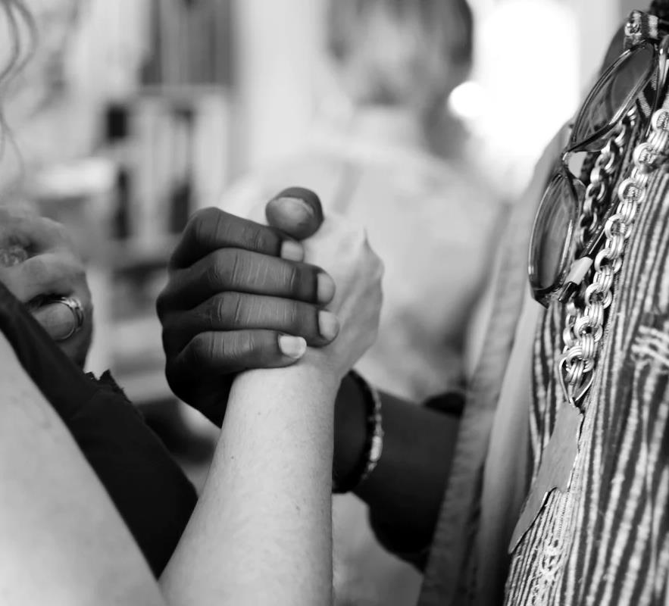
Theresa Wiseman’s four attributes of empathy:
To be able to see the world as others see it
To be nonjudgmental
To understand another person’s feelings
To communicate your understanding of that person’s feelings
Notes:
Ask the group what they heard in the video that is important for our role as companions.
Brene Brown mentions the work of Theresa Wiseman, who studied professions that rely on empathy. These are Theresa Wiseman's four attributes of empathy:
To be able to see the world as others see it—This requires putting your own "stuff" aside to see the situation through your loved one's eyes.
To be nonjudgmental—Judgement of another person's situation discounts the experience and is an attempt to protect ourselves from the pain of the situation.
To understand another person’s feelings—We have to be in touch with our own feelings in order to understand someone else's. Again, this requires putting your own "stuff" aside to focus on your loved one.
To communicate your understanding of that person’s feelings—Rather than saying, "At least you..." or "It could be worse..." try, "I've been there, and that really hurts," or (to quote an example from Brown) "It sounds like you are in a hard place now. Tell me more about it.”

Slide 23
Our crosses become bridges
Notes:
Our experiences, including those things that are hard and painful, help us to empathize, not because we try to compete or even share our own experience. The things we’ve been through help us to try to be with another in their pain and suffering. Our Crosses Become Bridges. When we recall challenging times, we make room in our heart to listen to someone else. This is why we sometimes prefer to give solutions or tell people that “it is not so bad” or that they should “look at the sunny side”. Sometimes we don’t want to really hear someone else’s pain because we have to remember our own. When we truly listen, we are aware of our vulnerability. That is what is so healing!

Slide 24
A Safe Place to Walk
“Public / Private Space”
Walking in Pairs
Notes:
We always provide a safe place to walk as we accompany.
Be sure to consider your diocesan guidelines for safe environment as you develop your strategies.
For example, if part of the way that we connect with youth as faith companions includes connecting through technology by text or message, we could create a way to provide “public/private space.” If you were meeting with a young person, you wouldn’t go into an office with locked, solid door. You would meet in a way where others could see you. Similarly, we can bring a “team” approach to our communications with youth. Choose another member of your team to partner with. Get permission from parents to text, email or message. Include the other adult leader in all of your communications. That way, you have each other’s back.

Slide 25
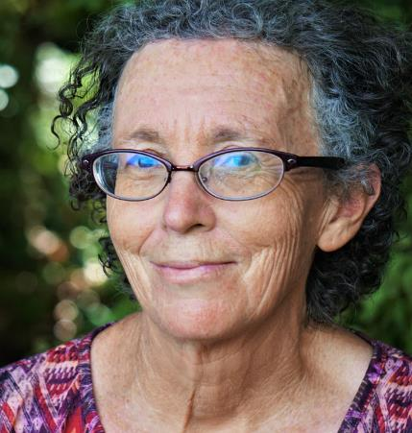
A Faith Companion
Connects
Listens
Empathizes
Cares
Witnesses
Calls
Prays
Notes:
We accompany young people by being a faith companion. Earlier, we brainstormed the qualities of someone who accompanies youth. These are some of the things we do as faith companions.
Prays
Faith Companions prays for young people in their care.
Connects
Faith Companions connects with young people. This includes initiating contact and finding regular ways to connect for conversation.
Listens
Faith Companions listen to questions, concerns, hopes, wonderings, and experiences.
Empathizes
Faith Companions empathize with young people.
Cares
Faith Companions provide care for young people, providing practical good news for their life situations.
Witnesses
Faith Companions witness to their faith with young people.
Calls
Faith Companions challenge young people to grow and share their gifts; they help young people to hear God’s call.

Slide 26
Prescribing Next Step
Connects
Listens
Empathizes
Cares
Witnesses
Calls
Prays
Notes:
As faith companions, we are constantly prescribing the next thing we can do to accompany. We ask ourselves, what does our companion need to hear God’s voice and respond? Do they need prayer? (they always need prayer.) What is a way I can connect with them in their life situation? A way to “Go out” to them? What are some patterns of connection we can create? How can I truly listen, understand and strive to empathize? What is the care that they need right now? What is the practical, touchable, tangible Good News they are longing for? How can I be a witness? How can I share a little bit of the story of God in my life? How can I join with God in calling this young person?

Slide 27
Faith Conversations
Recall a faith conversation you’ve had with a young person.
What was hard?
What was easy?
What worked?
What doesn’t work?
Notes:
Share a story of being in a faith conversation with a young person and invite the participants to reflect.
Reflection:
Recall a faith conversation you’ve had with a young person.
What was hard?
What was easy?
What worked?
What doesn’t work?
Allow a couple of minutes of silence, then ask participants to share in pairs. Collect responses with the large group and provide some coaching as people share what is hard. After the large group sharing, provide summarizing comments.

Slide 28
Watch For
Judgement
Adultism
Coercion
Lecturing
Notes:
Watch for these four things as you companion youth:
Judgement – Sometimes the most important thing we can do is hold our tongue and stop our finger from wagging.
Adultism – Which is the belief that our adult experience is the answer to every problem. We need to admit that we were never their age because we were never 15 in 2021.
Coercion – Sometimes we can be tempted to be coercive with a young person because it is for their own good. We should remember that there is no coercion in the love of God. There is lots of persistence, but no coercion.
Lecturing – Someone once asked how to know when you have started to lecture – you will see it in their eyes!
When we fall into one of these, we can name it, and then restart the conversation. For example, “I realize that I started to go into a lecture. I really want to understand your experience. Tell me more about what happened…”
For more information, see“ Getting Relationships Right” from the Search Institute, especially pages 12-22. Adultism is referenced on page 14. https://www.search-institute.org/wp-content/uploads/2018/01/Getting-Relationships-Right.pdf

Slide 29
Create Space for Conversation
Notes:
Talk about some ideas for parents and caring adults to create space for conversation.
Some examples:
One dad shared that he talks to his teen daughters when they take the dog for a walk.
Lots of parents share that there best talking time is car time – there is something about facing forward that creates a way to talk.
One mom shared that when she irons her clothes, she sets the ironing board behind the couch that is facing the TV. For some reason, this is the time that her son opens up. He comes and sits down on the couch and pretends to watch tv when he hears the groan of the ironing board opening. She shared, “I almost scorched my favorite blouse when I ironed it five times just to keep the conversation going!”

Slide 30
“Marinating” in the faith
Notes:
Families can create patterns and regular times to check in about faith. In our family, we did special activities with each of our daughters at Holy Week. It gave me a chance as a parent to talk about faith and find out where my daughters were.

Slide 31
Create Safe Places
Hold Questions as a Sacred Trust
Use Only Love
“We must relinquish any means other than love to persuade young people to the truth of the Gospel and the inherent value of a life lived in service of Christ and neighbor.”
Robert J. McCarty, Faith Talk – Having Conversations that Matter with Youth. Winona, Minnesota: Saint
Mary’s Press, 2018, page 42.
Notes:
In his book, Faith Talk, Dr. Robert McCarty speaks to all of us who are privileged to walk with youth in faith.
Create Safe Places
We need to create safe places for doubt, remembering that doubt is a sign that young people are struggling with God questions. We must be confident that this struggle will take them into a deeper relationship with Jesus.
Hold questions as a sacred trust
Creating a space in which such questions can be asked involves being able to ‘hold’ young people’s question as a sacred trust. Rather than declaring what a young person must believe, we need to adopt a position of patient accompaniment, of inviting dialogue, of proposing rather than imposing faith.
Use only love
We must relinquish any means other than love to persuade young people to the truth of the Gospel and the inherent value of a life lived in service of Christ and neighbor.
Robert J. McCarty, Faith Talk – Having Conversations that Matter with Youth. Winona, Minnesota: Saint
Mary’s Press, 2018, page 42.

Slide 32
The Injured
The Drifters
The Dissenters
Notes:
Dr. McCarty wrote his book in response to the study completed by Saint Mary’s Press and the Center for Applied Research on the Apostolate (CARA). This research studied the stories of young adults who chose to disaffiliate from the practice of the Catholic Faith. The average age that a young person made that decision was 13. One way to understand these young people would be looking at three groups: The injured – the drifters, and the dissenters. Oftentimes, these concerns overlap.

Slide 33
The Injured
Disruptions in family life
Witnessing inauthentic or hypocritical expressions of faith
Feeling forced to participate
Unanswered prayer
Notes:
The injured have experienced things in their life and in their faith life that felt inconsistent with faith in a loving God.
Provide a personal example:

Slide 34
The Drifter
Lack of connection between faith and life
Lack of companions on the faith journey
Families with marginal practice of faith
Unable to answer “so what?”
Notes:
The drifters lack a commitment to faith. They aren’t hostile to religion, but no one has answered their questions and they have little experience with people of vibrant faith.

Slide 35
The Dissenter
Active resistance to the faith, particularly around social issues like same-sex marriage, abortion, and birth control
Disillusionment and frustration that questions were never answered or heard
Difficulty in reconciling faith with science
Notes:
The dissenter disagrees with church teachings and struggles to reconcile their knowledge of science with the mystery of faith.

Slide 36
Going, Going, Gone…
The Injured
The Drifters
The Dissenters
Notes:
Check in with group – How does this information match with your experience of youth?
We should assume that the youth we care about are walking around with one or more of these kinds of questions and experiences. These kinds of concerns and doubts are a natural part of faith maturity. When youth begin to ask questions about the faith, it is a sign of their growth and readiness to accept a more mature faith stance. I’ve always thought that, instead of being bothered or annoyed by youth questions, we should stop and bless the holy questions when youth begin to share their insights about the faith that we love. In this midst of these questions, they need us more than ever. The faith journey was always intended to be a guided journey. We are privileged to be those guides.

Slide 37
Role Play Ideas:
One person is the Parent / Adult Faith Companion
One person is the Youth
“Sometimes I feel silly praying to God. I don’t know that God is really there.”
“Mom and dad are fighting all the time now. I think it might be my fault. I don’t know what to do.”
“I really don’t like going to youth ministry, or religious education. I feel like I’ve already heard this stuff. I don’t have anything in common with the other youth there.”
“God couldn’t care about me now. Not after the things I’ve done.”
Notes:
I am going to ask us to practice listening and guiding. Please divide into pairs. In your pair, one of you will be the parent or faith companion and one of you will be the youth. Once you have decided, I am going to ask the youth to face the screen and the parents to face away from the screen and face your young person.
(advance animation.)
Youth – please read over and choose one of these situations to discuss with your parent or faith companion.
Once you’ve decided, please begin.

Slide 38
Faith Conversations
From your role play:
What was hard?
What was easy?
What worked?
What doesn’t work?
Notes:
First, I am going to ask reactions from the young people:
How did that feel?
What was hard for you? What was easy?
What worked? What didn’t work?
If you felt listened to, what was it that your companion did?
For the Faith Companions and parents:
What was hard?
What was easy?
What worked?
What doesn’t work?

Slide 39
A Community of Faith Contacts
Parents / Aunts / Uncles / Grandparents
Ministry Leaders / Catechists / Teachers / Coaches / Group leaders
Sponsors / Godparents
Peers
Notes:
Imagine engaging a whole community of faith contacts for our young people! Consider these possibilities.

Slide 40
Young Person
Parent
Youth Ministry Leader
Aunt / Uncle or Godparent
CYO Coach / Catechist
Grandparent
Notes:
(This slide has animation to allow you to share one element at a time.)
What if each young person had five faith companions? Five people who were “echoes of faith”?
Talk through each person.
Some of the young people with whom we minister don’t have parents that are faith companions. Chap Clark says that in these situations we are called to help create the web of support, to create the five people who can walk with youth.

Slide 41
Be on the Lookout for the Holy
Notes:
Provide some summarizing comments and encourage parents and faith companions to keep their eyes out to look for the holy. Provide a personal example.

Slide 42
Parent and Faith Companion Toolkit
Notes:
Take a few minutes and review the resources in the handouts for the Parent and Faith Companion Toolkit.

Slide 43
What do you need next as a parent and/or as a faith companion?
Get together with other parents and faith companions for networking and support.
Have someone to talk to about companioning youth in faith.
Resources for knowing how to answer tough faith questions and for understanding the adolescent faith journey AND / OR
Training for knowing how to answer tough faith questions and for understanding the adolescent faith journey
Resources to help youth with pastoral care issues like anxiety, stress, and depression. AND / OR
Training to help youth with pastoral care issues like anxiety, stress, and depression.
Other?
Notes:
Ask participants to take a minute to reflect on this question and write down some ideas. Ask participants to share sample responses with the large group.

Slide 44
A Faith Companion
Connects
Listens
Empathizes
Cares
Witnesses
Calls
Prays
Notes:
We accompany young people by being a faith companion. Earlier, we brainstormed the qualities of someone who accompanies youth. These are some of the things we do as faith companions.
Prays
Faith Companions prays for young people in their care.
Connects
Faith Companions connects with young people. This includes initiating contact and finding regular ways to connect for conversation.
Listens
Faith Companions listen to questions, concerns, hopes, wonderings, and experiences.
Empathizes
Faith Companions empathize with young people.
Cares
Faith Companions provide care for young people, providing practical good news for their life situations.
Witnesses
Faith Companions witness to their faith with young people.
Calls
Faith Companions challenge young people to grow and share their gifts; they help young people to hear God’s call.

Slide 45
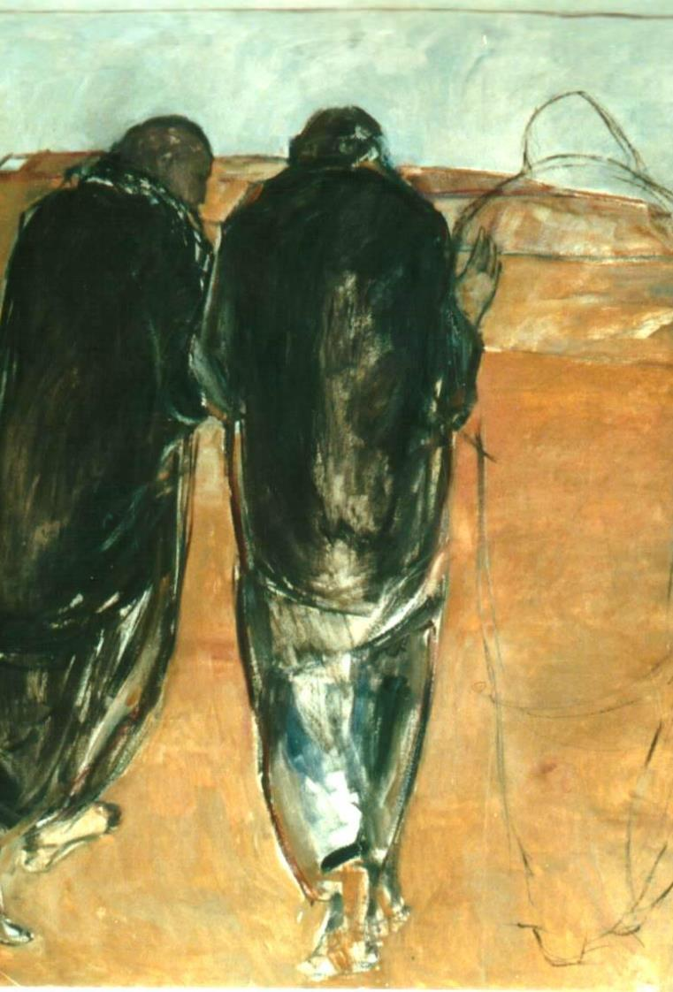
Reflection for Faith Companions
Take a moment to think about a young person with whom you are a faith companion, (Or with whom you could be a faith companion.)
What does she or he need at this moment?
What is your next step as a faith companion?
What is something you would pray for this young person?
Notes:
Accompanying Youth - Closing Prayer
Reflection
Take a moment to think about a young person with whom you are a faith companion, (Or with whom you could be a faith companion.)
What does she or he need at this moment?
What is your next step as a faith companion?
What is something you would pray for this young person?
Sharing
Without sharing personal details, take a moment to share about this young person with a partner at your table.
Silent Prayer
Now, let’s take a moment to pray for these young people.
(moment of silence)
Communal Prayer
Join me in prayer:
In the name of the Father, and the Son, and the Holy Spirit.
As a way for us to gather our prayers, let us say aloud the names of these youth whom we accompany.
(After community shares the names, continue with the closing prayer.)
We come before you humbly as echoes of your word of love.
Help us to be a companion, help us to be bread for the young people you entrust to our care.
Bless us with the discipline to pray for them
Bless us with the courage to connect with them.
Bless us with the humility to listen to them.
Bless us with the strength of heart to empathize with them.
Bless us with the compassion to care for them.
Bless us with the clarity of faith to witness to them.
Bless us with the love to join our voice to your call to them.
Open the ears of our heart to hear you and to follow you as we walk with young people to your waiting arms.
We ask this in the name of the one who walks with us in our questions, who warms our hearts and who sends us in mission. In Jesus name, we pray.
All: Amen

