Slide 1
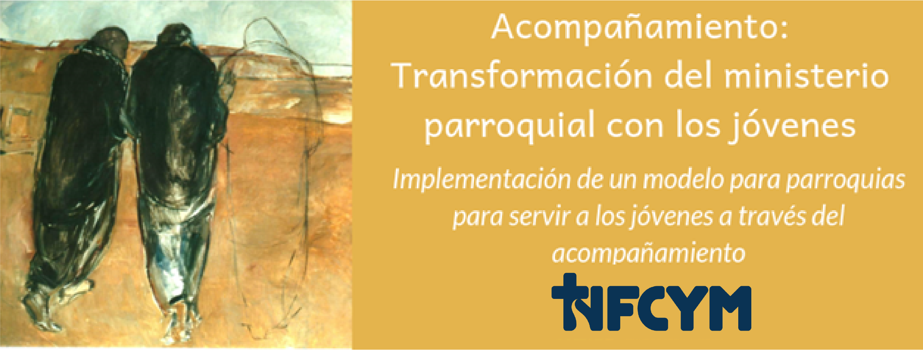
Witnessing Faith Accompaniment Project Conversation #3
Notes:
Welcome participants and introduce yourself and the workshop / conversation. Share the purpose for our gathering:
One of the most important ways that we share faith and help others grow in faith is by providing an authentic Witnessing of a living faith. Many of us feel awkward and lack confidence in witnessing faith. We may even have pictures in our minds of people talking about their faith in a way that seemed boastful or disrespectful of those with whom they were speaking. Our gathering today will introduce a vision for witnessing faith rooted in our Catholic faith. We can provide a witness in our relationships, with youth who we accompany, and within our ministries.

Slide 2
Need More Witnesses
The Church has no shortage of words; what she needs are more witnesses.
Page 3
Notes:
The Joy of Adolescent Catechesis is a document of the National Federation for Catholic Youth Ministry, the National Conference of Catechetical Leaders, and the National Catholic Education Association, working under the guidance of the United States Conference of Catholic Bishops. This document provides direction for us as witnesses and guides us to remember our Joy!
In this passage, we are reminded of the need for witnesses to make the information about our faith come alive.

Slide 3
Youth Need to Be Apprenticed
Our young people not only desperately need to see and hear what it means to be Catholic: they need to be apprenticed into the faith.
Page 2
Notes:
Witnesses apprentice young people in faith.

Slide 4
Let Us Pray…
Notes:
Invite participants to take a moment of quiet, then begin with the sign of the cross. Continue with the gathering prayer:
Generous, loving God,
We thank you for your call to serve and be witnesses to youth.
“Let us pray that we will always recognize the presence of the Holy Spirit, guiding us in wisdom and courage as, together, we strive to hand on the faith to the next generation of Catholic teenagers in the United States.” (page 3)
We ask this in Jesus’ name.
All: Amen
Ask the person you identified to share the reading:
Acts 1:8
But you will receive power when the holy Spirit comes upon you, and you will be my witnesses in Jerusalem, throughout Judea and Samaria, and to the ends of the earth.”

Slide 5
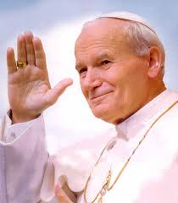
The Need for Genuine Witness
“When we meet Christ and accept His Gospel, life changes and we are driven to communicate our experiences to others. …the Church needs genuine witnesses: men and women whose lives have been transformed by meeting with Jesus, men and women who are capable of communicating this experience to others.”
Pope John Paul II
World Youth Day – Toronto, 2002
Notes:
Share a reflection: What does it mean to be a witness? This is how Saint John Paul II describes witnesses: (share quotation)

Slide 6
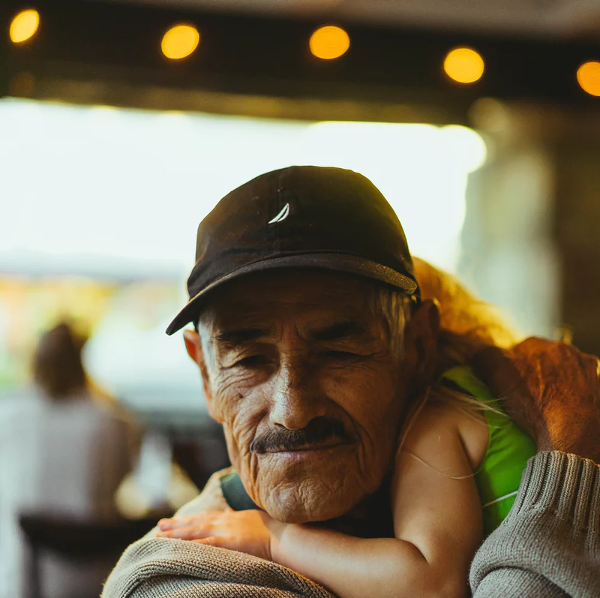
Witnesses
Who is someone that has been a witness to you? How did they witness Christ to you?
Share with one or two people about the person who was your witness.
Page 3
Notes:
A witness is someone whose life has been changed through an encounter with Christ who is able to share that experience.
Personal Sharing: Share an example story of someone who was a witness for you
Who is someone that has been a witness to you? How did they witness Christ to you? Share with one or two people about the person who was your witness.
Allow for 4 to 5 minutes for sharing. Provide a one-minute warning before gathering the group.
After gathering the group back together, ask participants what they noticed about witnesses from sharing their story and listening to their partner’s stories.

Slide 7
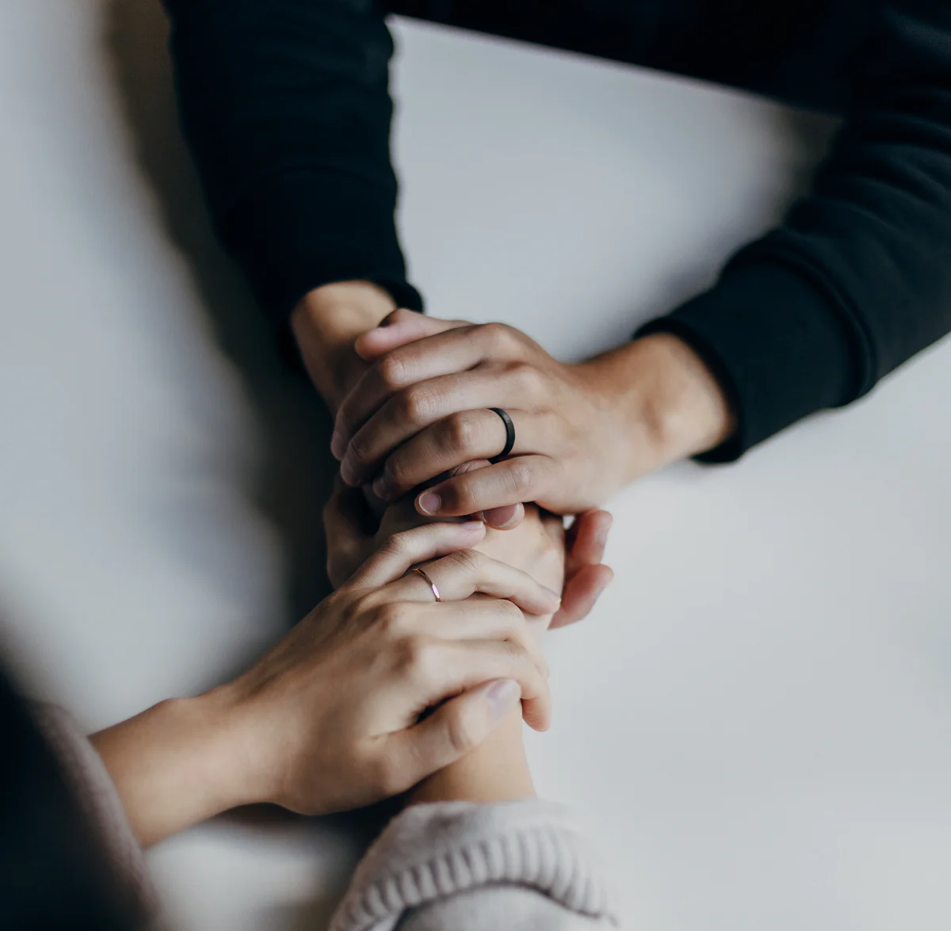
Petitions
Response:
Strengthen us, loving God
Notes:
Please join me in our prayers of petition. Our response is: Strengthen Us, Loving God.
All: Strengthen Us, Loving God
Loving God, we thank you for this cloud of witnesses. We thank you for their love, their vulnerability and their sincere faith. Fill them today with your spirit of peace.
All: Strengthen Us, Loving God.
For what else shall we pray?

Slide 8
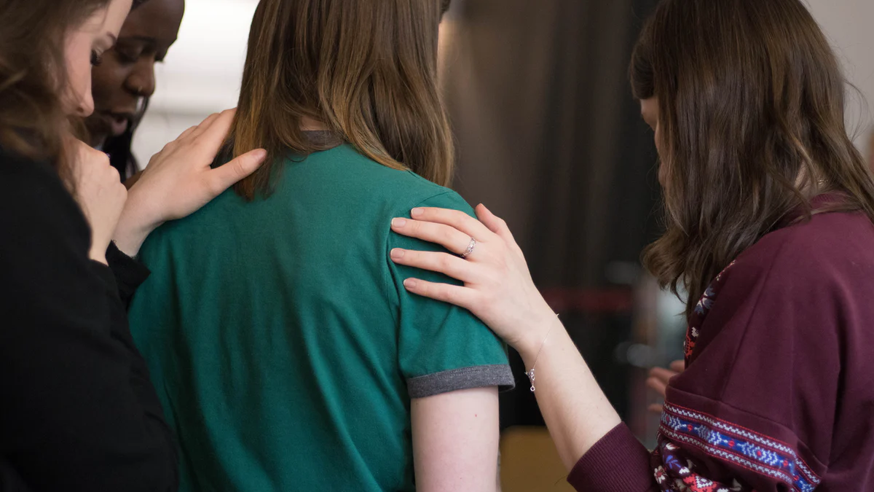
Prayer
We thank you, O God, for sending your witnesses into our lives and turning our lives around.
All: May we always turn to you.
Notes:
After allowing participants to share prayers aloud, provide this transition:
Let us bring our many prayers into one.
We thank you, O God, for sending your witnesses into our lives and turning our lives around.
All: May we always turn to you.

Slide 9
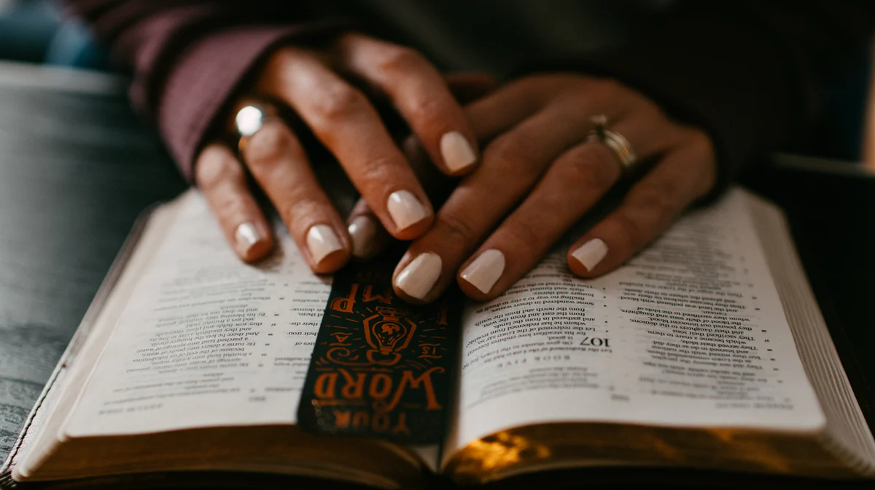
Prayer
We thank you, O God, for calling each of us to live in holiness and love. May we continue to embrace this calling with faith.
All: May we live in your love.
Notes:
We thank you, O God, for calling each of us to live in holiness and love. May we continue to embrace this calling with faith.
All: May we live in your love.

Slide 10
Prayer
We believe your Spirit fills us
And empowers us to respond to your presence and witness to your Gospel.
All: May your Spirit kindle in us the fire of your love
Notes:
We believe your Spirit fills us
And empowers us to respond to your presence and witness to your Gospel.
All: May your Spirit kindle in us the fire of your love

Slide 11
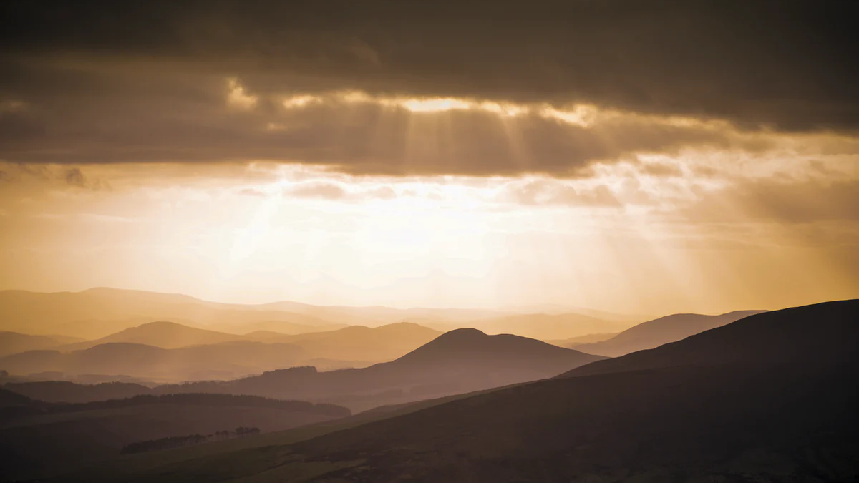
Prayer
We have been touched and healed by Christ who lives with us now and forever.
All: Fill us with grace, O God, strengthen us as witnesses,
And lead each of us to a holy life.
Amen
Notes:
We have been touched and healed by Christ
Who lives with us now and forever.
All: Fill us with grace, O God, strengthen us as witnesses,
And lead each of us to a holy life.
Amen

Slide 12
Witness Activity
Read over the quotation and discuss what this means for us as faith witnesses.
Consider these questions:
What does this mean for me as a faith witness?
What is an experience of teaching and sharing faith that connects to this quotation?
What is the challenge of living this out?
Be prepared to share a few key ideas with the large group.
Handout Page 2
Notes:
Introduce this session:
It takes a witness to share the joy of Christ’s message. Let’s begin by looking at some of the key messages about witnesses found with the document.
Review these instructions that are found on page 2 of the handouts.
Witness Activity
Point out page 2 in the handouts. Assign one of these 10 quotations to each group of two or three people. Choose the number of quotations you will use based upon the size of your group. (You do not have to cover all 10.) If you have more than 30 people, you can assign the same quotation to multiple groups.
Groups are to read over the quotation and discuss what this means for us as faith witnesses. What is an experience of adolescent catechesis that connects to this quotation? What is the challenge of living this out? Groups should be prepared to share a few key ideas with the large group.

Slide 13
Witnesses
Are centered in Christ and rely upon the Holy Spirit
Collaborate with others to plant seeds of faith
Share Christ’s loves
Share a reason for faith and hope
Lead youth to encounter Christ
Invite youth into intimate relationship with Christ
Share a living faith
Invite youth into conversion
Mentor youth in the faith
Summarized from The Joy of Adolescent Catechesis
Notes:
Provide comments about these quotations and this guidance for witnesses. Connect your ideas to the reports of the groups. Provide this summary by sharing the bullet points on this slide.

Slide 14
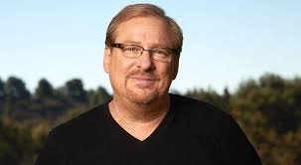
Rick Warren A Purpose Driven Life Zondervan Publishing: Grand Rapids, Michigan, 2002, 2011, 2012, page 288
“This is the essence of witnessing: simply sharing your personal experiences regarding the Lord. In a courtroom, a witness is not expected to argue the case, prove the truth, or press for a verdict. That is the job for attorneys. Witnesses simply report what has happened…You may not be a biblical scholar, but you are the authority of your life. And it’s hard to argue with personal experience.”
Notes:
Share this quotation by Rick Warren and provide an explanation of the role of a witness. This addresses the fear that many have that they are not knowledgeable enough or articulate enough to witness to their faith.

Slide 15
Be my witnesses
Share the story of God in your life.
Your life is your witness.
Be true to your values.
Sometimes our witness is subtle and sometimes we are called to be bold.
Notes:
Continue your explanation of the role of a witness:
Share the story of God in your life. Witnessing is about telling the story not about convincing or teaching. We’ve experienced God’s presence, God’s mercy, and God’s assistance in little ways and in big ways. We witness to everyday faith by sharing glimpses of these experiences.
Your life is your witness. The primary way you witness to your faith is the way you live your life. Youth have heard a lot about faith; they yearn to see faithful living in action. What does it look like to be a person of faith, hope, conviction, and joy? How do we show that we trust God and that we see purpose in our lives that is part of God’s plan?
Be true to your values. Little things (and big things) matter. Youth may not always be listening, but they are always watching. Our witness is our authenticity: we strive to be faithful in the way we treat others, the way we treat students, the way we handle challenges and successes, and the way we rely on God. Youth notice kindness and integrity.
Sometimes our witness is subtle and sometimes we are called to be bold. We can witness in subtle ways by connecting our faith in God in conversations, in the environment in our home, or referring to prayer. There are occasions when the context of the conversation and the relationship may invite a bolder response such as sharing a story of how we experienced God in a personal challenge, or by offering to pray with or for a young person.

Slide 16
Be a Witness to Christ
A witness sometimes has this pattern:
I was feeling (blank), then God broke into my situation.
Then, I felt (blank) and
I was surprised by, I learned that / or was reminded that God (is always there for me, always calls me back, is merciful beyond my imagination, loves me…).
I felt called to grow in (blank)
Notes:
A witness sharing is not a formula. It is a sincere sharing from the heart of an experience of coming to know God better and integrating that glimpse of the holy into our lives. There is often a familiar pattern to the way a witness shares their experience.
Share and explain this pattern for faith witness which is also found on page 5 of the handouts.
Share and explain this pattern for a faith witness which is also found on page 5 of the handouts.

Slide 17
Be a Witness to Christ
To prepare for a witness, recall the situation when you experienced God’s presence.
What was happening before? What is the background or context for the story?
What were you feeling?
How did you experience God’s presence? What surprised you?
What happened? What were you feeling? What did you notice?
What did this experience help you to learn about God or remember about God?
How did this encounter call you to change and grow?
Notes:
Review the questions on this slide which are on page 5 of the handouts.
These questions could help you recall your experience of God and prepare to share this experience.

Slide 18
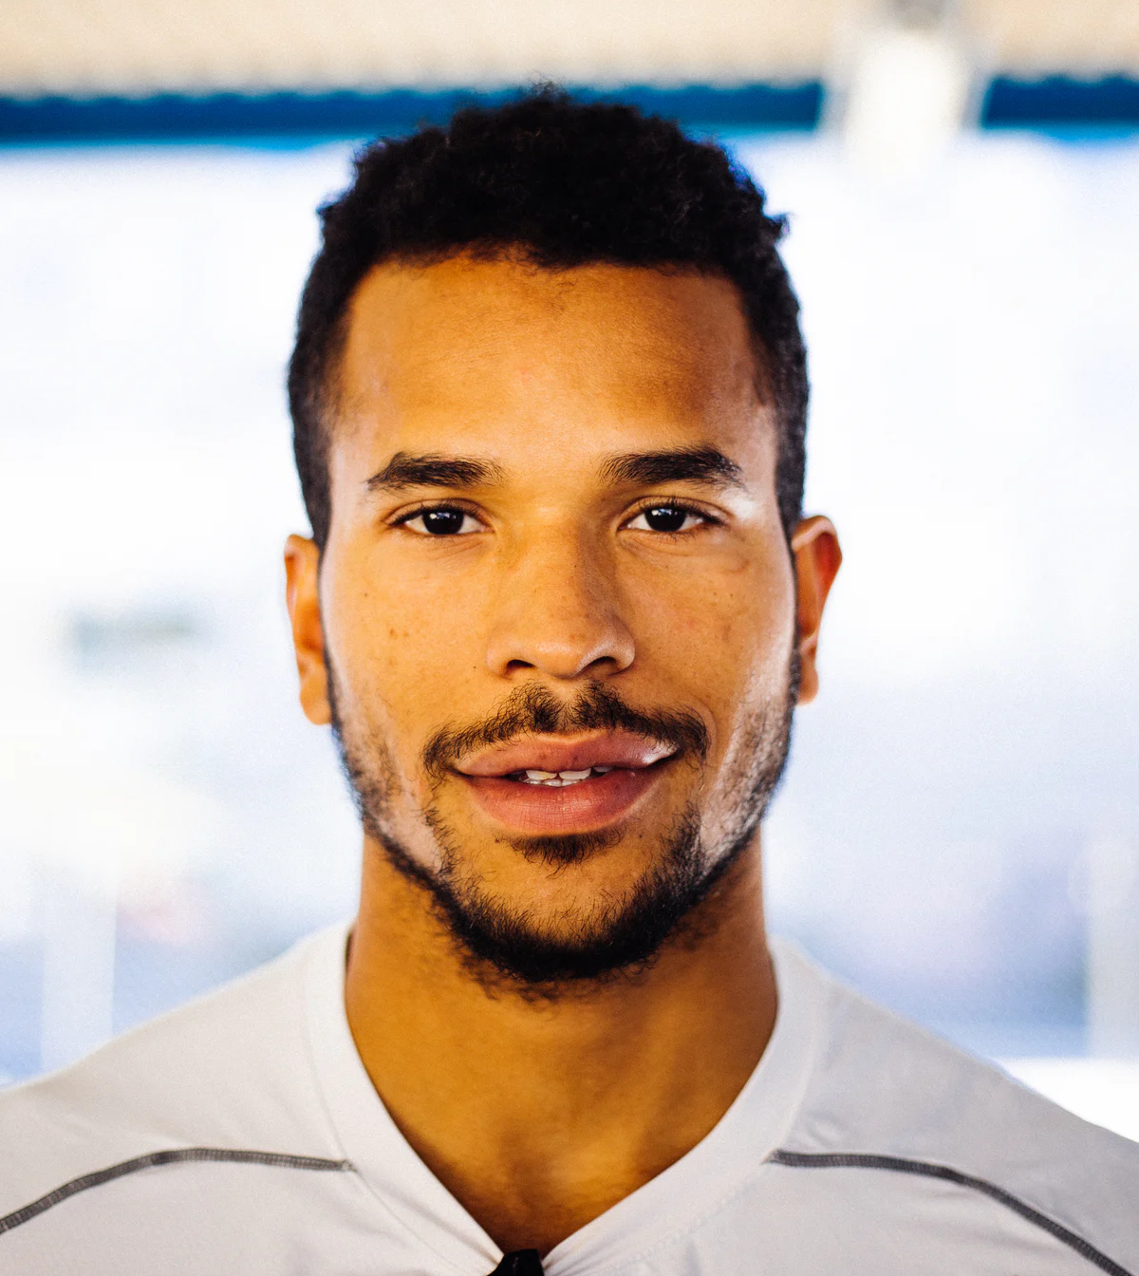
How did you experience God’s presence? What surprised you?
I experienced God’s friendship when I was feeling all alone.
I experienced God’s mercy when I was feeling ashamed.
I experienced God’s love and care for me when I was feeling unlovable.
I experienced God’s power in the beauty of creation when I was feeling depressed.
I experienced God’s reassurance when I was feeling overwhelmed and anxious.
I experienced God’s call to me when I was feeling lost.
I experienced God working through me when I was feeling empathy for someone in need
Notes:
Continue reviewing these preparation ideas.
Our God meets us in our life experiences. How and when did you experience God’s presence? What surprised you?

Slide 19
I have seen God at work…
To testify—to witness—is to say, “This is how I have seen God at work in this person, in my life, or in our communal lives right now,” then to name in specific ways the action of Christ’s Spirit they have seen.
Diana Macalintal
Codirector and Cofounder of TeamRCIA.com
Notes:
Point out the resources for witnesses on page 4 in the handouts. Share this reflection from Diana Macalintal.

Slide 20
Story of Victoria
Notes:
Share this witness story of a young person.
When Victoria was in high school, her theology and history teacher was Mrs. Gerson. Victoria had a grudge against her; she felt that Mrs. Gerson treated her in a demeaning way, dismissing her as a student. She had an encounter that really changed her perspective while she was distributing communion at her parish.
As I picked up the host and raised it up reverently before the communicant, I found myself looking eye-to-eye with Mrs. Gerson. I could not believe what was happening. In a moment that seemed to last forever, I felt all the pain, the fury, the hurt, and the hate resurge in my body. Then just as quickly as those feelings had come, they dissipated and sudden peace filled my body when I said the words, “The Body of Christ.”
I placed the host—the living God—into her outstretched hands. She said “Amen,” made the Sign of the Cross, and then turned down the aisle. I was stunned and didn’t know what to think. In an instant, we were no longer student and teacher (with a grudge between us) but rather two believers who had come to eat at the table of Christ. When I looked at her, I still felt the resentment that lingered in my heart, but looking up at the host, I saw Mrs. Gerson for who she really was. In the Body of Christ, I was able to see that Mrs. Gerson was like me: a sinner trying to orient her life toward Christ. As with me, Christ shows his love to her in spite of her sins. And it is Christ’s unconditional love given to us in the Eucharist that joins her to me and makes us one in him.
Leonard J. Delorenzo, Witness – Learning to Tell the Stories of Grace that Illumine Our Lives, Ave Maria Press: Notre Dame, Indiana, 2016, pages 90 and 91.
After sharing the story, connect Victoria’s story to the pattern for witnesses.

Slide 21
Notes:
Share a personal witness that you can connect to the pattern.

Slide 22
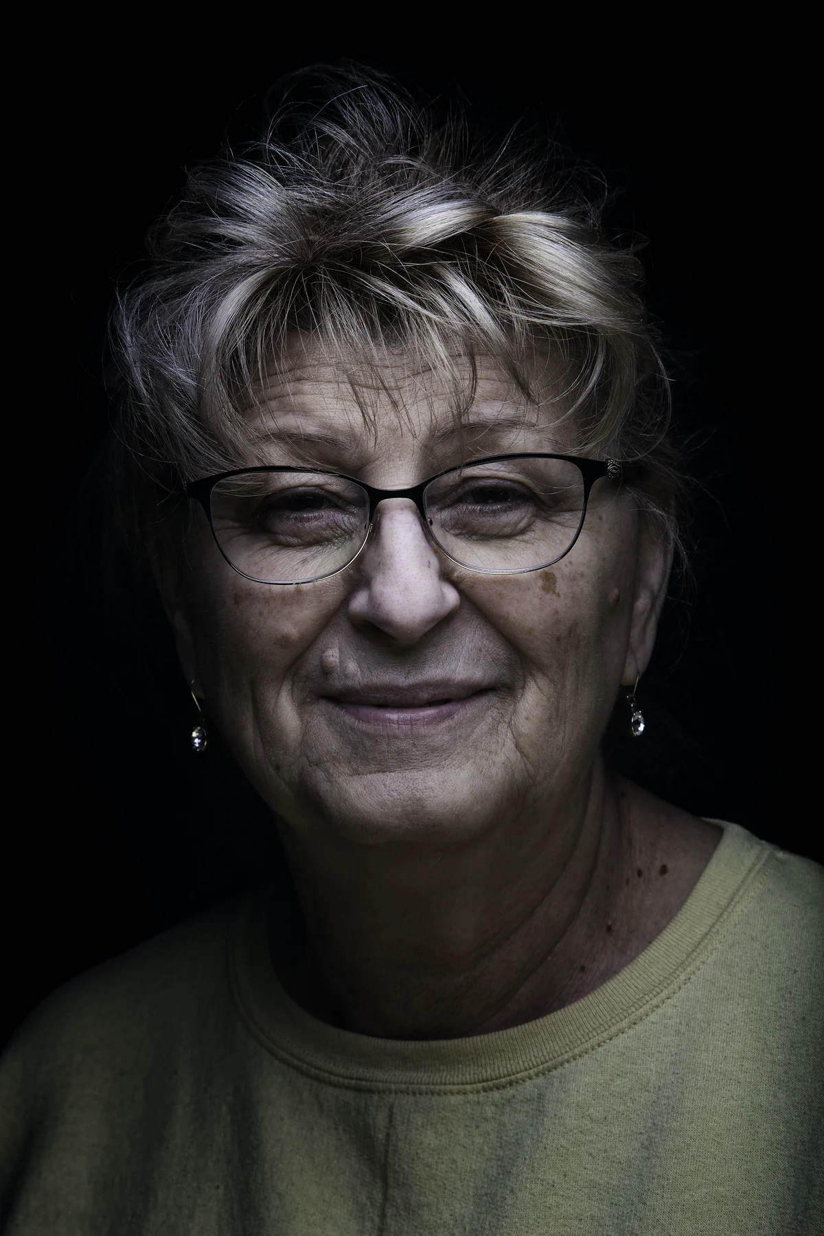
Be a Witness to Christ
A witness sometimes has this pattern:
I was feeling (blank), then God broke into my situation.
Then, I felt (blank) and
I was surprised by, I learned that / or was reminded that God (is always there for me, always calls me back, is merciful beyond my imagination, loves me…).
I felt called to grow in (blank)
Notes:
Connect the elements of your witness with this pattern.

Slide 23
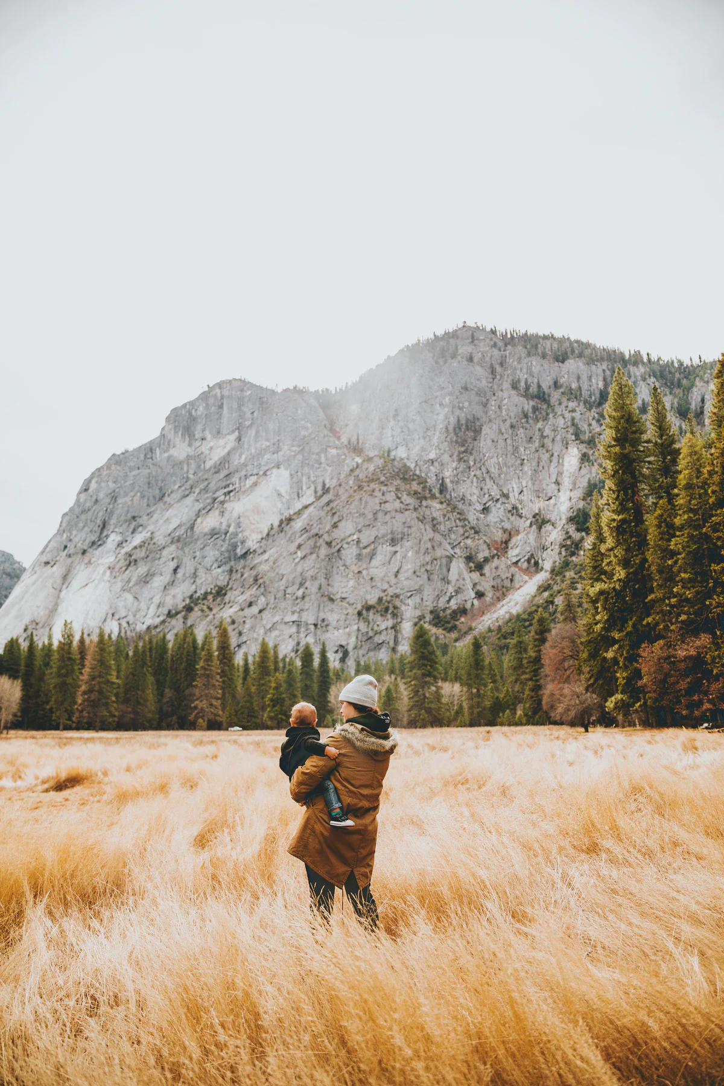
Be a Witness
Review the pattern for a witness on page 5.
Recall an experience of God’s presence.
Reflect on the questions.
Share a witness with your partner.
Listen to their witness.
Notes:
Invite participants to recall an experience of God’s presence and use the resources to reflect on that experience and prepare to share with others. After several minutes, ask participants to gather with the one or two others that they had shared with earlier. Allow several minutes for sharing.
After the sharing in pairs or groups of three, collect questions and comments from participants about using these resources:
What did you notice about the process of witnessing faith?
How did you feel about the resources that helped you prepare?

Slide 24
A Witness of Faith
Engaging a faith witness element
As a faith companion to youth
As a catechist
Bringing in witnesses from the community
Engaging and preparing youth and adults as faith witnesses
Providing faith witnesses and engaging youth in faith sharing and affective prayer throughout catechesis and ministry with youth.
Notes:
Present these ideas for integrating witness within our accompanying relationships and in our ministry and formation of youth. Provide an explanation for including youth and adult witnesses within our retreats, ministry and catechesis experiences. I recommend that witnesses prepare and write out their witness story. This gives the opportunity for feedback and guidance, to keep the story focused on how we see God’s action. This also allows for prayerful proclamation of the witness story.

Slide 25
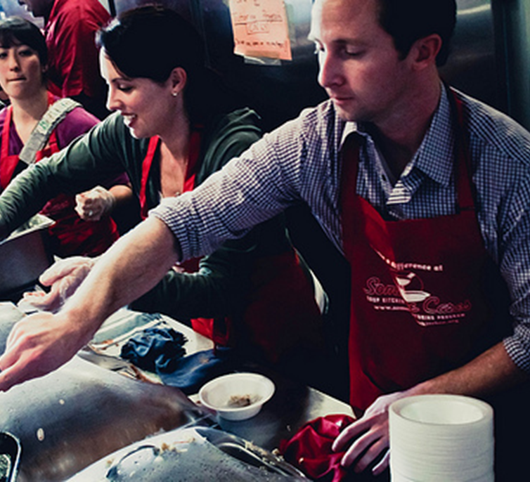
Family Witness
Consider all family relationships
Parents
Grandparents
Aunts / Uncles
Siblings
Empower parents and family to listen and witness faith
Engage families in service and ministry for shared witness
Notes:
We can empower families and coach family members to be witnesses.
We should consider all the relationships and provide support for family members.
We can also provide and encourage experiences that promote opportunities for encounter and witness such as service and shared ministries.

Slide 26
Parish Witness
Those of us who are no longer young need to find ways of keeping close to the voices and concerns of young people. “Drawing together creates the conditions for the Church to become a place of dialogue and a witness to life-giving fraternity.”
# 38- Christ is Alive – Christus Vivit, April 2, 2019
Notes:
In Christus Vivit, Pope Francis describes that process for parish communities to become witnesses. It begins with drawing close to young people and listening.

Slide 27
Parish Witness
We need to make more room for the voices of young people to be heard: “listening makes possible an exchange of gifts in a context of empathy…
At the same time, it sets the conditions for a preaching of the Gospel that can touch the heart truly, decisively and fruitfully.”
# 38- Christ is Alive – Christus Vivit, April 2, 2019
Notes:
We make room for young voices and we listen with empathy. This creates the setting where the witness to faith can be shared – heart to heart.

Slide 28
Reflection
Witnesses
Are centered in Christ and rely upon the Holy Spirit
Collaborate with others to plant seeds of faith
Share Christ’s love
Share a reason for faith and hope
Lead youth to encounter Christ
Invite youth into intimate relationship with Christ
Share a living faith
Invite youth into conversion
Mentor youth in the faith
Summarized from The Joy of Adolescent Catechesis
Which of these tasks come easily for you personally?
Which of these are challenges?
What is one thing you can do to grow as a Witness?
Notes:
Show participants the self-assessment for witnesses in their handouts on page 8.
Share with the group your own sense of tasks that come easily and areas you would like to grow in as a witness.
Invite participants to take the self-assessment (5 minutes) and share in groups of three. After the group sharing, collect some key ideas about strengths and areas to grow.
Provide concluding comments about being a faith witness for our young people, including ways that the parish can continue to provide support.
Thank the participants and share the gifts and strengths you saw in them today.

Slide 29
“If we are truly in love with Christ and if we sense how much he loves us, our heart will 'light up' with a joy that spreads to everyone around us.”
Pope Francis, World Youth Day, Rio de Janeiro, July 24, 2013
Notes:
Invite the community to join in the closing prayer.
Share this comment of Pope Francis about joy.

Slide 30
Prayer
Generous God, open our eyes to see you and our hearts to receive the encounters that you send to us. We seek to live in Joy. We seek to radiate Christ to those around us.
Response: Send us as witnesses of Joy.

Slide 31
“I have told you this so that my joy may be in you and your joy may be complete.”
John 15:11
Notes:
Proclaim this scripture. Allow for a moment of quiet for us to recall the joy in our hearts and pray for those we serve.

Slide 32
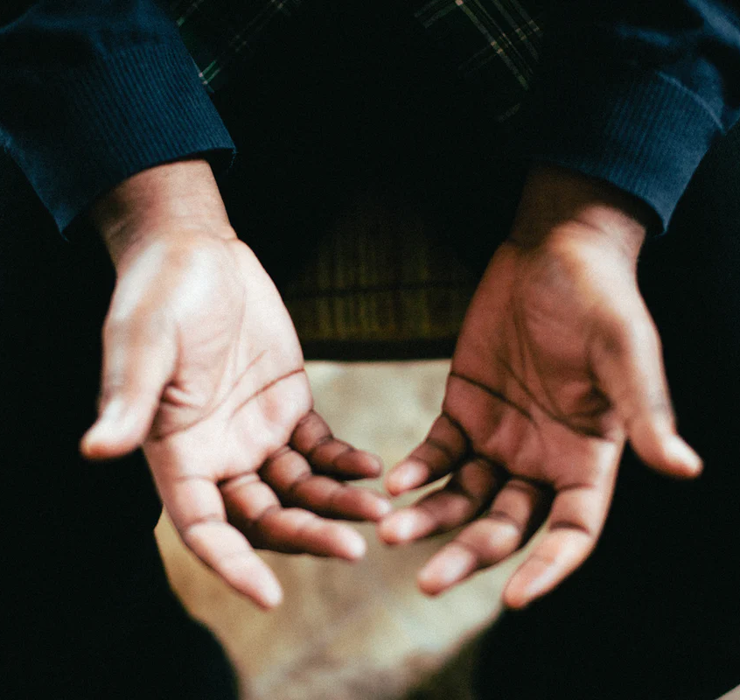
Prayer
Loving God, help us to guard and treasure the joy that you send us so that we may be ministers of your love and witnesses to your power in our lives. We say “yes” to the Joy of the Gospel!
Response: Send us as witnesses of Joy.
Notes:
Lead the community in this petition.

Slide 33
Prayer
May the God of hope fill you with all joy and peace in believing, so that you may abound in hope by the power of the holy Spirit.
Romans 15:13
We make this prayer as witnesses of the Joy of Christ in the Name of the Father, the Son, and the Holy spirit.
Respond: Amen
Notes:
Conclude with this prayer.

