Slide 1
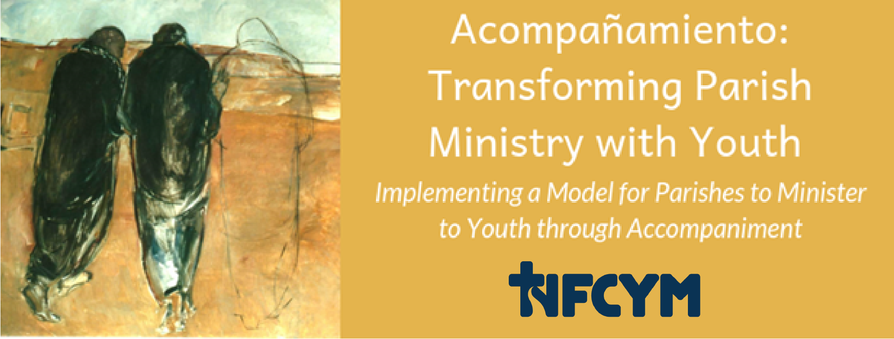
Developing Faith Companions for Youth Accompaniment Project Conversation #4
Notes:
Introduce yourself and the workshop. Share the purpose for our gathering: This leadership gathering is designed to assist ministry teams to plan for ways to empower faith companions for youth. This will include planning for ways to provide faith companions for each youth in our parish, and ways to equip and support parents and faith companions in our community.

Slide 2
Accompaniment
The Church will have to initiate everyone – priests, religious and laity – into this
“art of accompaniment”
which teaches us to remove our sandals before the sacred ground of the other….
Pope Francis, Evangeli Gaudium, #169
Notes:
(Note: slides 2 through 6 provide an introduction to accompaniment. If your group participated recently in Conversation #1 or if you experienced this introduction with Conversation #5 or 6, you can skip to slide 7.)
A new vision for ministry with youth is emerging. This vision is articulated in the document of the Synod on Youth, and Christus Vivit, the recent document of Pope Francis. In this vision, we are being guided to accompany young people as they grow in faith and discipleship. To accompany, we need to listen, empathize, and witness through our care and attention. Pope Francis describes “the art of accompaniment which teaches us to remove our sandals before the sacred ground of the other….”

Slide 3
Accompany All Young People
…just as our Lord Jesus Christ walked alongside the disciples of Emmaus (cf. Lk 24:13-35), the Church is also urged to accompany all young people, without exception, towards the joy of love.
Instrumentum Laboris 2018, #1
Notes:
We are called to accompany all young people – to broaden the scope of our ministry with youth to reach those who have often been left out.
“…just as our Lord Jesus Christ walked alongside the disciples of Emmaus (cf. Lk 24:13-35), the Church is also urged to accompany all young people, without exception, towards the joy of love.”
Instrumentum Laboris 2018, #1

Slide 4
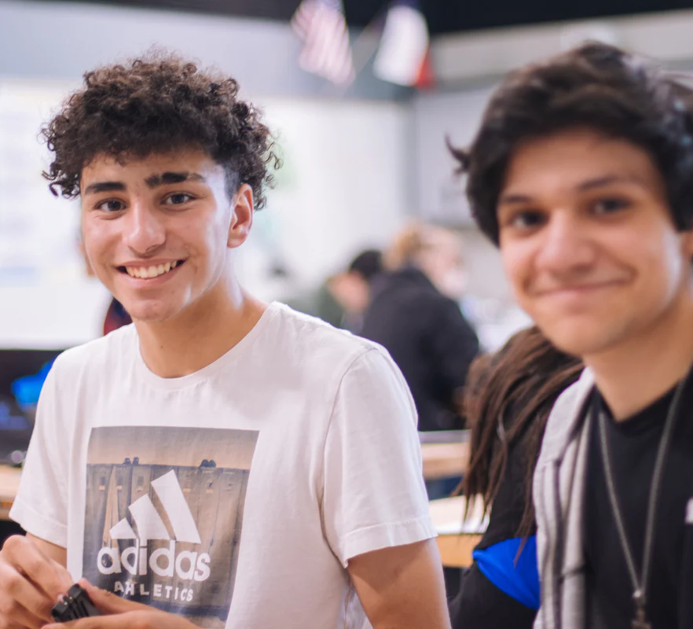
Vocation is at the Horizon of our Ministry with Youth
The word “vocation” can be understood in a broad sense as a calling from God, including the call to life, the call to friendship with him, the call to holiness, and so forth. This is helpful, since it situates our whole life in relation to the God who loves us.
Pope Francis, Christus Vivit, 2019, #248
Notes:
Youth are making choices about their life. Who will they share their life with? What will they do? How will they find their way? We are accompanying youth as they discover and discern a way to live now but also prepare for the future. All of us are called to live a life of holiness and to seek our place in God’s plan. In Christus Vivit, Pope Francis places the vocation of holiness at the horizon of all of our ministry.
“The word “vocation” can be understood in a broad sense as a calling from God, including the call to life, the call to friendship with him, the call to holiness, and so forth. This is helpful, since it situates our whole life in relation to the God who loves us.”
Pope Francis, Christus Vivit, 2019, #248

Slide 5
Accompaniment Direction for Ministry
Youth experience encounter and witness and are accompanied in their journey toward holiness as missionary disciples.
Notes:
Our hope for young people in our parish community is that they will experience an encounter with Christ and witness of faith, and that they are accompanied in their journey toward holiness as missionary disciples.

Slide 6
In such places… the person-to-person contact indispensable for passing on the message can happen, something whose place cannot be taken by any pastoral resource or strategy.
# 218- Christ is Alive – Christus Vivit April 2, 2019
Notes:
We are reminded that accompaniment is indispensable as a way of sharing faith.
“In such places…the person-to-person contact indispensable for passing on the message can happen, something whose place cannot be taken by any pastoral resource or strategy.”
# 218- Christ is Alive – Christus Vivit
April 2, 2019

Slide 7
The great things of God are not shouted from the rooftops but whispered heart to heart.
Notes:
In our own lives, we have often experienced that the great things of God are not shouted from the rooftops but whispered heart to heart.
This vision for accompaniment reminds us of the direction of St. Francis de Sales who tells us that “A heart speaks to a heart; lips speak only to ears.”

Slide 8
Prayer for Faith Companions
Jesus, you accompany us and lead us to your heart.
We come before you humbly as echoes of your word of love.
Help us to be a companion; help us to be bread for the young people you entrust to our care.
Bless us with the discipline to pray for them
Bless us with the courage to connect with them.
Bless us with the humility to listen to them.
Bless us with the strength of heart to empathize with them.
Bless us with the compassion to care for them.
Bless us with the clarity of faith to witness to them.
Bless us with love to join our voice to your call to them.
Open the ears of our heart to hear you and to follow you as we walk with young people to your waiting arms.
We ask this in the name of the one who walks with us in our questions, who warms our hearts and who sends us in mission.
In Jesus name, we pray. Amen
Notes:
You and I share in this mission of accompanying youth with care and prayers. Let us join together in praying this prayer for faith companions.

Slide 9
Accompaniment Direction for Ministry
Equipping parents and faith companions
Transforming ministries to promote accompaniment
Engaging the parish community in accompanying young members
Notes:
Parishes that are moving toward accompaniment move forward with these three directions:
Equipping parents and faith companions
Transforming ministries to promote accompaniment
Engaging the parish community in accompanying young members
In this gathering, we will focus on first bullet point: equipping parents and faith companions.

Slide 10
Implementing Accompaniment
Equipping and Empowering Parents and Faith Companions
Notes:
To equip and empower parents and faith companions, we help the community to understand this role, and we identify all of the potential faith companions for youth. We also plan for ways to form and support parents and faith companions for their role.

Slide 11
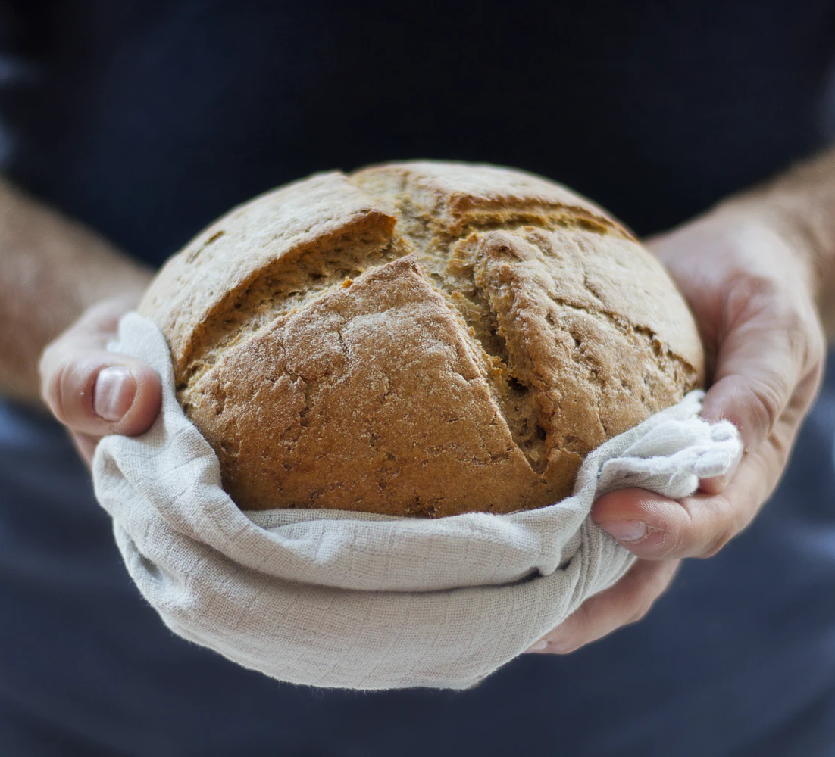
Companion
“the one who brings to you, or who is bread for you.”
Notes:
Companion and accompany share the Latin elements “com” which means “with” and “pan” which means “bread.” John Flaherty describes a companion as “the one who brings to you, or who is bread for you.”
Reflection
Provide a brief reflection about Christ as our bread and the companions who lead us to him.

Slide 12
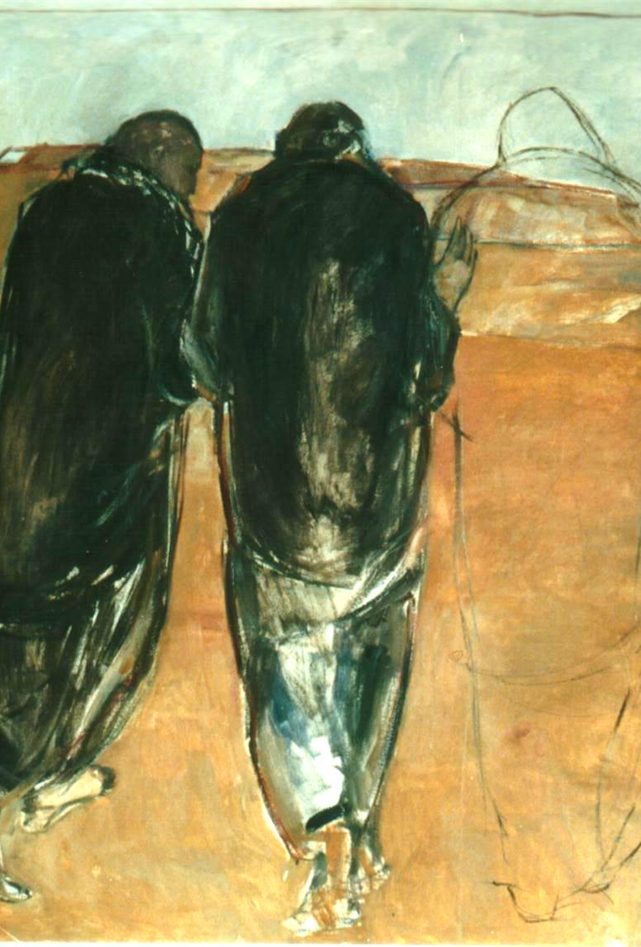
A good accompanier
is a person who is balanced, a listener, a person of faith and prayer, who has the measure of his own weaknesses and frailties. Hence, he knows how to be accepting of the young people he accompanies, without moralizing and without false indulgence.
Final Document for the Synod on Young People, the Faith, and Vocational Discernment, # 102
Notes:
A good accompanier is able to listen to youth and share from their experience with humility and balance.
(Read quotation above.)

Slide 13
The Qualities of a Mentor
being a faithful Christian who engages with the Church and the world;
someone who constantly seeks holiness;
someone who is a confidant without judging.
Similarly, someone who actively listens to the needs of young people and responds in kind;
someone deeply loving and self-aware;
someone who recognizes his or her limits and knows the joys and sorrows of the spiritual journey.
An especially important quality in mentors is the acknowledgement of their own humanity …
Pope Francis, Christus Vivit, 2019, # 246
Notes:
In Christus Vivit, Pope Francis elaborates on the qualities of a mentor. (Review some of the qualities listed in the slide.)

Slide 14
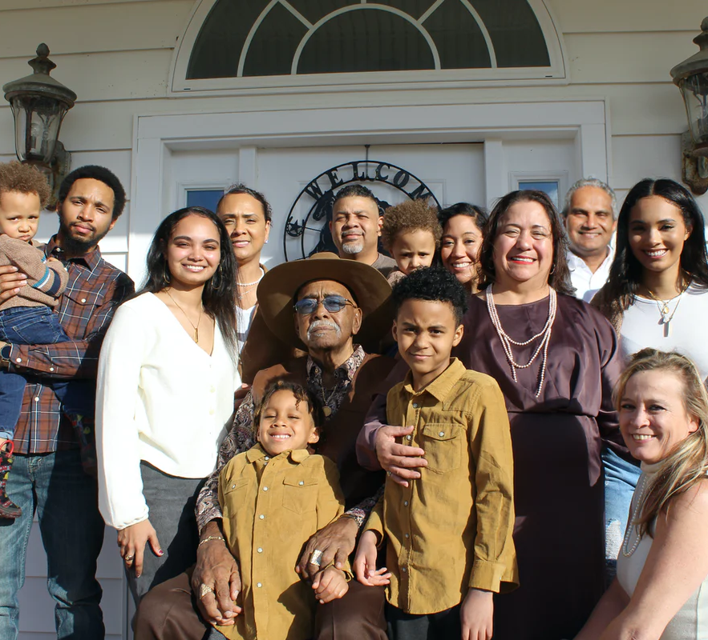
Accompaniment Direction for Ministry
Youth are accompanied by
Parents and faith companions
The family
A youth community
The parish
Notes:
Youth are accompanied by:
Parents and faith companions
The family
A youth community
The parish

Slide 15
A Safe Place to Walk
“Public / Private Space”
Walking in Pairs
Notes:
We always provide a safe place to walk as we accompany.
(Be sure to consider your diocesan guidelines for safe environment as you develop your strategies.)
For example, if part of the way that we connect with you as faith companions includes connecting through technology by text or message, we could create a way to provide “public/private space.” If you were meeting with a young person, you wouldn’t go into an office with locked, solid door. You would meet in a way where others could see you. Similarly, we can bring a “team” approach to our communications with youth. Choose another member of your team to partner with. Get permission from parents to text, email or message. Include the other adult leader in all of your communications. That way, you have each other’s back.

Slide 16
A Faith Companion
Connects
Listens
Empathizes
Cares
Witnesses
Calls
Prays
Notes:
We accompany young people by being a faith companion. These are some of the things we do as faith companions.
Prays
Faith Companions prays for young people in their care.
Connects
Faith Companions connects with young people. This includes initiating contact and finding regular ways to connect for conversation.
Listens
Faith Companions listen to questions, concerns, hopes, wonderings, and experiences.
Empathizes
Faith Companions empathize with young people.
Cares
Faith Companions provide care for young people, providing practical good news for their life situations.
Witnesses
Faith Companions witness to their faith with young people.
Calls
Faith Companions challenge young people to grow and share their gifts; they help young people to hear God’s call.

Slide 17
Who were your faith companions?
Take a moment to reflect upon your faith life as a youth or young adult (or as an adult if you came to faith more recently.)
Who were the family members who supported you in faith?
Who were the other adults who supported you?
Who were the peers who supported you?
Notes:
(Ask the participants to reflect on these questions. Refer to page 3 in the handouts. Allow a few minutes for individual reflection, then invite participants to share in groups of three. Use an easel pad sheet or white board to collect examples of categories of people who were faith companions.)

Slide 18
Potential Faith Companions
Family: Parents Aunts & Uncles Siblings & Cousins Grandparents Family Friends
Sacramental: Sponsors & Godparents
Community: teachers counselors community workers employers
Ministry: pastor pastoral leaders ministry leaders catechists coaches
Peers
Notes:
Let’s compare our list with these categories:
Family connections: Parents / Aunts / Uncles / Grandparents /siblings / cousins, and family friends
Sacramental connections: Godparents / Sponsors
Ministry connections: pastor, pastoral leaders, ministry leaders, catechists
Community connections: teachers, counselors, community workers, employers
Peers

Slide 19
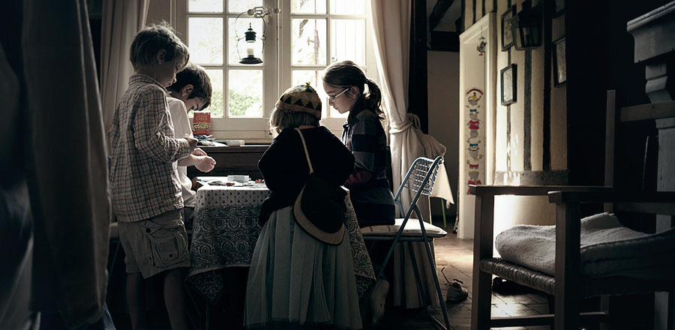
Moving away from the kid table…
Kara Powell and Chap Clark – Fuller Institute
5 to 1 instead of 1 to 5
Notes:
Explain the idea of moving away from the kid table concept in our parishes (where youth and adults are separated) and moving toward a 5 to 1 ratio: 5 caring adults for each young person.
Dr. Kara Powell tells the story of moving away from the kid’s table in an article here:
https://fulleryouthinstitute.org/articles/moving-away-from-the-kid-table
She also tells the story in this video (begin at 3:06 and continue until 5:40 or so)
https://vimeo.com/185232849
Transition to talking about the 5 to 1 ration developed by Chap Clark.
From page 13 of the Handouts for Session 1:
We really need a 5 to 1 ratio. Many children’s and youth ministries wish they had one teacher for every five kids. But researchers Kara Powell and Chap Clark have found that to see students remain in church into adulthood, there should be five adults for each student.
This is a research-based reversed ratio. Ideally, there should be five people praying for one student by name and showing up at their sporting events throughout the year. It’s a paradigm shift. It’s not about finding five small group leaders per student, it’s about finding five adults who show an interest in a teen.
The key is to motivate and equip parents to create that team around their child. Then the youth pastor can focus on the kids who don’t have parents at home who are able to do this. They need to look for teachable moments along with modelling a healthy relationship with Christ.

Slide 20
Young Person
Parent
Youth Ministry Leader
Uncle Godparent
CYO Coach
Grandparent
Notes:
(This slide has animation to allow you to share one element at a time.)
What if each young person had five faith companions? Five people who were “echoes of faith”?
Talk through each person.
Some of the young people with whom we minister don’t have parents that are faith companions. Chap Clark says that in these situations we are called to help create the web of support, to create the five people who can walk with youth.

Slide 21
Examples of Supporting Parents and Faith Companions
Parent and Youth Role Play
Notes:
These are some examples of ways that parishes are helping to empower parents and faith companions:
Parent / Youth Role Play
a mom described that she didn’t feel she had faith conversations, it was always more of a debate, and she always lost. She had the chance to role play a faith conversation with a young person and heard some tips from the community to help her feel more confident.

Slide 22
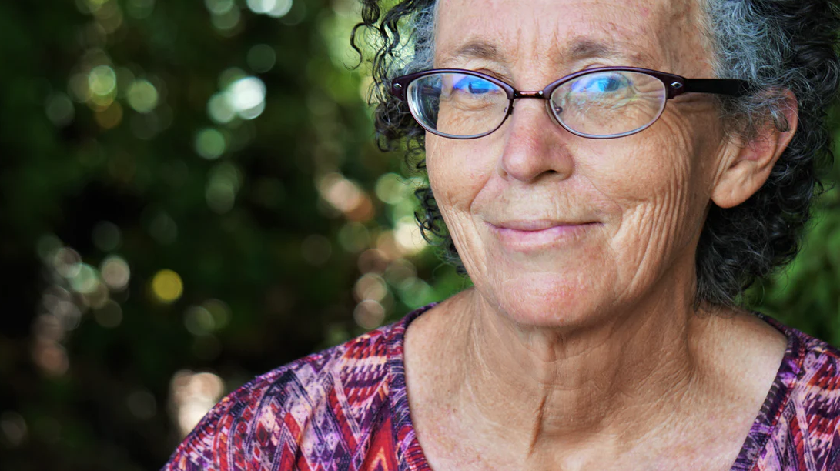
Examples of Supporting Parents and Faith Companions
Faith Companion Mentor
Notes:
Faith Companion Mentor
an older woman began sharing about the various youth she connects with regularly, youth in her family, children of friends, youth in the ministries that she is a part of. She started sharing the ways that she talks about faith and ways that she helps youth connect with and talk with their parents. The youth minister discovered a treasure here in his own backyard by finding this resource who could be such a powerful mentor for other faith companions.

Slide 23
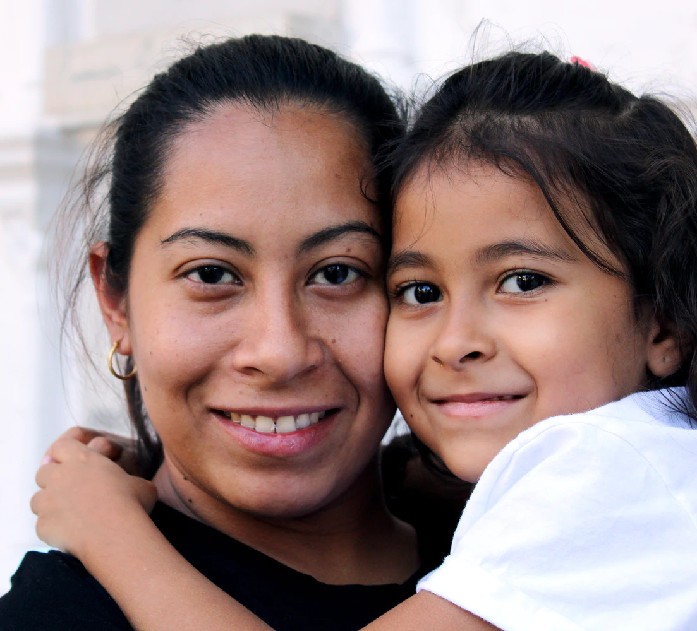
Examples of Supporting Parents and Faith Companions
Parent and Faith Companion Networking
Notes:
Parent and Faith Companion Networking
parents shared success stories by describing the ways that they create the opportunity for conversations with their teens. One dad talked about walking the dog with his adolescent daughters. Other parents talked about using car time as connect time. One mom talked about ironing her clothes in preparation for a meeting at work. She always set up the ironing board behind the coach facing the television in the family room. “There is something about the creaking sound of opening the ironing board that gets my teenage son away from his computer and onto the couch. He pretends to watch something with volume low, but really this is his chance to talk. One time, we were so engaged, I nearly scorched my favorite blouse when I re-ironed it for the fifth time.”

Slide 24
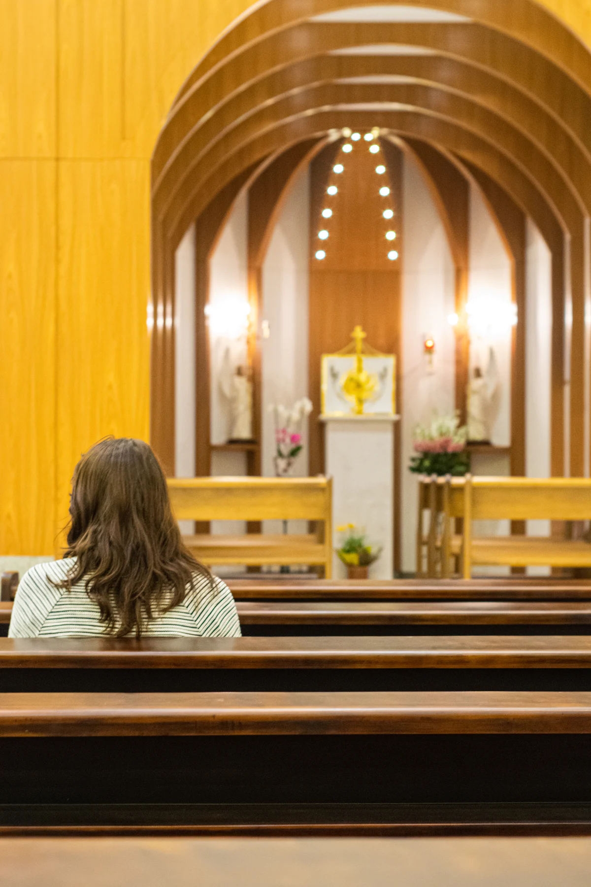
Developing Faith Companions
Assessing the strengths and areas for our parish to grow
Assessment considers
Youth
Pastors and Parish Leaders
Ministry Programs that Include Youth
Parents and Faith Companions
Notes:
Our assessment of the current reality will help us plan for renewed efforts that match these directions. We will be considering 12 statements described on page 4 of your handouts. .

Slide 25
Youth
Have an intimate relationship with Jesus Christ sustained through their Catholic faith
Have faith companions, adults and other youth, to guide their journey of discipleship
Can identify five caring adults in their life
Notes:
These are the statements you will evaluate about young people in our parish.
Youth
Have an intimate relationship with Jesus Christ sustained through their Catholic faith
Have faith companions, adults and other youth, to guide their journey of discipleship
Can identify five caring adults in their life

Slide 26
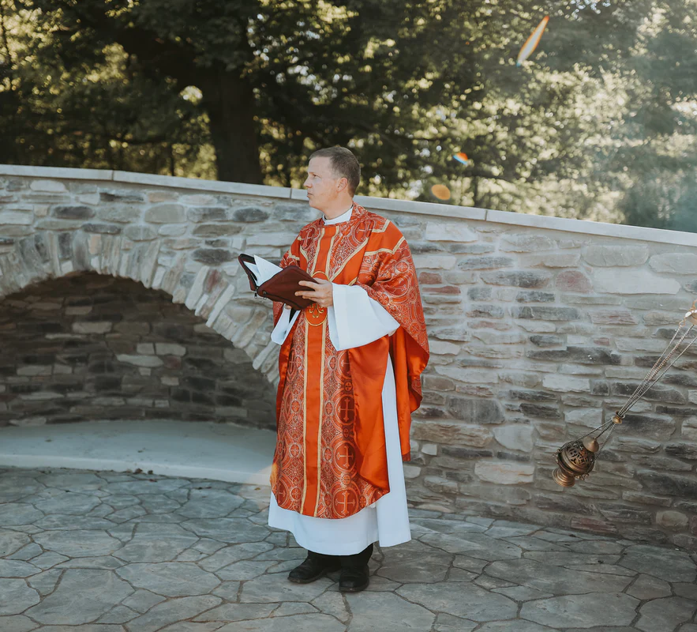
Pastors and Parish Leaders
Understand the process of accompanying youth in faith
Notes:
This is the statement for pastors and parish leaders.
(Pastors and parish leaders) Understand the process of accompanying youth in faith

Slide 27
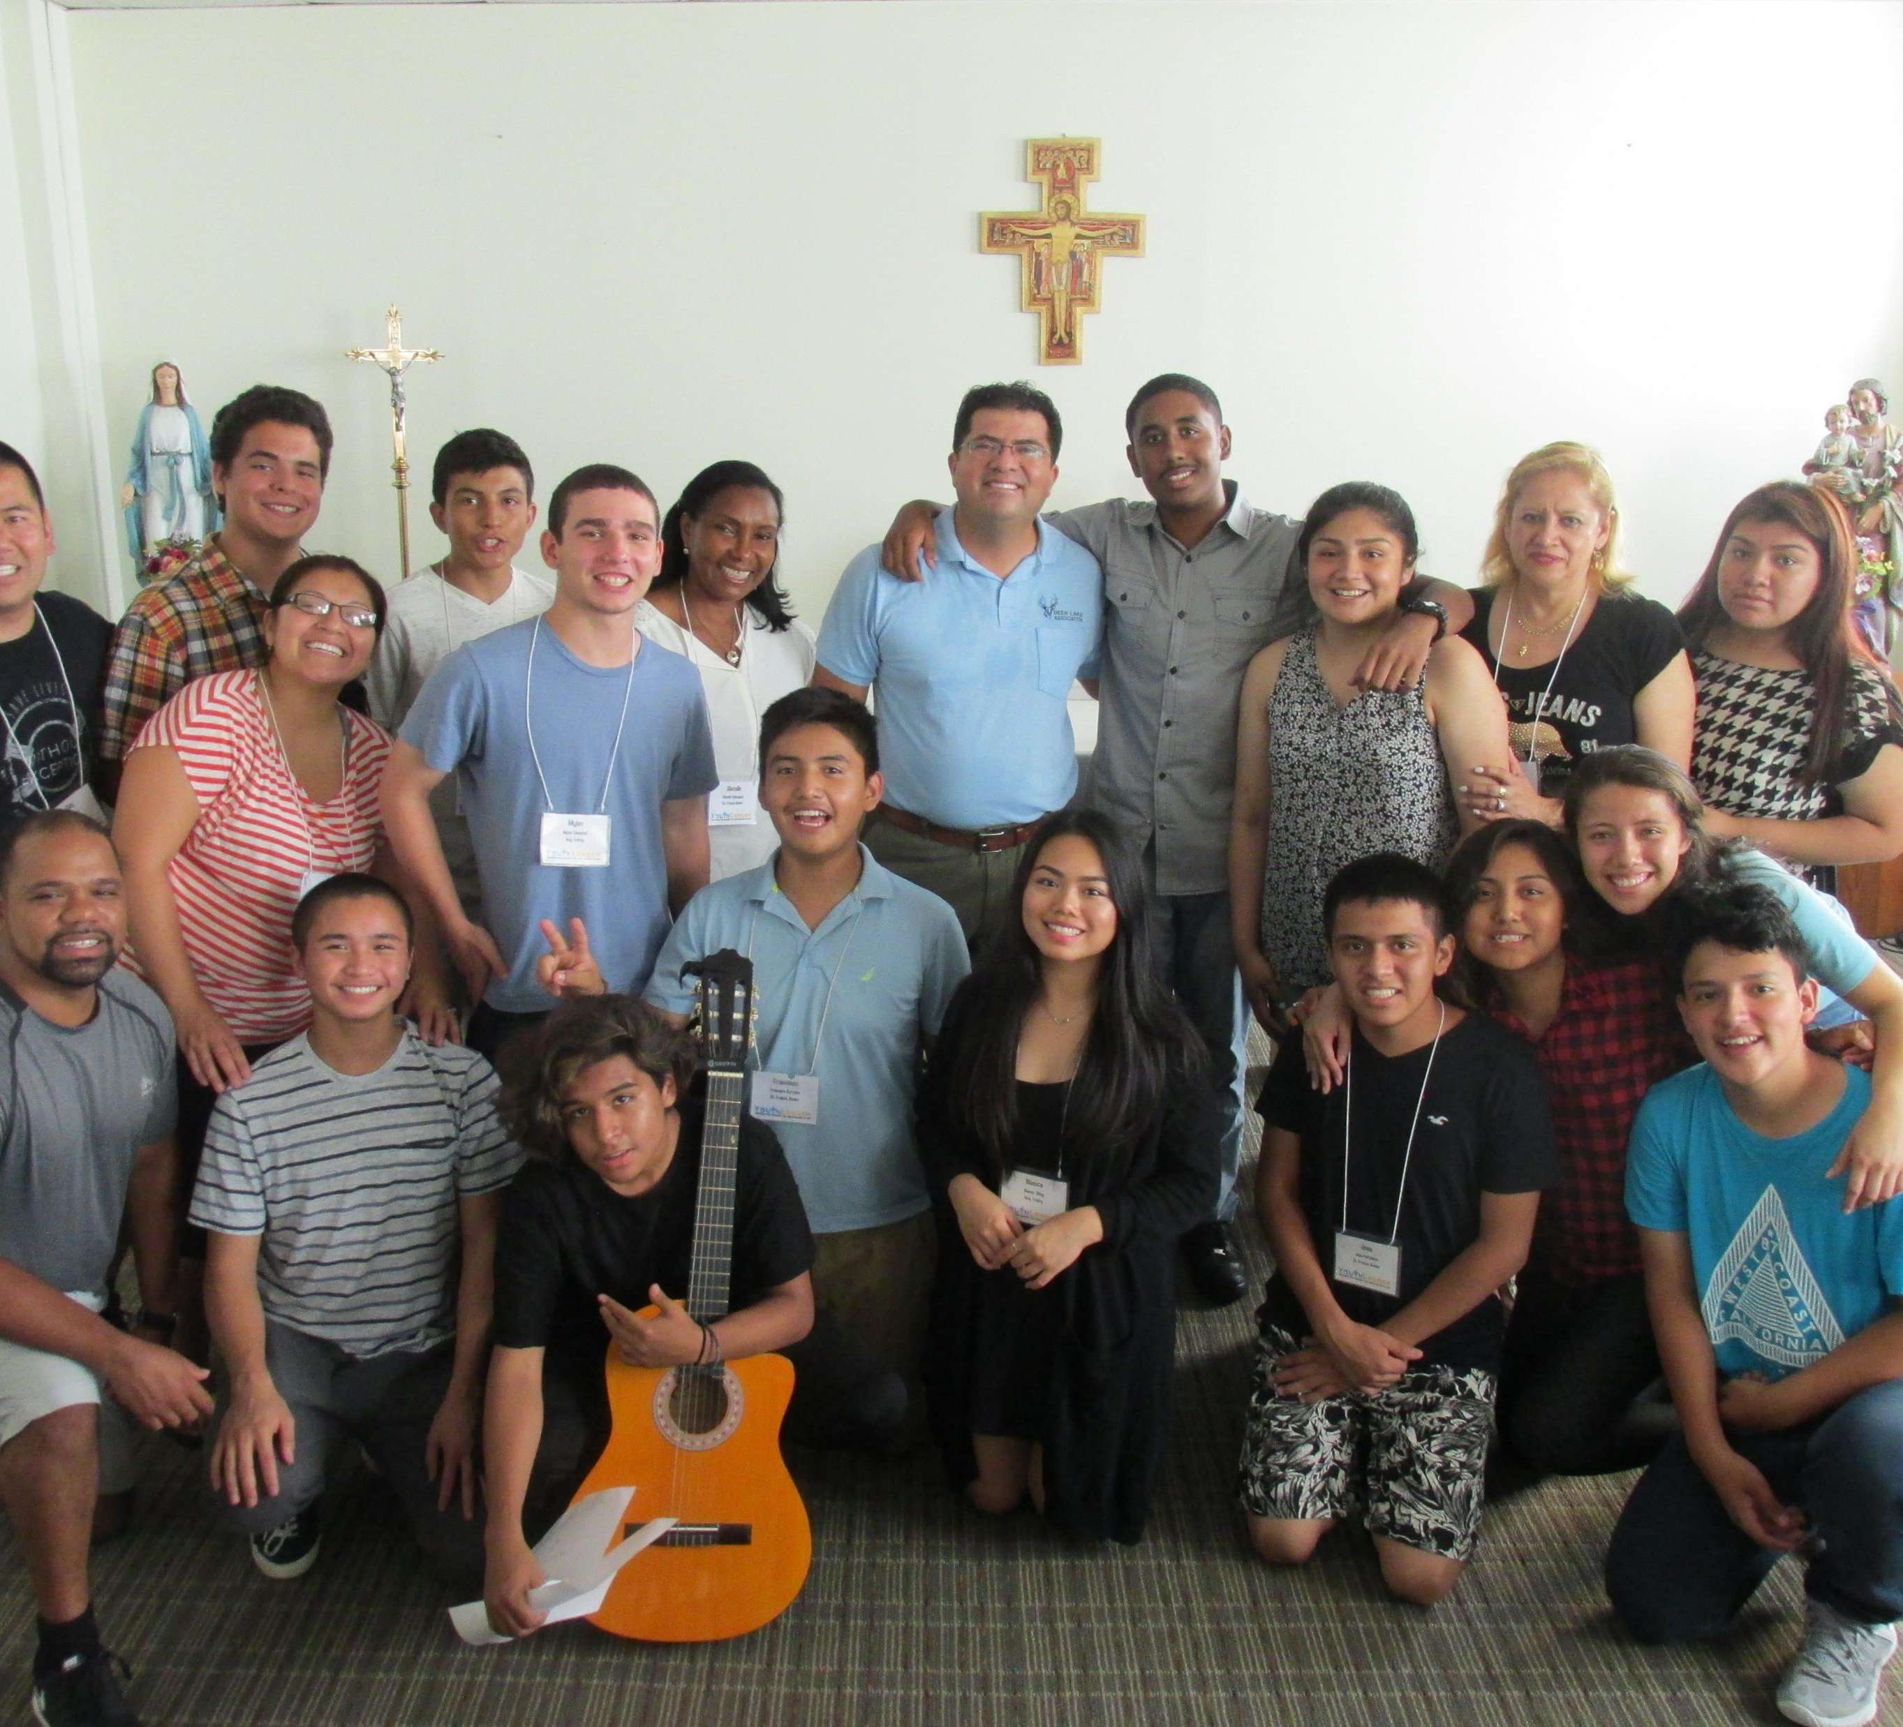
Ministry Programs that Include Youth
Promote faith sharing relationships with peers and adult faith companions
Notes:
This is the statement for ministry programs that include youth.
(Ministry programs) Promote faith sharing relationships with peers and adult faith companions

Slide 28
Parents and Faith Companions
Understand the process of accompanying youth in faith
Have skills for listening
Show empathy for youth and their families
Witness to their faith
Share faith with youth and engage in faith conversations
Pray for young people and their families
Notes:
These are the statements about parents and faith companions.
Understand the process of accompanying youth in faith
Have skills for listening
Show empathy for youth and their families
Witness to their faith
Share faith with youth and engage in faith conversations
Pray for young people and their families
Please take some time to provide your assessment of our current ministry efforts. For each statement, you will provide an assessment for your parish community by providing a rating on a scale of 1 to 5 with 1 being low and 5 being high. If you feel that you don’t have enough information to answer, select N/A (no answer.) You can also provide comments at the end.
(Allow 12 minutes for individual work.)

Slide 29
Our Parish
From this assessment, what do you notice about the ways that our parish develops faith companions for youth?
What are our strengths?
Where do we need the most work?
Notes:
(Ask someone to record the feedback discussion. Regather and collect the assessments by recording the number assigned by each participant. After each section, invite participants to share comments, questions and observations. After gathering general comments, consider these questions.)
From this assessment, what do you notice about our parish’s efforts to empower and equip parents and faith companions?
What are our strengths?
Where do we need the most work?

Slide 30
Empowering Parents and Faith Companions
Identifying Faith Companions with Families
Parents
Aunts and Uncles
Siblings
Family Friends
Grandparents
Godparents
Sponsors
Identifying Faith Companions in the Parish Community
Ministry Leaders
Catechists
Coaches
Adults in ministries with youth
Faith Mentors within youth programs
Peers
Notes:
Our work begins by identifying faith companions for youth in the family and the parish community. (Review the lists in the slide.)
Sometimes we recruit faith companions and match them with youth within specific programs that include youth.

Slide 31
Providing Support for Parents and Faith Companions
Networking
Gather parents and faith companions for networking and support.
Coaching
Provide someone to talk to about companioning youth in faith.
Training
Training for knowing how to answer tough faith questions and for understanding the adolescent faith journey
Training to help youth with pastoral care issues like anxiety, stress, and depression.
Resources
Resources for knowing how to answer tough faith questions and for understanding the adolescent faith journey
Resources to help youth with pastoral care issues like anxiety, stress, and depression.
Notes:
We also plan for ways to support parents and faith companions.
Networking
Gather parents and faith companions for networking and support.
Coaching
Provide someone to talk to about companioning youth in faith.
Training
Training for knowing how to answer tough faith questions and for understanding the adolescent faith journey
Training to help youth with pastoral care issues like anxiety, stress, and depression.
Resources
Resources for knowing how to answer tough faith questions and for understanding the adolescent faith journey
Resources to help youth with pastoral care issues like anxiety, stress, and depression.

Slide 32
Providing Training and Resources for Faith Companions
Understanding the Role of Faith Companion
Skills for Empathic Listening
Skills for Witnessing
Understanding Youth Faith and Spirituality
Faith Issues
Pastoral Care Issues
Notes:
These are some categories for providing training and resources for parents and faith companions.
Understanding the Role of Faith Companion
Skills for Empathic Listening
Skills for Witnessing
Understanding Youth Faith and Spirituality
Faith Issues
Pastoral Care Issues

Slide 33
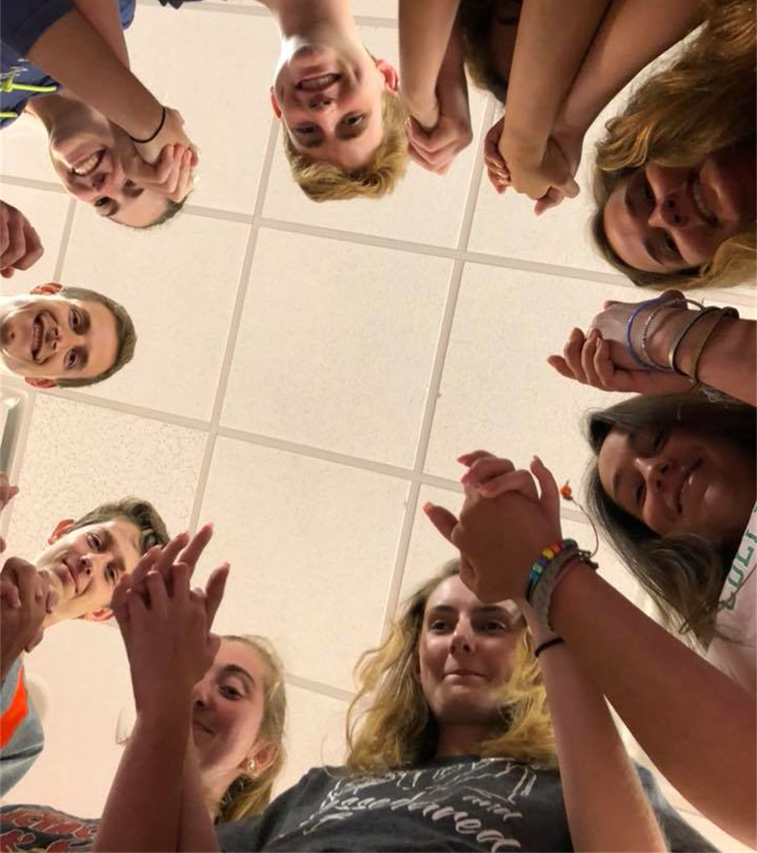
Planning for Empowering Faith Companions
Building a Community of Faith Companions
Work with families to identify faith companions for youth
Build faith companion relationships into youth ministry communities and programs
Identify faith companion relationships in the parish
Recruit faith companions to match with youth
Providing Support for Parents and Faith Companions
Provide networking
Provide coaching and support
Provide training
Provide resources
Notes:
We have two main tasks: creating a community of faith companions and then providing support.
Here are the opportunities for each:
Building a Community of Faith Companions
Work with families to identify faith companions for youth
Build faith companion relationships into youth ministry communities and programs
Identify faith companion relationships in the parish
Recruit faith companions to match with youth
Providing Support for Parents and Faith Companions
Provide networking
Provide coaching and support
Provide training
Provide resources

Slide 34
Discussion: Potential Resources
Who are the people and what are the resources in our community that could help us empower parents and faith companions?
Think about people who could serve as trainers, coaches, or mentors for parents and faith companions.
Consider resources in the parish such as counselors, parents who could serve as mentors to other parents, and experienced ministry leaders.
Consider resources in the wider community and those that are available in neighboring churches and through the diocese.
Notes:
Let’s continue our planning by thinking about potential resources:
Who are the people and what are the resources in our community that could help us empower parents and faith companions?
Think about people who could serve as trainers, coaches, or mentors for parents and faith companions.
Consider resources in the parish such as counselors, parents who could serve as mentors to other parents, and experienced ministry leaders.
Consider resources in the wider community and those that are available in neighboring churches and through the diocese.
(Collect input from participants. Allow 5-7 minutes for discussion. Record ideas on easel pad paper or on the white board. Be sure to invite someone to record this information for future planning.)

Slide 35
Developing Faith Companions
How can we plan for identifying and recruiting faith companions for youth?
How will we match youth with faith companions?
How will we plan for measures to provide a safe environment for accompaniment?
How will we plan for support for faith companions?
Networking
Coaching
Training
Resources
Notes:
Let’s continue our planning by considering these questions.
(Collect input for each question – allow 12 to 15 minutes for discussion.)
How can we plan for identifying and recruiting faith companions for youth?
How will we match youth with faith companions?
How will we plan for measures to provide a safe environment for accompaniment?
How will we plan for support for faith companions?
Networking
Coaching
Training
Resources

Slide 36
Closing Prayer
Notes:
We began this conversation by sharing envisioning youth surrounded by love and care as they grow in faith and discipleship. During our gathering we took the time to consider the ways that our parish can empower and support parents and faith companions. We can continue to plan for faith companions and for the support they need. Thank you for being a part of these efforts.
(After thanking the participants, make announcements about next steps in the process, then conclude in prayer.)
Loving God, thank you for the gift of young people in our community. We ask a special blessing on all parents of youth, and all who work with youth in our parish. We also pray for each young person. We ask that you guide us to surround each youth with love, care, and support. Help our youth to see your face and answer your call to discipleship. We ask this in Jesus’ name.
All: Amen

