Slide 1
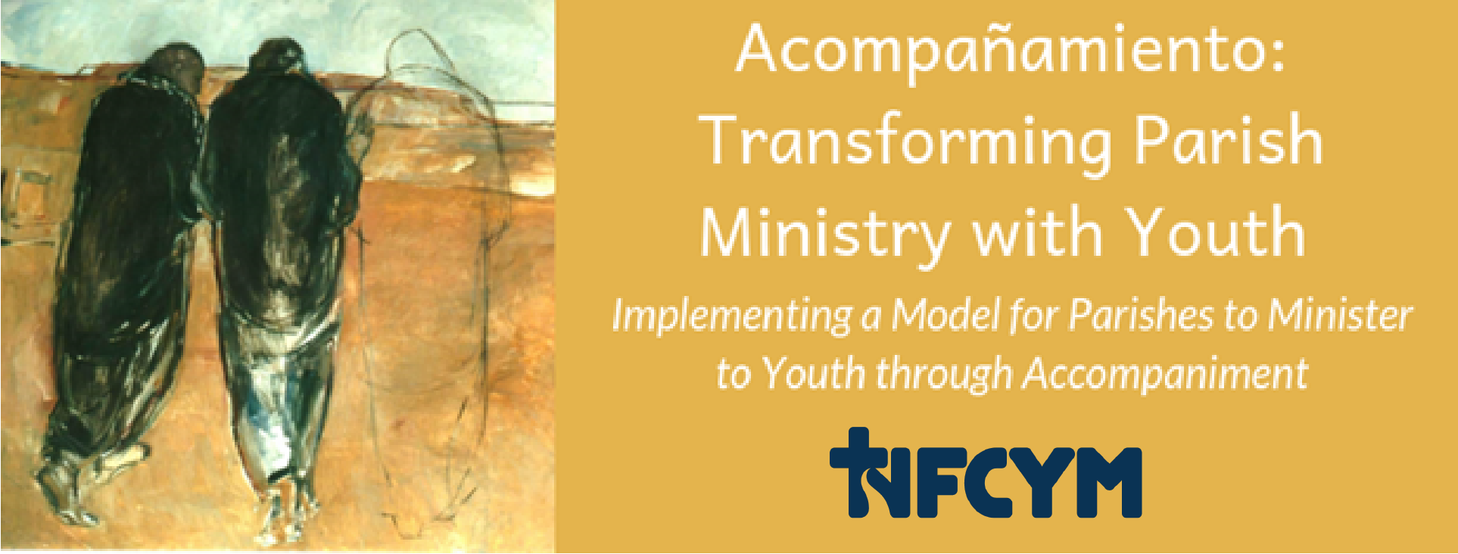
Transforming Youth Ministry Accompaniment Project Conversation #5
Notes:
Welcome participants and introduce yourself and the workshop / conversation. Share the purpose for our gathering:
Youth in our parish and community are longing for good news and are making choices about their life and their future. We have an opportunity to surround them with love and support as invite them to grow in faith and discipleship. We are being called to look at our ministry with youth with new eyes and see the possibilities for engaging this generation of young disciples.

Slide 2
Accompaniment
The Church will have to initiate everyone – priests, religious and laity – into this
“art of accompaniment”
which teaches us to remove our sandals before the sacred ground of the other….
Pope Francis, Evangeli Gaudium, #169
Notes:
(Note: slides 2 through 6 provide an introduction to accompaniment. If your group participated recently in Conversation #1 or if you experienced this introduction with Conversation #5 or 6, you can skip to slide 7.)
A new vision for ministry with youth is emerging. This vision is articulated in the document of the Synod on Youth, and Christus Vivit, the recent document of Pope Francis. In this vision, we are being guided to accompany young people as they grow in faith and discipleship. To accompany, we need to listen, empathize, and witness through our care and attention. Pope Francis describes “the art of accompaniment which teaches us to remove our sandals before the sacred ground of the other….”

Slide 3
Accompany All Young People
…just as our Lord Jesus Christ walked alongside the disciples of Emmaus (cf. Lk 24:13-35), the Church is also urged to accompany all young people, without exception, towards the joy of love.
Instrumentum Laboris 2018, #1
Notes:
We are called to accompany all young people – to broaden the scope of our ministry with youth to reach those who have often been left out.
“…just as our Lord Jesus Christ walked alongside the disciples of Emmaus (cf. Lk 24:13-35), the Church is also urged to accompany all young people, without exception, towards the joy of love.”
Instrumentum Laboris 2018, #1

Slide 4
Vocation is at the Horizon of our Ministry with Youth
The word “vocation” can be understood in a broad sense as a calling from God, including the call to life, the call to friendship with him, the call to holiness, and so forth. This is helpful, since it situates our whole life in relation to the God who loves us.
Pope Francis, Christus Vivit, 2019, #248
Notes:
Youth are making choices about their life. Who will they share their life with? What will they do? How will they find their way? We are accompanying youth as they discover and discern a way to live now but also prepare for the future. All of us are called to live a life of holiness and to seek our place in God’s plan. In Christus Vivit, Pope Francis places the vocation of holiness at the horizon of all of our ministry.
“The word “vocation” can be understood in a broad sense as a calling from God, including the call to life, the call to friendship with him, the call to holiness, and so forth. This is helpful, since it situates our whole life in relation to the God who loves us.”
Pope Francis, Christus Vivit, 2019, #248

Slide 5
Accompaniment Direction for Ministry
Youth experience encounter and witness and are accompanied in their journey toward holiness as missionary disciples.
Notes:
Youth experience encounter and witness and are accompanied in their journey toward holiness as missionary disciples.

Slide 6
In such places… the person-to-person contact indispensable for passing on the message can happen, something whose place cannot be taken by any pastoral resource or strategy.
# 218- Christ is Alive – Christus Vivit April 2, 2019
Notes:
We are reminded that accompaniment is indispensable as a way of sharing faith.
“In such places…the person-to-person contact indispensable for passing on the message can happen, something whose place cannot be taken by any pastoral resource or strategy.
# 218- Christ is Alive – Christus Vivit
April 2, 2019

Slide 7
Prayer for Faith Companions
Jesus, you accompany us and lead us to your heart.
We come before you humbly as echoes of your word of love.
Help us to be a companion; help us to be bread for the young people you entrust to our care.
Bless us with the discipline to pray for them
Bless us with the courage to connect with them.
Bless us with the humility to listen to them.
Bless us with the strength of heart to empathize with them.
Bless us with the compassion to care for them.
Bless us with the clarity of faith to witness to them.
Bless us with love to join our voice to your call to them.
Open the ears of our heart to hear you and to follow you as we walk with young people to your waiting arms.
We ask this in the name of the one who walks with us in our questions, who warms our hearts and who sends us in mission.
In Jesus name, we pray. Amen
Notes:
You and I share in this mission of accompanying youth with care and prayers. Let us join together in praying this prayer for faith companions.

Slide 8
Accompaniment Direction for Ministry
Equipping parents and faith companions
Transforming ministries to promote accompaniment
Engaging the parish community in accompanying young members
Notes:
Parishes that are moving toward accompaniment move forward with these three directions:
Equipping parents and faith companions
Transforming ministries to promote accompaniment
Engaging the parish community in accompanying young members
In this gathering, we will focus on looking at the second bullet point: transforming our youth ministry efforts.

Slide 9
Hope
What is a hope that you have for our parish youth ministries?
Notes:
We’ve been hearing about the vision and direction for ministry with youth built around accompaniment. What is your hope for our parish youth ministry? What do you hope for youth and their families?
(Collect the hopes expressed by the participants. Invite someone to record the hopes on an easel sheet or whiteboard. Ask participants to name their hopes.
After collecting all responses, summarize the comments and provide a transition to the next slide.)
We have a variety of hopes for our ministry with the youth in our parish. Together we can look at the current reality and dream about ways to transform our ministries to reach youth and help them grow in faith and discipleship.

Slide 10
Current Models
Ministry with youth is often built around a youth group, Confirmation preparation, or catechesis.
Notes:
Currently, most ministry with youth is built around a youth group, Confirmation preparation, or catechesis.

Slide 11
Challenges of Current Youth Ministry Models
reach only a small percentage of young people, leaving a lot of youth out.
In most places does not address racial, ethnic and language diversity.
Notes:
One of the challenges in our current models is that we reach only a small percentage of young people, leaving a lot of youth out.
In most places models do not address racial, ethnic and language diversity.

Slide 12
Challenges of the Current Models for Youth Ministry
The work of maintaining a youth group or multiple youth programs by a few people is unsustainable.
Notes:
Another challenge is that there are not enough people involved in the ministry. The work of maintaining a youth group or multiple youth programs by a few people is unsustainable.

Slide 13
Challenges of the Current Models for Youth Ministry
Youth continue to feel isolated.
Research demonstrates that even for youth who participate, results are not what we would want. Youth continue to feel isolated unless they have accompanying relationships.
Notes:
Youth continue to feel isolated. Research demonstrates that even for youth who participate, results are not what we would want. Youth continue to feel isolated unless they have accompanying relationships.

Slide 14
Challenges of the Current Models for Youth Ministry
Faith formation and sacramental preparation often focus only on the content of the faith and do not attend to encounter, witness, and accompaniment.
Notes:
Faith formation and sacramental preparation often focus only on the content of the faith and do not attend to encounter, witness, and accompaniment.

Slide 15
Challenges of the Current Models for Youth Ministry
Parents and families remain in a passive, disconnected role.
Notes:
Parents and families often remain in a passive, disconnected role.

Slide 16
Challenges of the Current Models for Youth Ministry
The parish and her members are often disconnected from the youth community.
Notes:
The parish and her members are often disconnected from the youth community.

Slide 17
Need for New Styles and Strategies
The young make us see the need for new styles and new strategies. For example, while adults often worry about having everything properly planned, with regular meetings and fixed times, most young people today have little interest in this kind of pastoral approach.
Pope Francis, Christus Vivit, 2019, #204
Notes:
We need new strategies. Strategies that are based in relationships and are connected to families and the parish community. Strategies that are built around accompaniment.
“The young make us see the need for new styles and new strategies. For example, while adults often worry about having everything properly planned, with regular meetings and fixed times, most young people today have little interest in this kind of pastoral approach.”
Pope Francis, Christus Vivit, 2019, #204

Slide 18
Need for New Styles and Strategies
Youth ministry needs to become more flexible: inviting young people to events or occasions that provide an opportunity not only for learning, but also for conversing, celebrating, singing, listening to real stories and experiencing a shared encounter with the living God.
Pope Francis, Christus Vivit, 2019, #204
Notes:
We are being called to provide ministry that is less programattic, less structured and more flexible.
“Youth ministry needs to become more flexible: inviting young people to events or occasions that provide an opportunity not only for learning, but also for conversing, celebrating, singing, listening to real stories and experiencing a shared encounter with the living God.”
Pope Francis, Christus Vivit, 2019, #204

Slide 19
Implementing Accompaniment
Building Ministry around Accompaniment
Notes:
We are being called to build ministry around accompaniment.

Slide 20
Transforming ministry Efforts
Transform
youth communities, programs and strategies to promote accompaniment
Connect
ministry with youth to families and the parish community
Focus on
helping youth grow in faith and discipleship
Provide
flexibility in the ways that youth participate and the ways that we deliver ministry
Provide
ministry to youth who are on the peripheries and are often left out of ministry efforts
Notes:
To transform youth ministry efforts, we can allow ministry efforts to be new and focus on these directions:
Transform youth communities, programs and strategies to promote accompaniment.
Connect ministry with youth to families and the parish community.
Focus on helping youth grow in faith and discipleship.
Provide flexibility in the ways that youth participate and the ways that we deliver ministry
Provide ministry to youth who are on the peripheries and are often left out of ministry efforts

Slide 21
Transforming Youth Ministry
Assessing the strengths and areas for your parish to grow
Assessment considers
Youth
Ministry Programs that Include Youth
Pastors and Parish Leaders
Notes:
Our assessment of the current reality will help us plan for renewed efforts in our ministries with youth that match these directions. We will be considering 10 statements described on page 4 of your handouts. .

Slide 22
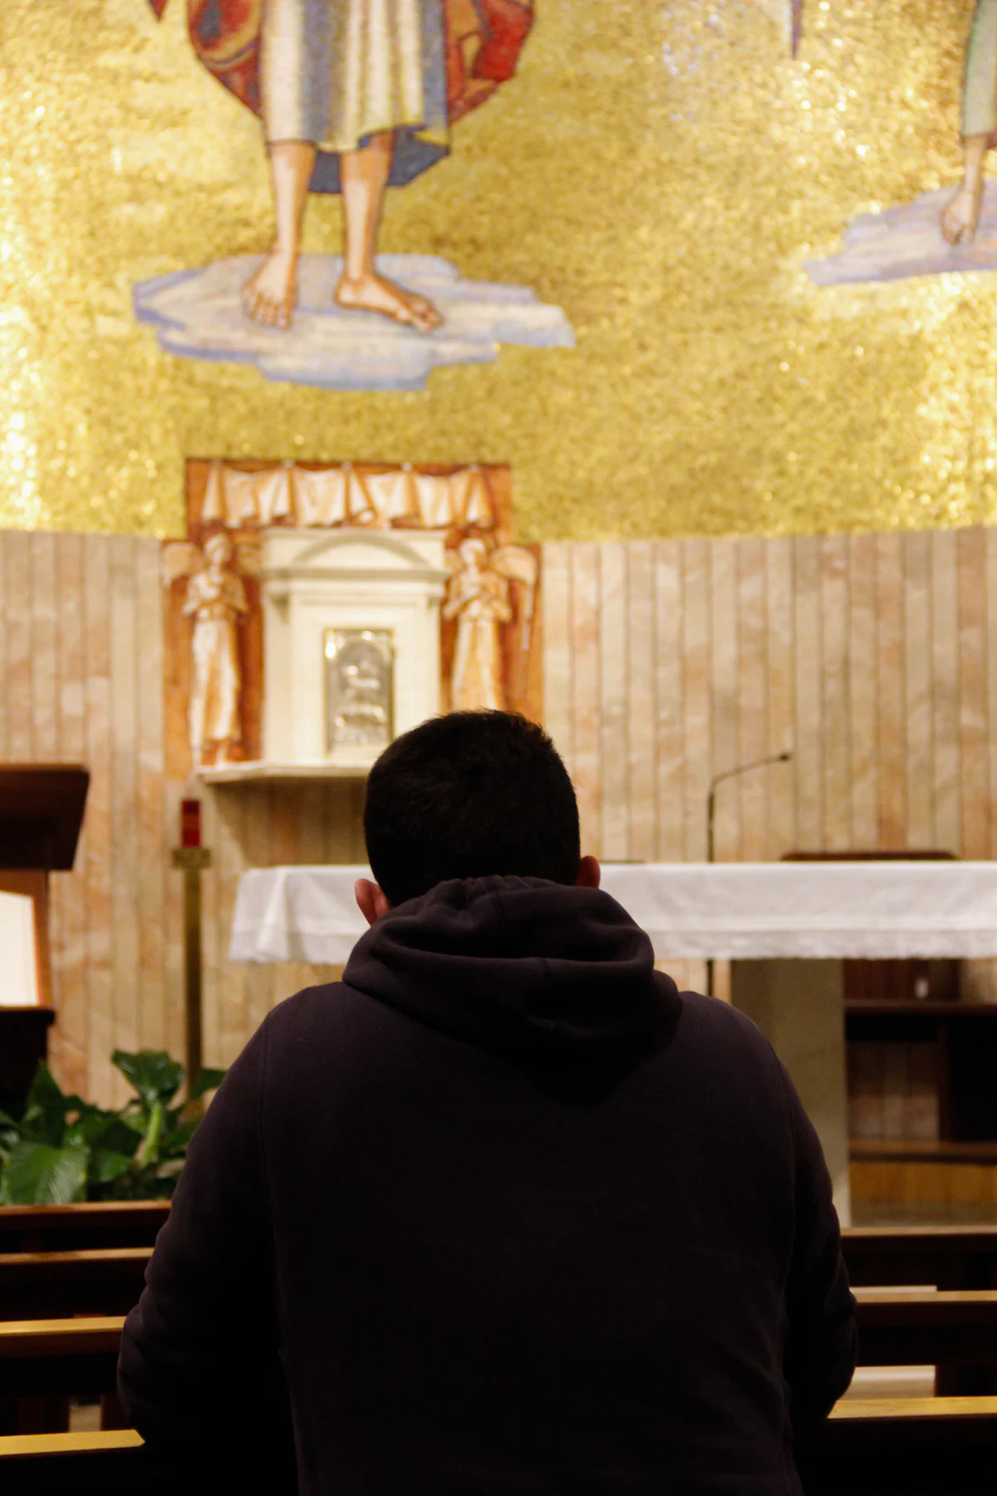
Youth
Have an intimate relationship with Jesus Christ sustained through their Catholic faith
Notes:
This is the statement you will evaluate about young people in our parish.
(Youth) Have an intimate relationship with Jesus Christ sustained through their Catholic faith

Slide 23
Ministry Programs that Include Youth
Provide
encounters with Christ
Promote
faith sharing relationships with peers and adult faith companions
Provide
for flexible participation
Provide
accompaniment for youth
Provide
pastoral care and outreach for youth and their families
Include
families of youth, especially parents
Notes:
These are the statements about ministry programs.
Provide encounters with Christ
Promote faith sharing relationships with peers and adult faith companions
Provide for flexible participation
Provide accompaniment for youth
Provide pastoral care and outreach for youth and their families
Include families of youth, especially parents

Slide 24
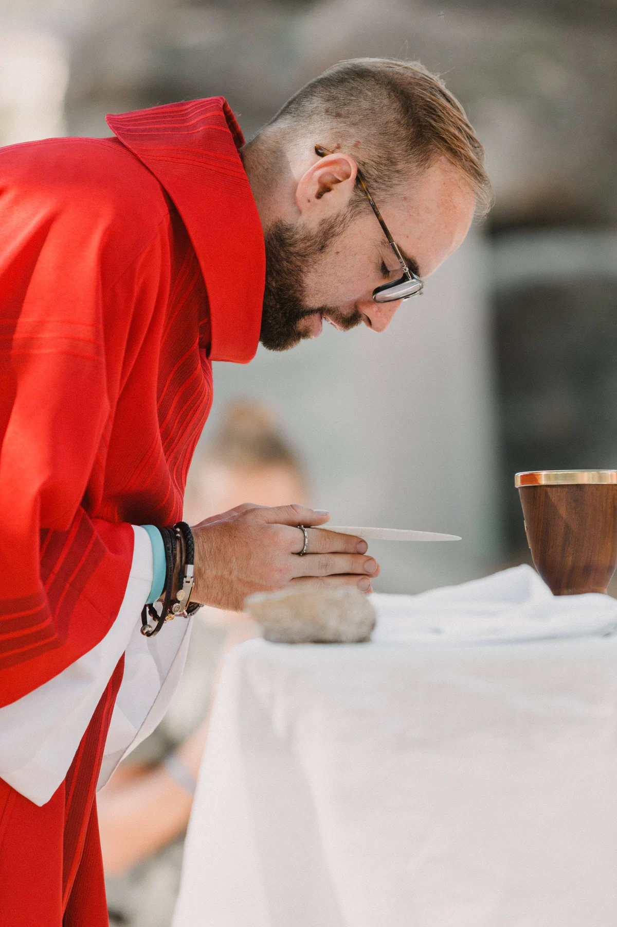
Pastors and Parish Leaders
Understand the process of accompanying youth in faith
Provide ministry for youth and their families that promote faith sharing relationships
Provide for an intentional way of engaging young people online (e.g. website, social media) that young people find meaningful, helpful, and responsive.
Notes:
These are the statements about pastors and parish leaders.
Understand the process of accompanying youth in faith
Provide ministry for youth and their families that promote faith sharing relationships
Provide for an intentional way of engaging young people online (e.g. website, social media) that young people find meaningful, helpful, and responsive.
Please take some time to provide your assessment of our current ministry efforts. For each statement, you will provide an assessment for your parish community by providing a rating on a scale of 1 to 5 with 1 being low and 5 being high. If you feel that you don’t have enough information to answer, select N/A (no answer.) You can also provide comments at the end.
(Allow 12 minutes for individual work.)

Slide 25
Our Parish
From this assessment, what do you notice about our parish’s ministry with youth?
What are our strengths?
Where do we need the most work?
Notes:
(Ask someone to record the feedback discussion. Regather and collect the assessments by recording the number assigned by each participant. After each section, invite participants to share comments, questions and observations. After gathering general comments, consider these questions.)
From this assessment, what do you notice about our parish’s ministry with youth?
What are our strengths?
Where do we need the most work?

Slide 26
Transforming ministry Efforts
Transform youth communities, programs and strategies to promote accompaniment.
Connect ministry with youth to families and the parish community.
Focus on helping youth grow in faith and discipleship.
Provide flexibility in the ways that youth participate and the ways that we deliver ministry
Provide ministry to youth who are on the peripheries and are often left out of ministry efforts
Notes:
We remember the directions we are building toward in transforming our youth ministry efforts:
Transform youth communities, programs and strategies to promote accompaniment.
Connect ministry with youth to families and the parish community.
Focus on helping youth grow in faith and discipleship.
Provide flexibility in the ways that youth participate and the ways that we deliver ministry
Provide ministry to youth who are on the peripheries and are often left out of ministry efforts

Slide 27
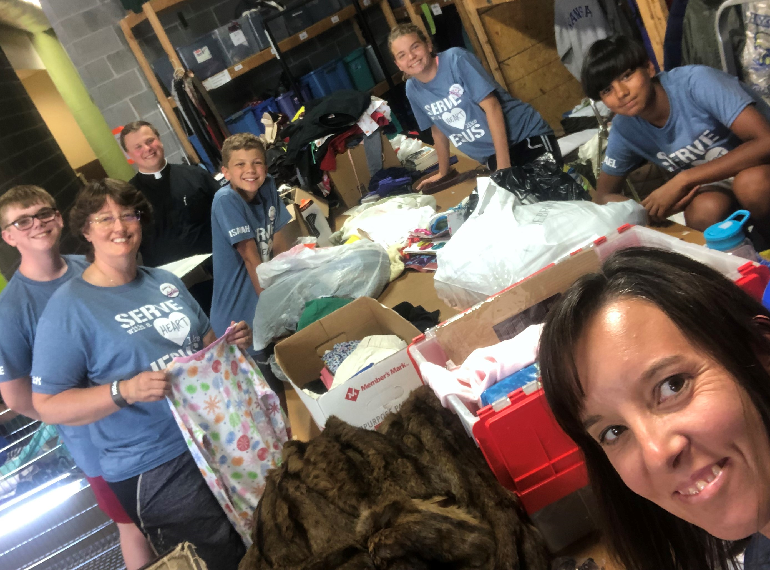
Transforming Youth Ministry Examples
Create small groups with two adult faith companions and five to six young people
Notes:
These are some examples of ways that parishes are building ministry around accompaniment.
One Parish Community - recruited and trained faith companions so that each youth in the ministry was part of a group with five other youth and two adult accompaniers. These small groups participated in ministries together and met regularly to pray with Lectio Divina and have conversations about life and faith. The accompaniers were also grouped into faith groups and provided with their own accompanier.

Slide 28
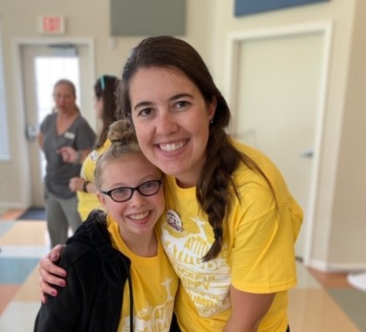
Transforming Youth Ministry Examples
Build Confirmation preparation around accompaniment.
Notes:
One Parish Community - transformed their process for Confirmation preparation so that all youth were divided into groups of five to seven members with two faith mentors to accompany them through the process of preparing to receive the sacrament.

Slide 29
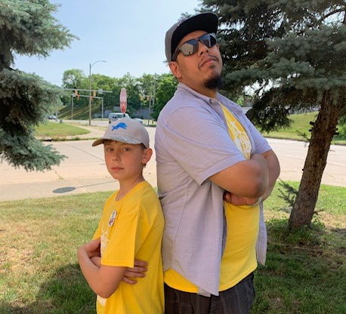
Transforming Youth Ministry Examples
Connect each youth involved in ministry, leadership, or service roles with an adult faith companion.
Notes:
One Parish Community - developed accompaniment relationships and mentors for each youth involved in leadership ministry and service roles in the parish by connecting them with adults in various ministries and providing training and support for the adult accompaniers.

Slide 30
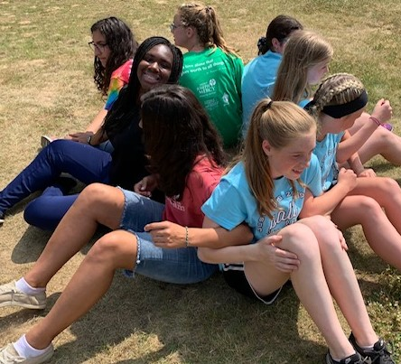
Evaluate current offerings and the needs in your community
Step 1:
Name all of the ministries that are directed to youth or that involve youth.
Notes:
In our parish community, what are the areas to grow, the gaps, and the ministries that are not working?
We will want to involve the community in helping us to evaluate, but let’s have an initial discussion to get things started. You can refer to page 6 in your handouts for this session.
(Allow for several minutes of individual reflection, then regather as a group. Identify someone to take notes for the discussion. Begin your group discussion by naming all of the existing programs and strategies that are directed to youth or that involve youth.)
Our first step is to identify all of the current ministries.
What are all of the ministries directed to youth or that involve youth?

Slide 31
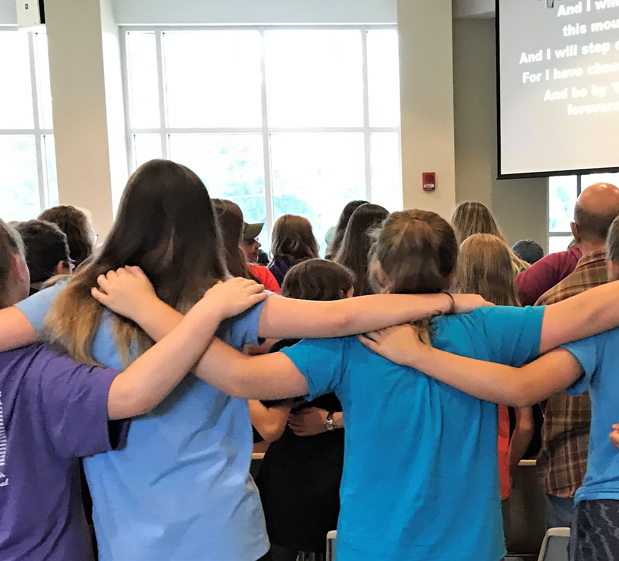
Evaluate current offerings and the needs in your community
Step 2:
Strengthen existing programs to promote accompaniment.
What are existing programs that we can strengthen to promote accompaniment?
Notes:
Our second step is to identify programs that we can grow.
What are existing programs that we can strengthen to promote accompaniment?

Slide 32
Evaluate current offerings and the needs in your community
Step 3:
Eliminate some programs and strategies.
What are some programs or strategies that we could consider eliminating?
Notes:
Our third step is a challenging one. There may be programs that have worked in the past that people are attached to. We need to make room for ministries to grow. We can’t embrace new things if we continue everything we are already doing.
What are some programs or strategies that we could consider eliminating?

Slide 33
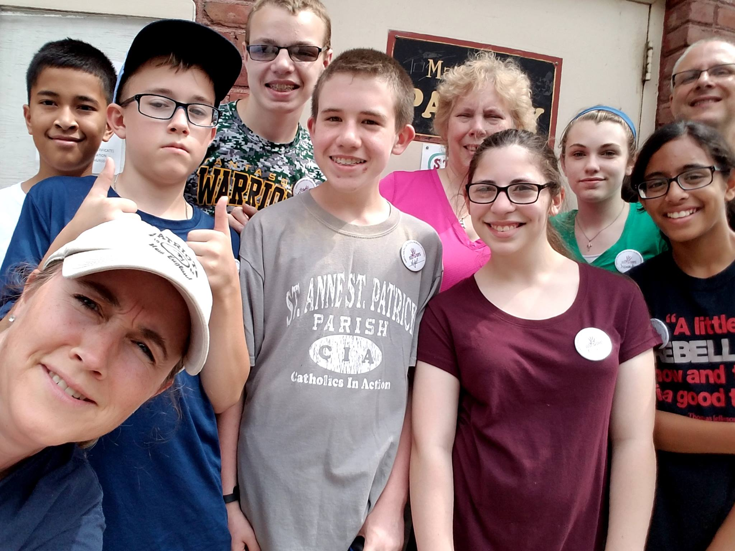
Evaluate current offerings and the needs in your community
Step 4:
Create new efforts paying particular attention to outreach.
What are some new efforts we could create to promote accompaniment and discipleship?
Notes:
Now is the time to be creative and brainstorm. Step 4 is all about creating new efforts that pay particular attention to outreach.
What are some new efforts we could create to promote accompaniment and discipleship?

Slide 34
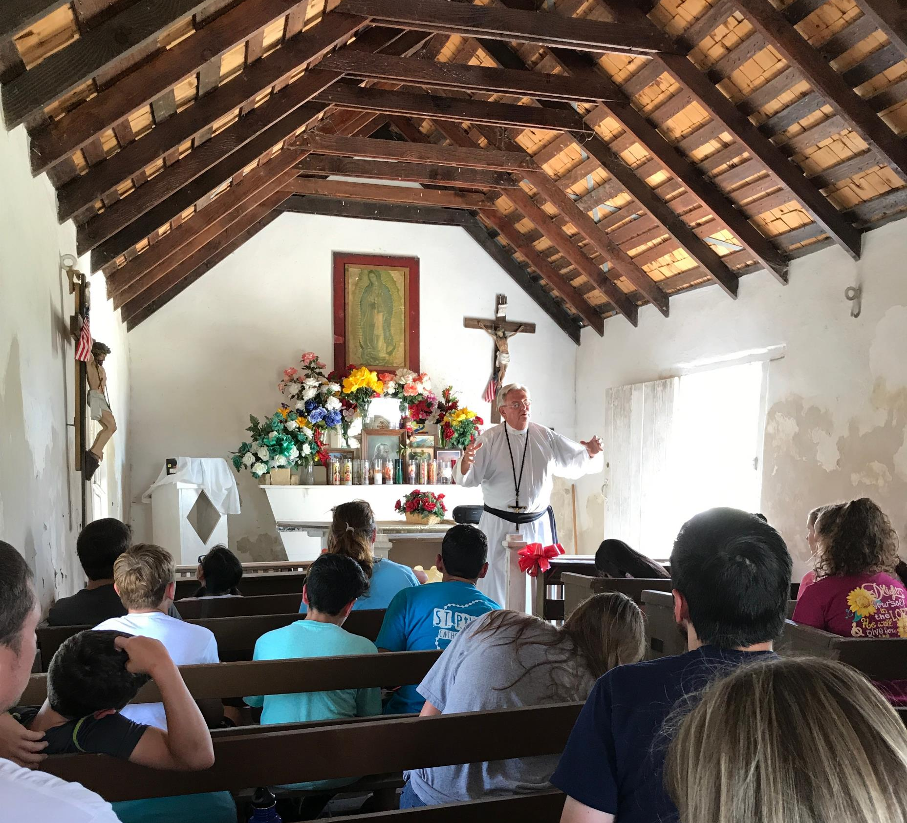
Who else could be involved in these efforts of transformation?
Who else could we involve in evaluating our current ministries and dreaming about new responses? How could we gather their input and ideas?
Notes:
This was an initial look at our ministries. We will want to involve others in this process. Let’s take a few minutes to consider these questions:
Who else could we involve in evaluating our current ministries and dreaming about new responses?
How could we gather their input and ideas?

Slide 35
Accompaniment Direction for Ministry
Youth experience encounter and witness and are accompanied in their journey toward holiness as missionary disciples.
Notes:
We began this conversation by sharing this hope that youth will experience encounter and witness and would be accompanied in their journey toward holiness as missionary disciples. During our gathering we took the time to consider the ministries of our parish directed toward youth. Together, we will plan for ways to transform our ministry efforts to support accompaniment and guide youth to grow in faith and discipleship. Thank you for being a part of these efforts.
(After thanking the participants, make announcements about next steps in the process, then conclude in prayer.)
Loving God, you call us to be new in the ways that we walk with youth in faith. Strengthen us as a community. Help us to see the people and resources that help youth to experience encounter, witness, and accompaniment. Guide us to be open to your Spirit as we discern and plan for ways to share your face with youth and their families. We ask this in Jesus’ name.
All: Amen

