Slide 1
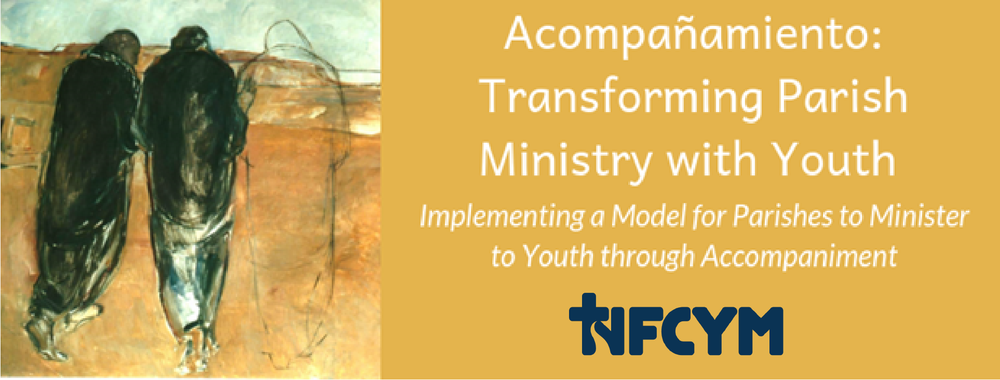
Conversation #6 Becoming a Parish Who Accompanies
Notes:
Introduce yourself, welcome participants and distribute the handouts.
Introduce this conversation:
Youth are choosing the adventure of their life. We have an opportunity to surround them with love and support as invite them to choose to be a disciple of Jesus Christ. We are being called to look at our ministry with youth with new eyes and see the possibilities for engaging this generation of young disciples.
In our conversation today, we will explore the ways that the parish community is engaged with our young members. Together, we will assess the relationships and engagement of youth in our parish community, and plan for efforts to share insights about accompaniment with the wider parish community.

Slide 2
Accompany All Young People
…just as our Lord Jesus Christ walked alongside the disciples of Emmaus (cf. Lk 24:13-35), the Church is also urged to accompany all young people, without exception, towards the joy of love.
Instrumentum Laboris 2018, #1
Notes:
We are being called to minister with youth in new ways. We are called accompany all young people – to broaden the scope of our ministry with youth to reach those who have often been left out.
“…just as our Lord Jesus Christ walked alongside the disciples of Emmaus (cf. Lk 24:13-35), the Church is also urged to accompany all young people, without exception, towards the joy of love.”
Instrumentum Laboris 2018, #1

Slide 3
Accompaniment Direction for Ministry
Youth experience encounter and witness and are accompanied in their journey toward holiness as missionary disciples.
Notes:
Youth experience encounter and witness and are accompanied in their journey toward holiness as missionary disciples.

Slide 4
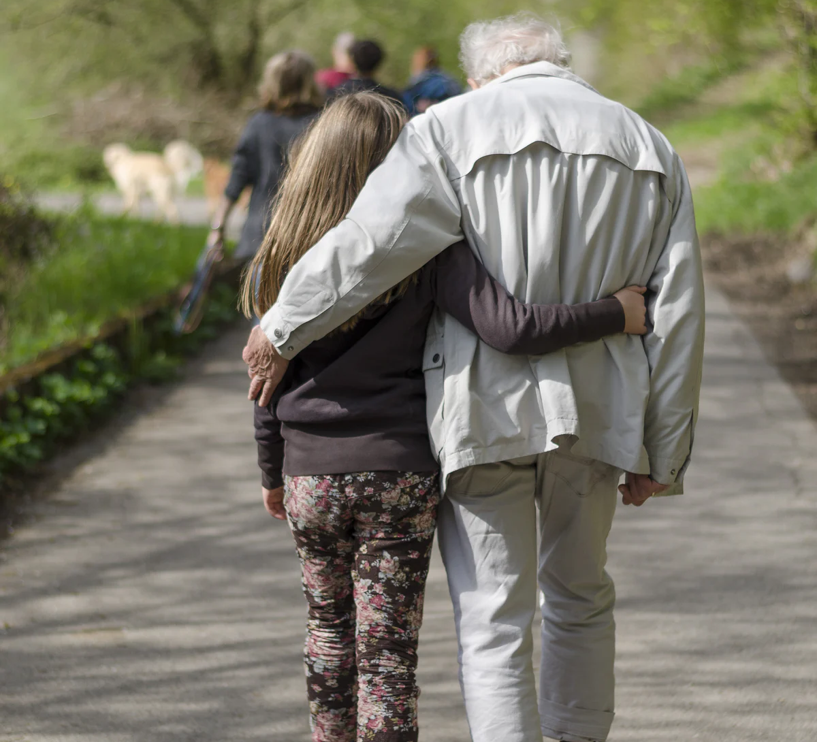
Accompaniment Direction for Ministry
Equipping parents and faith companions
Transforming ministries to promote accompaniment
Engaging the parish community in accompanying young members
Notes:
Parishes that are moving toward accompaniment move forward with these three directions:
Equipping parents and faith companions
Transforming ministries to promote accompaniment
Engaging the parish community in accompanying young members
In this gathering, we will focus on looking at the third bullet point: engaging the parish community in accompanying young members.

Slide 5
Radiate Christ
… (Young people) will be better integrated into communities that are open, living their faith, eager to radiate Christ, joyful, free, fraternal and committed. These communities can be settings where they feel that it is possible to cultivate precious relationships.
# 220- Christ is Alive – Christus Vivit
April 2, 2019
Notes:
This passage from Christus Vivit reminds us of this call.
What does it mean to Radiate Christ? Think about a concrete park bench sitting in the sun in the middle of the summer. You usually check it before you sit down because it can get too hot. If you hold your hand a foot away, you can feel the heat radiating from the bench.
People can radiate anger or despair; people can also radiate hope or joy.
To radiate Christ is to have the light and warmth of Christ shine through our lives to those around us.
Please take a moment to prepare yourself to join in prayer.
(Make the Sign of the Cross.)
Opening Prayer
Jesus, our friend and brother,
We know the warmth of your love.
Break through any darkness in our lives.
Send your Spirit into our brokenness.
We want to make you known. We want to radiate your love and light.
Shine through us today!
We ask this in Your name, as we continue to pray with each breath that we take.
Amen

Slide 6
What are the ways you radiate Christ? Consider your various roles: son, daughter, wife, husband, sister, brother, friend, parishioner, leader, minister, catechist, witness, evangelist, community member, citizen…
Notes:
I invite you to journal about the question on page 2. What does it mean to be children of the light? It is about our relationship with Christ. It means that our lives are in Christ and that this light and love shines through us.

Slide 7
Shine through Us, Loving God
Notes:
Petitions
Our prayer response will be:
Shine through Us, loving God.
God of light, we want to radiate your goodness and light. Remove the doubts and obstacles that keep us from letting you shine through us. For this we pray.
Response: Shine through Us, Loving God.
For what else shall we pray?
Conclusion of petitions:
God, you know our hearts, you know what we need. Fill us with your goodness as we continue to pray in Jesus’ name.
All: Amen

Slide 8
Radiate Christ Prayer By Saint John Henry Newman
ALL: Dear Jesus, help me to spread Your fragrance wherever I go.
Flood my soul with Your spirit and life.
1: Penetrate and possess my whole being so utterly, that my life may only be a radiance of Yours. Shine through me, and be so in me that every soul I come in contact with may feel Your presence in my soul.
2: Let them look up and see no longer me, but only Jesus! Stay with me and then I shall begin to shine as You shine, so to shine as to be a light to others.
3: The light, O Jesus, will be all from You; none of it will be mine.
It will be you, shining on others through me. Let me thus praise You the way You love best, by shining on those around me.
ALL: Let me preach You without preaching, not by words but by my example, by the catching force of the sympathetic influence of what I do, the evident fullness of the love my heart bears to You.
Amen.
Notes:
Divide the group into three sections. Invite participants to share this prayer by reciting for the sections indicated ALL. Each section (1, 2, and 3) will recite their assigned text.

Slide 9
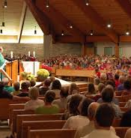
The Parish Accompanies Young People
The community has an important role in the accompaniment of young people; it should feel collectively responsible for accepting, motivating, encouraging and challenging them.
# 243- Christ is Alive – Christus Vivit
April 2, 2019
Notes:
The parish has a primary responsibility for accompanying young disciples.

Slide 10
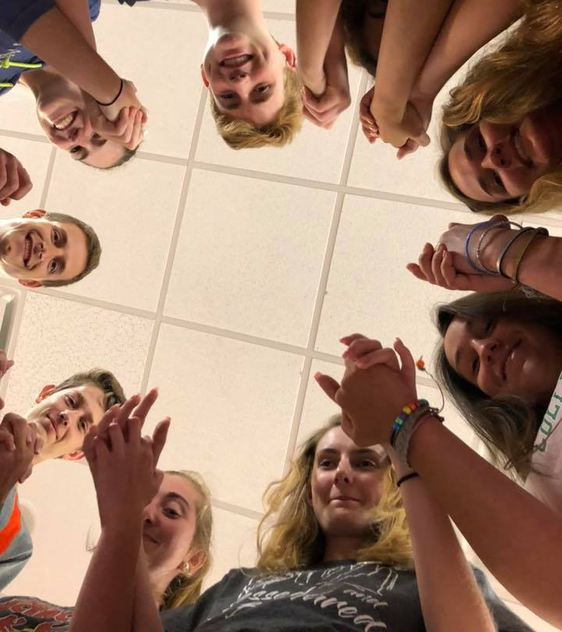
Listen to young people and accompany them
Rather than listening to young people attentively, “all too often, there is a tendency to provide prepackaged answers and ready-made solutions, without allowing their real questions to emerge and facing the challenges they pose”.
Pope Francis, Christus Vivit, 2019, # 65
Notes:
In Christus Vivit, Pope Francis describes what it means to really walk with young people. It calls on us to respond in relationship, not provide pre-packaged answers.

Slide 11
Listen to young people and accompany them
Yet once the Church sets aside narrow preconceptions and listens carefully to the young, this empathy enriches her, for “it allows young people to make their own contribution to the community, helping it to appreciate new sensitivities and to consider new questions”.
Pope Francis, Christus Vivit, 2019, # 65
Notes:
We are called to truly listen to them and allow them to bring their insights and their gifts to our parish. We are challenged to include them and consider their ideas.

Slide 12
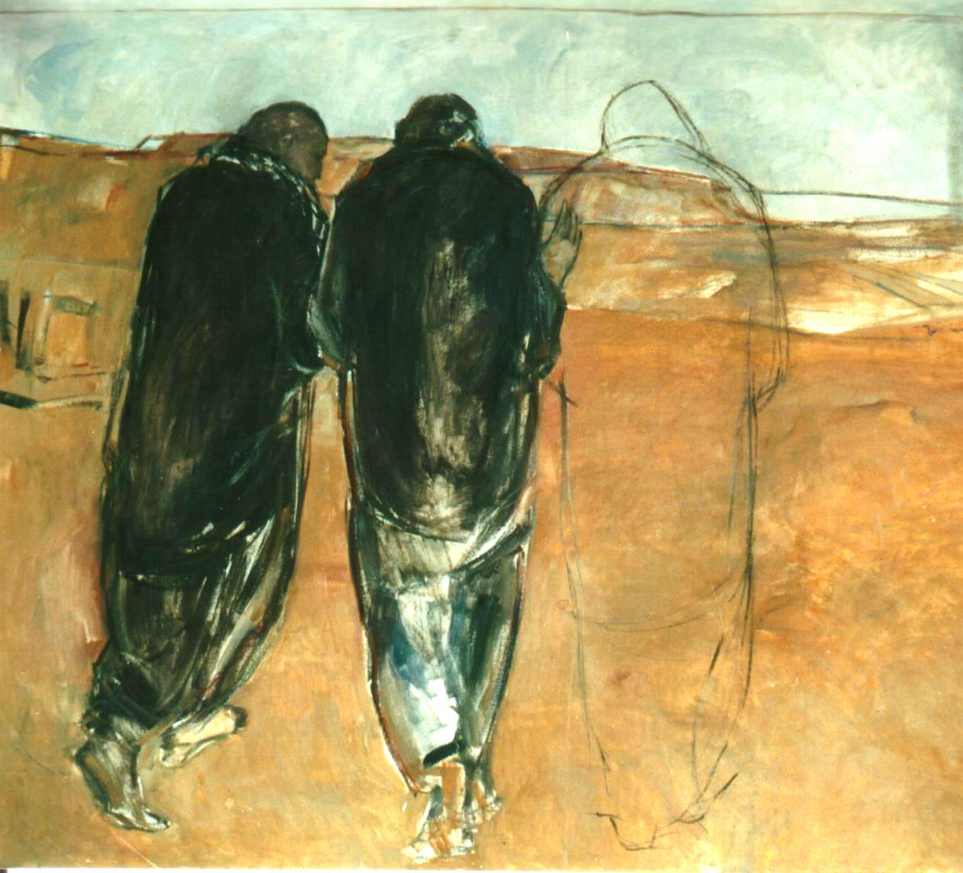
Accompaniment
“Accompanying young people requires going beyond a preconceived framework, encountering young people where they are, adapting to their times and pace of life and taking them seriously.”
Preparatory Document
Notes:
The preliminary document for the upcoming Synod provides a beautiful, but challenging vision of Accompaniment. We are told to:
Go beyond a preconceived framework
Encounter young people where they are, adapt to their times and pace of life and
Take them seriously.
These words are intended to wake us up, to challenge us, to help us go beyond the “same old, same old” way of ministry and envision something new.

Slide 13
The Current Reality
Many youth feel disconnected from their communities.
Many families are disengaged from the parish and are not empowered to share faith at home.
Many youth do not have anyone to talk to about faith and their lives.
Many youth do not pray regularly; they are often distracted from integrating an experience of God
Notes:
This is our current reality:
Many youth feel disconnected from their communities.
Many families are disengaged from the parish and are not empowered to share faith at home.
Many youth do not have anyone to talk to about faith and their lives.
Many youth do not pray regularly; they are often distracted from integrating an experience of God

Slide 14
Relationships
Parents / Family – Grandparents, Aunts, Uncles, Cousins, Siblings
Sacramental Relationships – Godparent / Sponsor
Ministry Leaders / Catechists / Coaches
Members of the Parish Family
Peers
Notes:
To accompany young people, we need to consider all of the potential relationships with young people.
Parents / Family – Grandparents, Aunts, Uncles, Cousins, Siblings
Sacramental Relationships – Godparent / Sponsor
Ministry Leaders / Catechists / Coaches
Members of the Parish Family
Peers

Slide 15
Accompanying Youth – Radiating Christ
Person to Person Accompaniment
Formation of Youth
Witness
Engagement in Community
Three Communities:
Family
Ministry
Parish
Notes:
Christus Vivit speaks of three communities who accompany. (animation)
Family, Youth Ministry, Parish
We can accompany by:
Providing faith companions – providing person to person accompaniment
Providing dynamic formation of faith
Engaging youth in the community
Providing a witness of faith

Slide 16
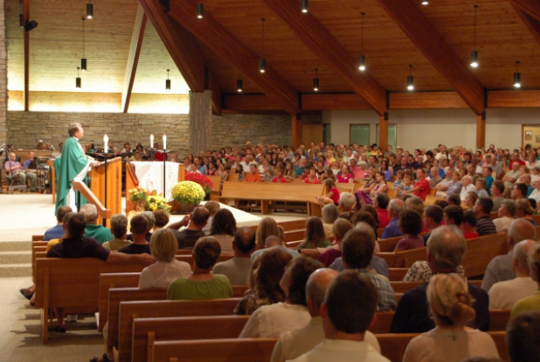
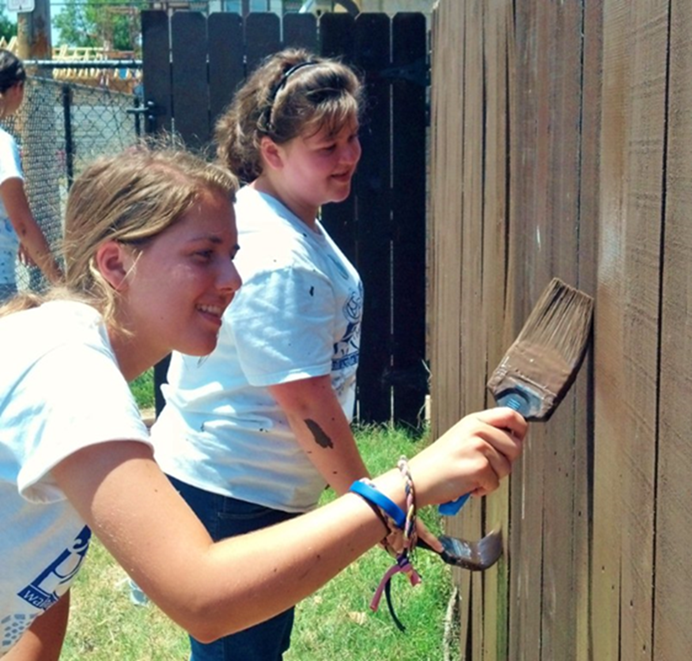
Full and Active Participation in Parish Life
Notes:
What we hope for is for young people to have full and active participation in the life of the parish.
(Share examples of ways that you see youth who are fully engaged in the parish.)

Slide 17
Begin with the parish relationship with youth
Look at the engagement of youth in liturgy, community life, service
Look for involvement of youth in ministries, leadership and decision making
Look for the engagement of members of the parish community with young people
Notes:
There are three things to look for and grow to build the relationship with youth in our parish.
Look at the engagement of youth in liturgy, community life, service
Look for involvement of youth in ministries, leadership and decision making
Look for the engagement of members of the parish community with young people

Slide 18
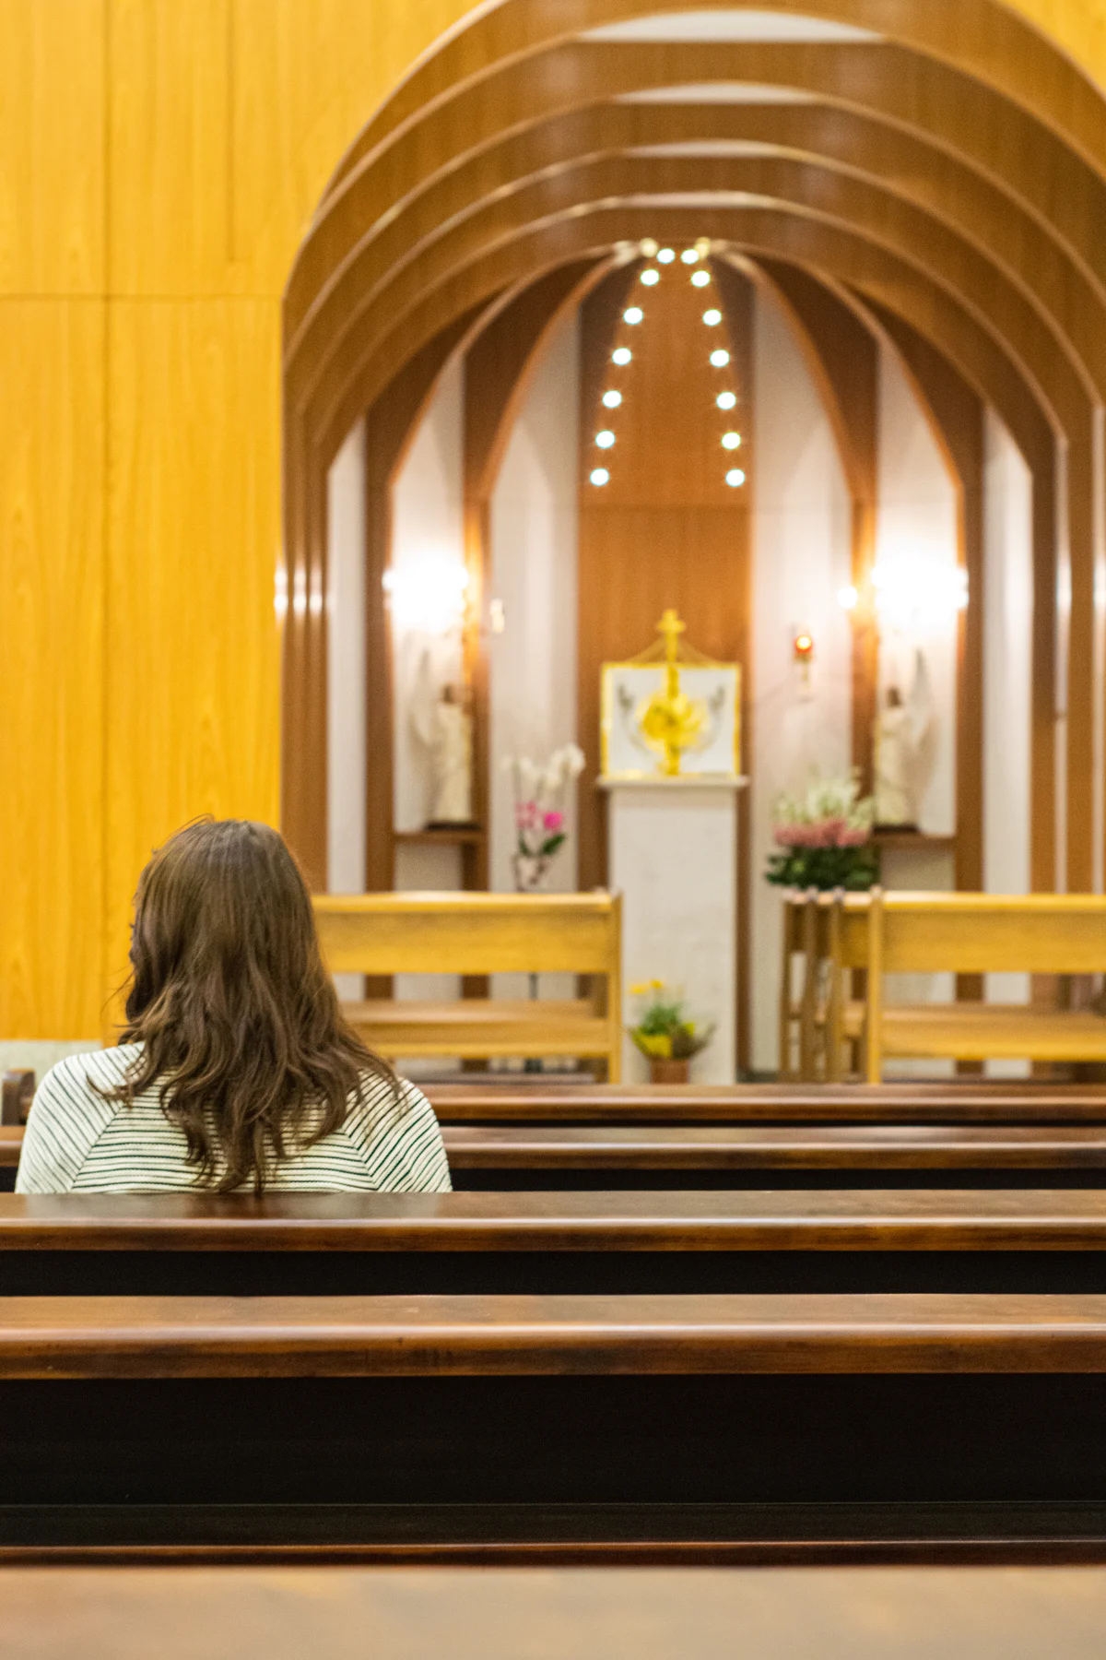
Becoming a Parish Who Accompanies
Assessing the strengths and areas for your parish to grow.
Assessment considers
Youth
Pastor and Parish Leaders
Members of the Parish Community
Notes:
Our assessment of the current reality for our parish will help us plan for renewed efforts in our parish relationship with youth that match these directions. We will be considering 19 statements described on pages 6 and 7 of your handouts.
Our assessment includes statements about:
Youth,
Pastor and Parish Leaders, and
Members of the Parish Community

Slide 19
Youth
Have an intimate relationship with Jesus Christ sustained through their Catholic faith
Are known in the community
Have access to ministry and leadership roles
Participate in community decision making
Are appreciated for their contributions
Have conversations with members of the parish community beyond their family and peers
Notes:
These are the statements you will evaluate about young people in our parish.
Youth
Have an intimate relationship with Jesus Christ sustained through their Catholic faith
Are known in the community
Have access to ministry and leadership roles
Participate in community decision making
Are appreciated for their contributions
Have conversations with members of the parish community beyond their family and peers

Slide 20
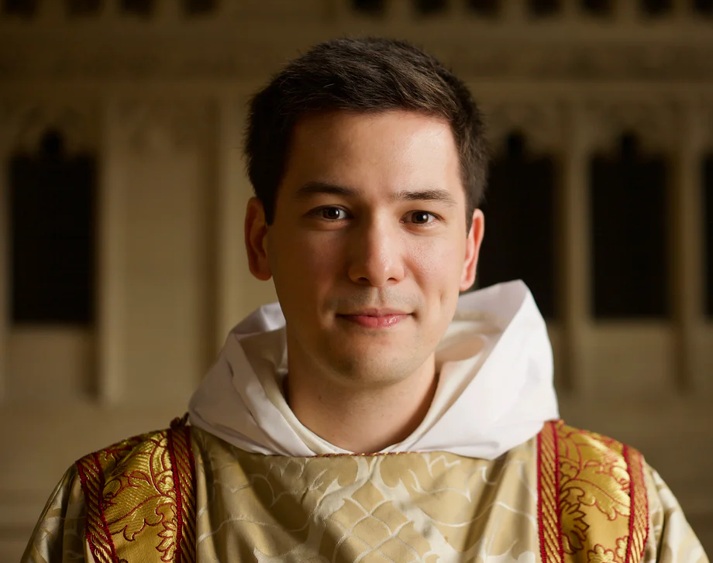
Pastor and Parish Leaders
Promote a culture of welcome and inclusion
Provide ministry for youth and their families that promote faith sharing relationships
Know youth and their families in the community
Understand the dynamics of being an adolescent today
Consider youth when planning for parish life
Help to provide access for youth to ministry and leadership roles
Pray for young people and their families
Notes:
These are the statements about the pastor and parish leaders.
Promote a culture of welcome and inclusion
Provide ministry for youth and their families that promote faith sharing relationships
Know youth and their families in the community
Understand the dynamics of being an adolescent today
Consider youth when planning for parish life
Help to provide access for youth to ministry and leadership roles
Pray for young people and their families

Slide 21
Members of the Parish Community
Know youth in the community
Acknowledge and appreciate youth’s perspective and contributions
Have conversations with youth in the parish beyond family members
Pray for young people and their families
Notes:
These are the statements about members of our parish community:
Parish Members
Know youth in the community
Acknowledge and appreciate youth’s perspective and contributions
Have conversations with youth in the parish beyond family members
Pray for young people and their families

Slide 22
Our Parish
From this assessment, what do you notice about our parish’s relationship with youth?
What are our strengths?
Where do we need the most work?
Notes:
(Ask someone to record the feedback discussion. Regather and collect the assessments by recording the number assigned by each participant. After each section, invite participants to share comments, questions and observations. After gathering general comments, consider these questions.)
From this assessment, what do you notice about our parish’s relationship with youth?
What are our strengths?
Where do we need the most work?

Slide 23
Youth enrich the Church
Young Catholics are not merely on the receiving end of pastoral activity: they are living members of the one ecclesial body, baptized persons in whom the Spirit of the Lord is alive and active. They help to enrich what the Church is and not only what she does. They are her present and not only her future.
Final Document for the Synod on Young People, the Faith, and Vocational Discernment, 54.
Notes:
It’s not just that young people need the parish’s love and care. Our parish needs their energy and gifts. They are our present and our future!

Slide 24
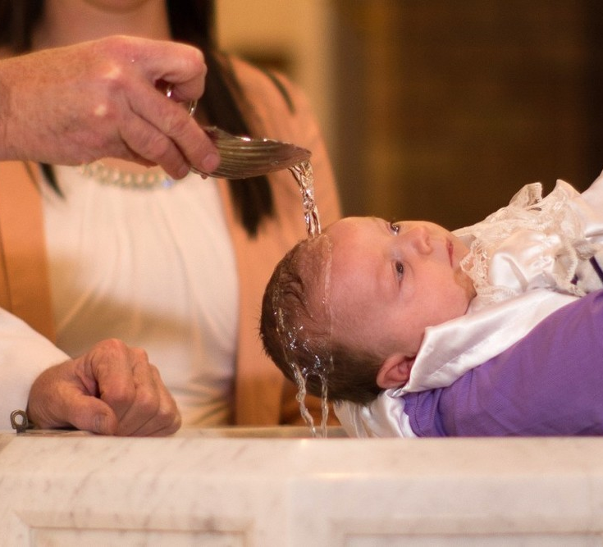
We made a promise to youth and their families.
Notes:
In the rite of baptism, the parish community makes a commitment to support the parents and the newly baptized. When we look at the youth in our parish, we need to remember this commitment. These aren’t just any young people, these are young people to whom we made a promise at their baptism. When the youth minister asks people to help in ministry with youth, it’s not about helping the minister to her /his job, it’s about the community remembering and living out the promise we made.

Slide 25
We should take responsibility for forming young disciples. This is not something we can delegate.
Notes:
We should take responsibility for forming young disciples. (This is not something we can delegate.)
In many cultures, the highest celebration of their identify comes in forming and ritualizing the way that children grow into adults in the community. In many Catholic communities the job of forming youth has been delegated. We delegate the task to a youth minister or to a small group of adults. We delegate the task to catechists or to a particular youth community. In many ways, we delegate the task of evangelizing and catechizing youth to publishers and those who develop media content.
In Christus Vivit, Pope Francis describes a vision for a parish community that is collectively responsible for accompanying young people. This means that the community knows, cares for, prays for, and is in relationship with their young members. In this vision, the parish is in partnership with families in forming young disciples. Youth ministry leaders work to animate these relationships and engage youth in the life of the parish.
One youth minister shared this story: “I was talking with youth at a parish who were preparing for Confirmation. It was a good parish, with a variety of youth ministry activities. I asked the youth about their experience of the preparation process. One young man hemmed and hawed. He didn’t want to complain. When pressed, he shared that mostly the preparation process was watching videos with a speaker who lives 2000 miles away. He said that the speaker clearly knew about the faith, but he asked me, ‘isn’t there anyone in our parish who believes this stuff and cares enough about us to share it with us?’”
Forming youth in faith is our job as a parish community.

Slide 26
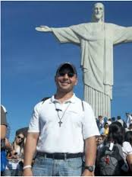
Spiritual First Aid
“If the parish is a field hospital, everyone should be equipped to provide spiritual first aid. We should all be lifeguards, ready to dive in to help our brothers and sisters.”
Fr. Abraham Feliciano, SDB
Notes:
Fr. Abraham Feliciano is the Youth Delegate for the Salesian community for the Eastern United States and Canada. He shared this vision for accompaniment. Inspired by Pope Francis’s call that we become like field hospitals, he suggests that everyone in the parish should be willing to provide spiritual first aid.
“If the parish is a field hospital, everyone should be equipped to provide spiritual first aid. We should all be lifeguards, ready to dive in to help our brothers and sisters.”
Fr. Abraham Feliciano, SDB

Slide 27
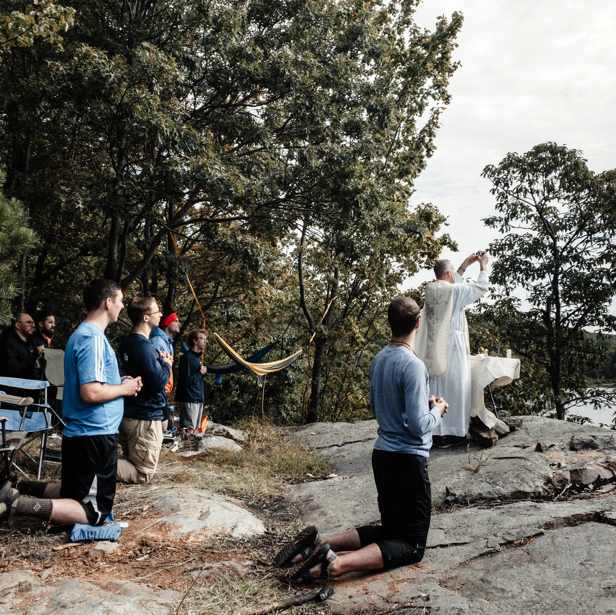
Connect the Parish with Young Disciples
Introduce Young People
Connect Parish Members as Prayer Partners
Engage Youth in Ministries
Involve Parish Ministries in Youth Ministry
Invite Parish Members to Help – Create New Roles
Notes:
We can connect our parish with our youth.
Introduce Young People
Connect Parish Members as Prayer Partners
Engage Youth in Ministries
Involve Parish Ministries in Youth Ministry
Invite Parish Members to Help – Create New Roles
I would like to share an example of a way for the community to grow in their relationships with young members:
What if we had all youth preparing for Confirmation or getting ready to go on a mission trip stand at the end of mass and be recognized, and then gave them a small loaf of bread. Imagine the conversations this could start. Sometimes, all our community needs is a nudge and an easy way to get the conversation started.

Slide 28
Begin with the parish relationship with youth
Look at the engagement of youth in liturgy, community life, service
Look for involvement of youth in ministries, leadership and decision making
Look for the engagement of members of the parish community with young people
Notes:
Recall that we described three things to look for and grow to build the relationship with youth in your parish.
Look at the engagement of youth in liturgy, community life, service
Look for involvement of youth in ministries, leadership and decision making
Look for the engagement of members of the parish community with young people

Slide 29
Examples of Growing the Parish Relationship with Youth
Connecting Parishioners with Youth Around Common Interests
Notes:
These are some examples of ways that parishes are growing their relationship with youth:
One Parish connected parishioners with youth around common interests. They received a small amount of grant money that enabled them to sponsor a series of non-traditional gatherings for parishioners and youth. The first gathering focused on auto maintenance. Youth and people in the parish who knew how to work on cars were invited to join in this workshop and be mentored in car safety and basic maintenance such as checking the tires and changing oil. The parish’s next planned gathering will focus on cooking. The idea was to provide connection points for youth and adults in the parish to build relationships in a safe, caring environment.

Slide 30
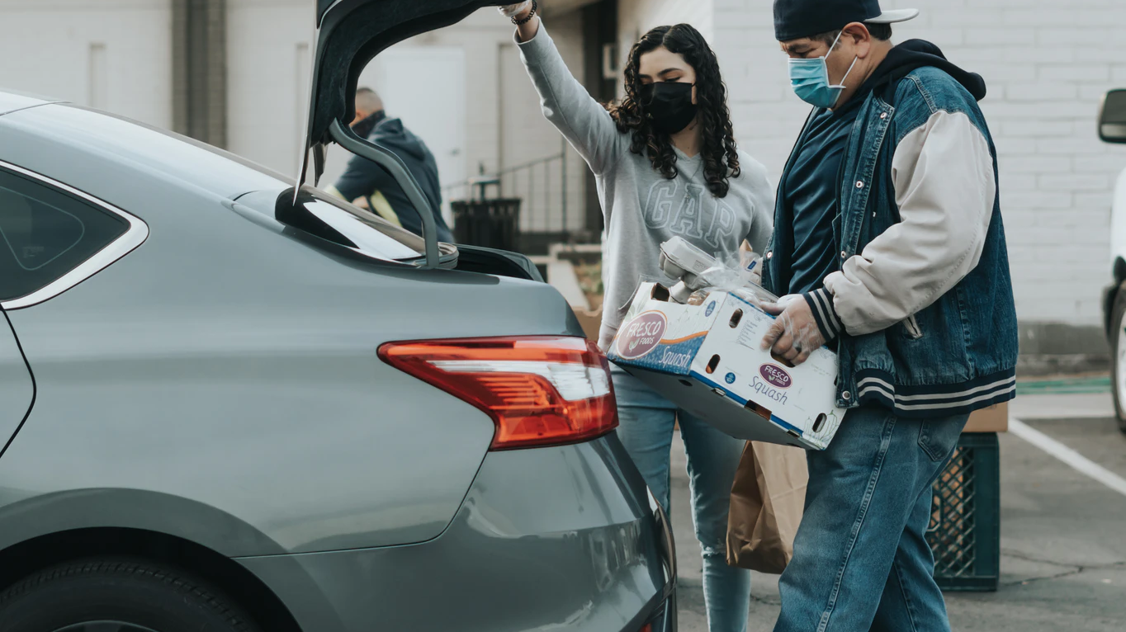
Examples of Growing the Parish Relationship with Youth
Connecting Youth to Active Disciples
Notes:
One Parish partnered youth preparing for Confirmation with intentional disciples. There was a woman parishioner who was already providing meals each Monday at the women’s shelter. An adult from the youth ministry team accompanied two parish youth who went with the woman on Saturday to shop for the meal (and talk and pray). The small group gathered again on Monday to prepare the meal and then travel together to the shelter to serve it (and talk and pray). After the meal, the two youth and the adult accompanier provided childcare for the moms in the shelter, so the women had a chance to build community with each other. This initiative became a regular part of the Confirmation preparation process. The parish leadership identified parishioners in various ministries who could mentor and accompany youth in discipleship.

Slide 31
Examples of Growing the Parish Relationship with Youth
Engaging Youth in Ministries
Notes:
One Parish - connected youth preparing to receive the sacrament of Confirmation to the ministries, service work, and leadership roles within the community. Youth were introduced to the various ministries of the parish during a weekend retreat. In one session, each young person created a resume that identified their interests and experiences. The leadership team then used the young people’s resumes to connect them with parish ministry leaders and match them to a ministry position. After celebrating their Confirmation liturgy, the youth processed to the parish hall for a reception. Waiting for the newly confirmed was a line of parish leaders ready to meet and welcome them. Each young person was greeted with a specific invitation such as, “Alex, my name is Jane and I coordinate the lectors, we’d like to invite you to consider becoming a lector for our parish.” This new tradition became part of the parish’s Confirmation processes each year.

Slide 32
Team Discussion
How can we grow in the ways we welcome all young people?
How can we build the parish relationship with youth?
How can we grow the ways that youth are engaged in parish life?
What are some ways we will encourage the parish to accompany young people?
Who needs to be involved in these conversations?
Notes:
Take some time as a team to discuss these questions which can be found on page 8 of your handouts.
How can we grow in the ways we welcome all young people?
How can we build the parish relationship with youth?
How can we grow the ways that youth are engaged in parish life?
What are some ways we will encourage the parish to accompany young people?
Who needs to be involved in these conversations?

Slide 33
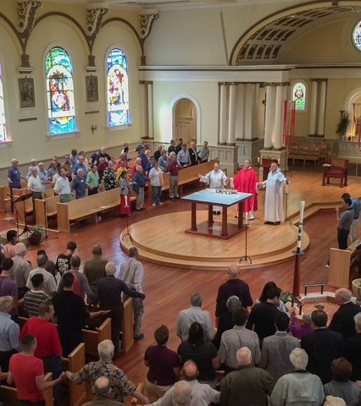
Blessing the Youth Ministry Team
Notes:
There was a parish that had a tradition of blessing the youth ministry core team at one of the masses each October. One year the pastor and the youth minister conspired to change up the blessing as a way to communicate a vision for engaging youth in the parish.
The pastor invited the youth minister to the podium. She asked the youth ministry core team to stand. Then she said, “we recognize this year that the team is bigger than just this group. We would also like to ask all of the catechists who work with youth and help prepare them for sacraments to also stand. We recognize that we work in partnership with parents and families of youth, so we also ask you to stand. Would anyone who is a sponsor or a Godparent of a young person please stand? We also know that many of you are part of ministries here in the parish that include youth. You are part of a choir that has young members, or you do service side by side with youth: please stand. We also know that many of you work with youth in our community, you work in our Catholic or public schools, or you work in healthcare or mental health, or your work in our community services, or you are an employer who supervises youth. Please stand. Finally, I would like to ask that anyone who is willing to pray for young people in our parish please stand. (Who is standing now? Everyone!)
Father, please bless our Youth Ministry Team.
This story reminds us that our task in ministry with youth is more than finding the right leader or inviting youth to join a particular group. We are talking about the generational transfer of faith. Passing the faith to a new generation is something that needs the whole parish to be “on the team.”

Slide 34
Closing Prayer
Notes:
We began this conversation by thinking about ways that we can radiate Christ’s presence to youth as a parish community. During our gathering we took the time to consider that youth are known, valued, welcomed and included. We can continue to build the parish’s relationship with our young members and find more ways to engage youth in the life of our community. Thank you for being a part of these efforts.
(After thanking the participants, make announcements about next steps in the process, then conclude in prayer.)
Loving God, thank you for your presence in our parish. Thank you for the gifts and resources you have given us to share. Help us to answer your call to welcome all youth and accompany them to your loving arms. Help our youth to see your face and answer your call to discipleship. We ask this in Jesus’ name.
All: Amen

