Slide 1
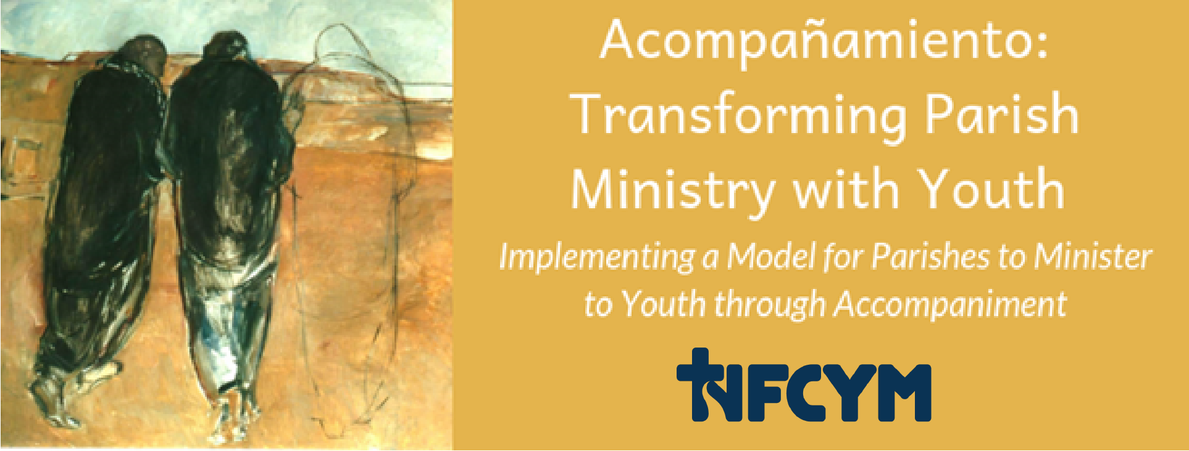
Conversation #7 Leadership for Accompaniment
Notes:
Greetings. Ministry with youth is being transformed by a vision focused on accompanying young people in faith. In this gathering, we are exploring the vision and practice of leadership for youth ministry in a parish who accompanies. For these communities, it is not really about the leaders; it’s about the parish. The parish accompanies. The parish supports parents and faith companions for youth. The parish engages and includes youth. The parish provides vibrant ministry for youth and reaches out to connect with young people on the margins. Leaders animate the relationship between the parish and the communities’ young members.

Slide 2
The Art of Accompaniment
The Church will have to initiate everyone – priests, religious and laity into this “art of accompaniment” which teaches us to remove our sandals before the sacred ground of the other….
Pope Francis, Evangeli Gaudium, #169
Notes:
In Evangeli Gaudium, Pope Francis describes the art of accompaniment and guides us to be humble and honor the person we accompany.

Slide 3
Accompany All Young People
“…just as our Lord Jesus Christ walked alongside the disciples of Emmaus
the Church is also urged to accompany all young people, without exception, towards the joy of love.”
Instrumentum Laboris 2018, #1
Notes:
We are called as Church to accompany all young people without exception!

Slide 4
# 218, Christus Vivit April 2, 2019
“In such places… the person-to-person contact indispensable for passing on the message can happen, something whose place cannot be taken by any pastoral resource or strategy.”

Slide 5
The Parish Accompanies Young People
“The community has an important role in the accompaniment of young people;
it should feel collectively responsible for accepting, motivating, encouraging and challenging them.”
# 243- Christ is Alive – Christus Vivit
April 2, 2019
Notes:
Along with the family, the parish has a primary responsibility for accompanying young disciples.

Slide 6
Prayer for Faith Companions
Jesus, you accompany us and lead us to your heart.
We come before you humbly as echoes of your word of love.
Help us to be a companion; help us to be bread for the young people you entrust to our care.
Bless us with the discipline to pray for them
Bless us with the courage to connect with them.
Bless us with the humility to listen to them.
Bless us with the strength of heart to empathize with them.
Bless us with the compassion to care for them.
Bless us with the clarity of faith to witness to them.
Bless us with love to join our voice to your call to them.
Open the ears of our heart to hear you and to follow you as we walk with young people to your waiting arms.
We ask this in the name of the one who walks with us in our questions, who warms our hearts and who sends us in mission.
In Jesus name, we pray. Amen
Notes:
You and I share in this mission of accompanying youth with care, witness, and prayers. Let us join together in this prayer for all faith companions.

Slide 7
Basic Facts about Christus Vivit
Synodal Process:
2013-2016: Pre-Synodal Development
2017: Global Consultation and Listening
2018: Pre-Synod and Bishops Synod
2019: Christus Vivit Exhortation and Post-Synod
Intended Audiences
Youth and Young Adults (“a todos los jovenes”)
The Entire People of God (“a todo el Pueblo de Dios”)
Pastors, Families, Communities, Leaders...
Notes:
We are at a historic moment. This seven-year process has led to Christus Vivit, which is the first Papal Encyclical written especially about young people.

Slide 8
Christus Vivit: New Foundations
New Ways of Seeing Young People
New Ways of Being Church/Parish
New Ways of Understanding Leadership
Notes:
Christus Vivit invites us to see young people in a new way, to see new ways of being Church and Parish, and to understand leadership for ministry with youth in a new way.
In your handouts, pages 1 to 5 there is a description of 10 things from Christus Vivit about leadership. These quotations from the document point to the kind of leadership needed in an accompanying parish. We are going to divide up to look at these more carefully. I will ask each group to read over the quotation(s) and be ready to provide one or two examples of how we can live this out as a parish.
Process:
Divide into groups of three. Assign the leadership insights individually or in clusters depending on the number of participants. If you have a group of 30 you can divide into 10 groups. Assign one leadership insight per group. If you have more than 30, you can assign one insight to more than one group. If you have less than thirty, you can group two or three insights together as an assignment for one group, or you can provide examples that you prepare in advance.
Allow ten minutes for groups to read over the quotations and brainstorm examples. Ask each group to assign a reporter to share the example with the large group when called upon.

Slide 9
1. Leaders Reflect Christ
…Consequently, the Church should not be excessively caught up in herself but instead, and above all, reflect Jesus Christ.
…“Christ is alive, and he wants you to be alive!”
Christus Vivit # 39
Notes:
Our first insight is that Leaders in youth ministry reflect Christ. As people who love young people, our first job is to show Jesus Christ to the young through our words, actions and relationships. Let’s hear from our first group – what are examples of ways we can reflect Christ?
(Pages 1-5 in Handouts)

Slide 10
2. Leaders Accompany the Young
Jesus walks with two disciples who did not grasp the meaning of all that happened to him and are leaving Jerusalem and the community behind…
he enters into their night.
As they listen to him speak, their hearts burn within them and their minds are opened; they then recognize him in the breaking of the bread.
Christus Vivit # 237
Notes:
Leaders accompany the young – in this quotation, the Emmaus story is provided as the example for us in walking with young people. We walk with the young in their questions and together we open ourselves to Christ who leads us. Group 2 – what are our examples of accompanying?

Slide 11
3. Leaders Are Young at Heart
To be credible to young people, there are times when (the Church) needs to regain her humility and simply listen, recognizing that what others have to say can provide some light to help her better understand the Gospel.
A Church always on the defensive, which loses her humility and stops listening to others, which leaves no room for questions, loses her youth and turns into a museum.
How, then, will she be able to respond to the dreams of young people?
Christus Vivit # 41
Notes:
Leaders are young at heart. In Christus Vivit, Pope Francis shared that God views youthfulness differently. He encourages all of us to be young at heart. To be youthful is to be capable of loving. To grow old is to be stagnant and attached to things that pass away. We are reminded that Jesus did not tolerate those who dismissed the young. Group 3 – what are some examples of ways to show that we are young at heart?

Slide 12
4. Leaders Take Young People Seriously, Listen to Them and Stay Close to Their Concerns
Rather than listening to young people attentively, “all too often, there is a tendency to provide prepackaged answers and ready-made solutions, without allowing their real questions to emerge and facing the challenges they pose.”
Yet once the Church sets aside narrow preconceptions and listens carefully to the young, this empathy enriches her, for “it allows young people to make their own contribution to the community, helping it to appreciate new sensitivities and to consider new questions.”
Christus Vivit # 65
Notes:
Leaders take young people seriously, listen to them, and stay close to their concerns. Walking with youth in faith begins with our stance of truly seeing them, hearing their story, and responding. Young people often experience us as ready to jump in with the answer. Throughout the Synod process, we have been consistently urged to listen to youth with empathy and value their contributions and concerns. Group 4 – What are some examples of ways that we can value youth and listen with empathy?

Slide 13
5. Leaders are Collaborative to Provide Ministry That is Synodal
Youth Ministry has to be synodal;
it should involve a “journeying together” that values the charisms that the Spirit bestows in accordance with the vocation and role of each of the Church’s members, through a process of co-responsibility...
Motivated by this spirit, we can move towards a participatory and co-responsible Church, one capable of appreciating its own rich variety, gratefully accepting the contributions of the lay faithful…
Christus Vivit # 206
Notes:
Leaders are collaborative to provide ministry that is synodal. Leadership in parishes who accompany youth is not personality or ego based. We are urged to move together in ministry. This is described in Hispanic ministry as “pastoral de conjunto.” We move forward in ministry together by valuing the gifts, perspectives, and contributions of the members of the parish community. As a parish we strive to love young people in Christ’s name and accompany them toward holiness.
Group 5 – what are some examples of acting collaboratively?

Slide 14
6. Leaders Are Flexible
The young make us see the need for new styles and new strategies. For example, while adults often worry about having everything properly planned, with regular meetings and fixed times, most young people today have little interest in this kind of pastoral approach.
Youth ministry needs to become more flexible:
inviting young people to events or occasions that provide an opportunity not only for learning, but also for conversing, celebrating, singing, listening to real stories, and experiencing a shared encounter with the living God.
Christus Vivit # 204
Notes:
Leaders are flexible. Pope Francis is urging us to make room for the spontaneity and enthusiasm of young people. In the preparatory document, we were warned of creating ministries that “dominate space.” Instead, we create space with room to breathe, where community can grow, and faith can be shared. Group 6 – what are examples of ways to show that we are flexible?

Slide 15
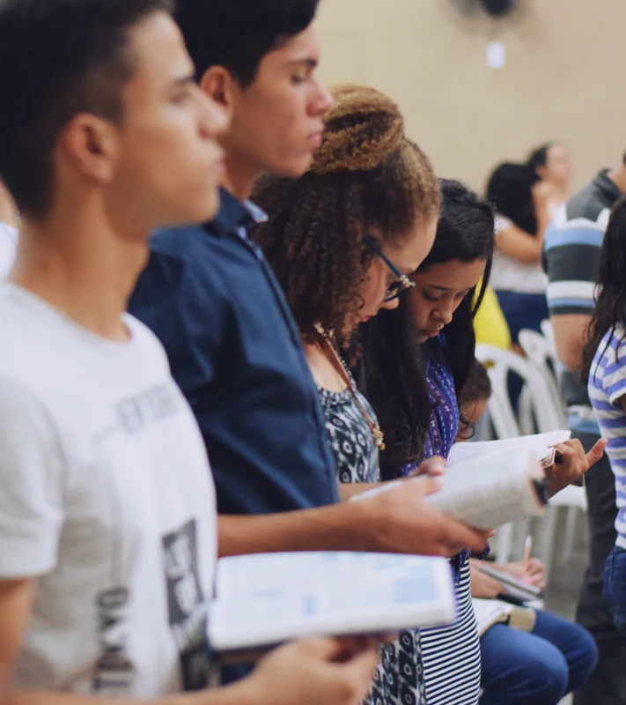
7. Leaders Empower Young People for Mission
This involves growing in a relationship with the Father, in awareness of being part of a family and a people, and in openness to being filled with the Holy Spirit and led to carry out the mission God gives them, their personal vocation.
…Rather, we need projects that can strengthen them, accompany them and impel them to encounter others, to engage in generous service, in mission.
Christus Vivit # 30
Notes:
Leaders empower young people for mission. Growing in faith means growing in our awareness of our mission. Those of us who walk with youth have the privilege of providing ways to encourage and empower youth for service and leadership. Group 7 – what are some examples of ways to empower youth for mission?

Slide 16
8. Leaders Awaken Young People to Encounter
…many young people get bored; they lose the fire of their encounter with Christ and the joy of following him;
many give up and others become downcast or negative.
Rather than being too concerned with communicating a great deal of doctrine, let us first try to awaken and consolidate the great experiences that sustain the Christian life.
Christus Vivit # 212
Notes:
Leaders awaken young people to encounter. Our generous God is always sending opportunities for encounter to young people. We are told to awaken youth to these encounters and consolidate these experiences to sustain discipleship. We are also warned – don’t bore young people. Sometimes we allow our fear to dominate what we share with the young and how we spend our time. Group 8 – What are examples of ways to awaken and sustain youth’s experience of encounter?

Slide 17
9. Leaders Engage the Parish to Make a Home For All Young People
… (Young people) will be better integrated into (parish) communities that are open, living their faith, eager to radiate Christ, joyful, free, fraternal, and committed.
These communities can be settings where they feel that it is possible to cultivate precious relationships.
Christus Vivit # 220
Notes:
Leaders engage the parish to make a home for all young people. The Instrumentum Laboris document from the Synod reminded us of our call as Church to “accompany all young people, without exception, towards the joy of love.” (#1) In Christus Vivit, we are told to be bold and daring in making a home for all young people and to become a community who radiates Christ. Group 9 – What are examples of ways we can make a home in our community for young people?

Slide 18
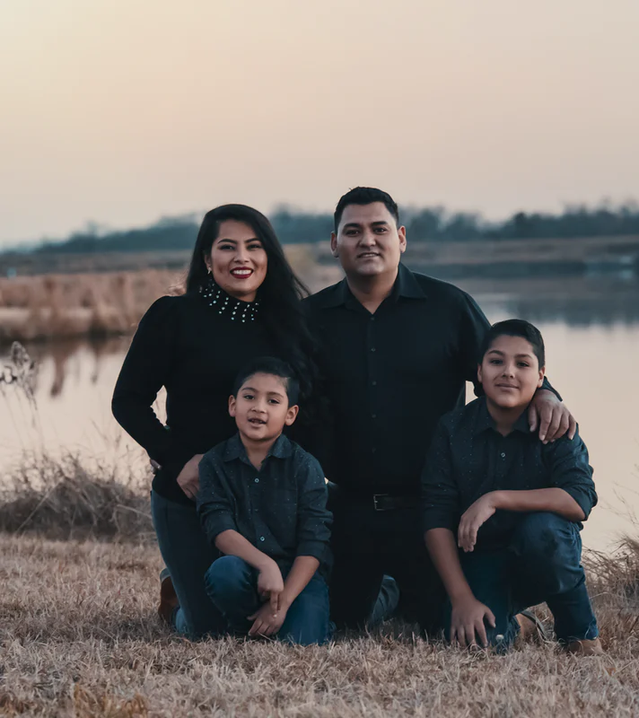
10. Leaders Support Families Who Accompany the Young
The Synod insisted that “the family continues to be the principal point of reference for young people.
Children appreciate the love and care of their parents, they give importance to family bonds, and they hope to succeed in forming a family when it is their time.”
Christus Vivit # 262
Notes:
Leaders support families who accompany the young. Families accompany young people in faith. Families are often the first place where young people experience acceptance, encouragement, and unconditional love. To accompany youth, families need support and resources. Group 10 – What are some ways to provide support and resources for families as they accompany young people in faith?
(Thank the participants for their work in providing examples.)

Slide 19
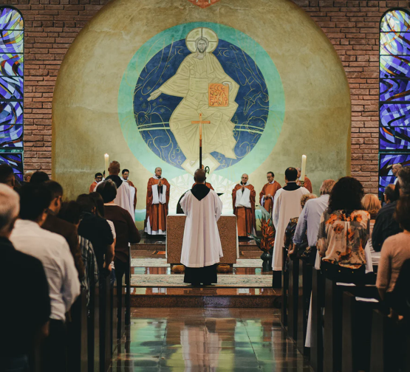
Leadership in Parishes Who Accompany Youth
Parishes accompany youth on their journey toward holiness as missionary disciples.
Leaders in ministry with youth animate these actions by listening, planning, implementing, evaluating, and engaging the community in the accompaniment of youth.
Notes:
We can see through this vision, that parishes have a mission to accompany. Accompaniment isn’t a piece of youth ministry, or a strategy – it is a way to look at all the parish’s ministry with youth. This is a summary of this vision: (advance animation)
Parishes accompany youth on their journey toward holiness as missionary disciples.
This mission clarifies the role of leaders for youth ministry: (advance animation)
Leaders in ministry with youth animate these actions by listening, planning, implementing, evaluating, and engaging the community in the accompaniment of youth.
(Page 8 in handouts.)

Slide 20
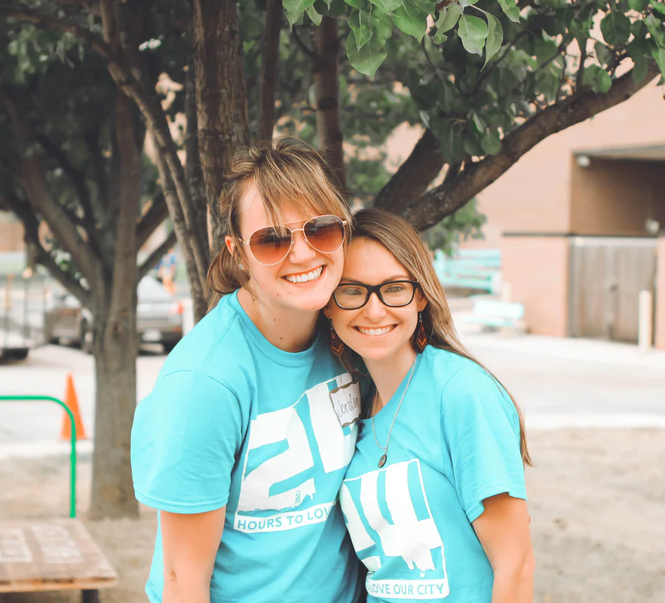
The Parish Accompanies
Parish Leaders Support Accompaniment
Notes:
As I mentioned previously, the parish accompanies young people, working in tandem with families. Leaders animate the relationship between the parish and the communities’ young members. They do that through a variety of actions that have one purpose: to support the parish community as they accompany youth on their journey toward holiness as missionary disciples. Leaders Accompany
Youth ministry leaders accompany youth in the parish community. This could include specific faith companion relationships as well as engagement with youth through the life of the parish and ministry offerings. Leaders also accompany the accompaniers, providing support for parents and faith companions for youth in the parish community.
(Pages 6-7 in handouts.)

Slide 21
The Parish Accompanies - Leaders Support Accompaniment
Leaders Listen and Assess Needs
Notes:
Leaders Listen and Assess Needs
Youth ministry leaders listen to young people and seek to understand their needs and aspirations. They pay particular attention to reaching out to youth who are underserved and are on the peripheries of the parish.

Slide 22
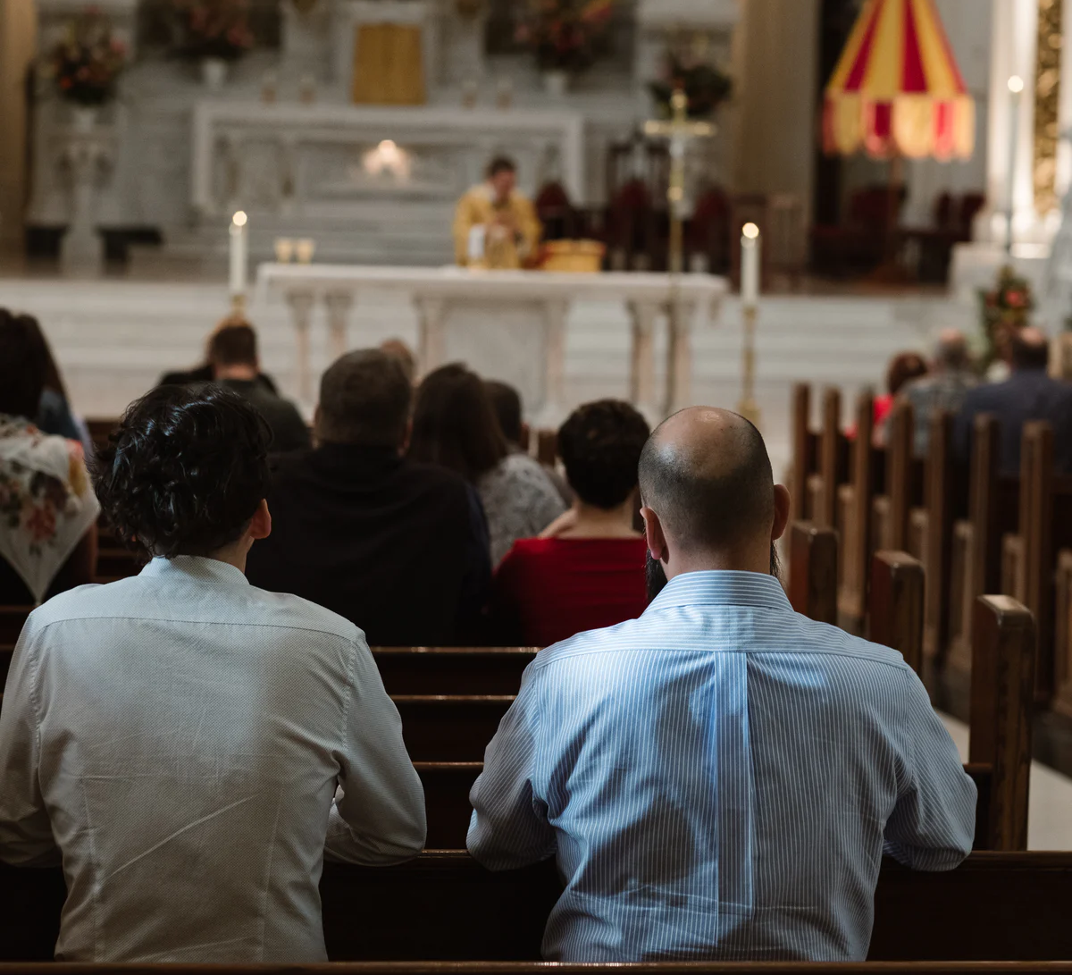
The Parish Accompanies – Leaders Support Accompaniment
Leaders Utilize Resources and Research Best Practices
Notes:
Leaders Utilize Resources and Research Best Practices
Youth ministry leaders seek to utilize dynamic resources and effective models for the parish’s ministry with youth and their families. This includes networking and research in identifying best practices for the accompaniment of youth, the transformation of ministries, and the engagement of youth with the parish community.

Slide 23
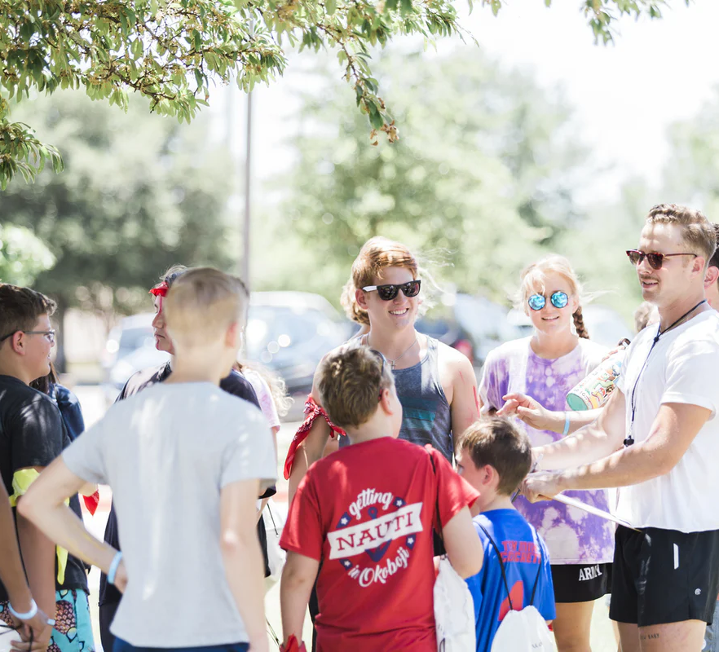
The Parish Accompanies – Leaders Support Accompaniment
Leaders Plan and Implement Ministry Responses
Notes:
Leaders Plan and Implement Ministry Responses
Youth ministry leaders plan and implement initiatives and responses to youth and their families on behalf of the parish.

Slide 24
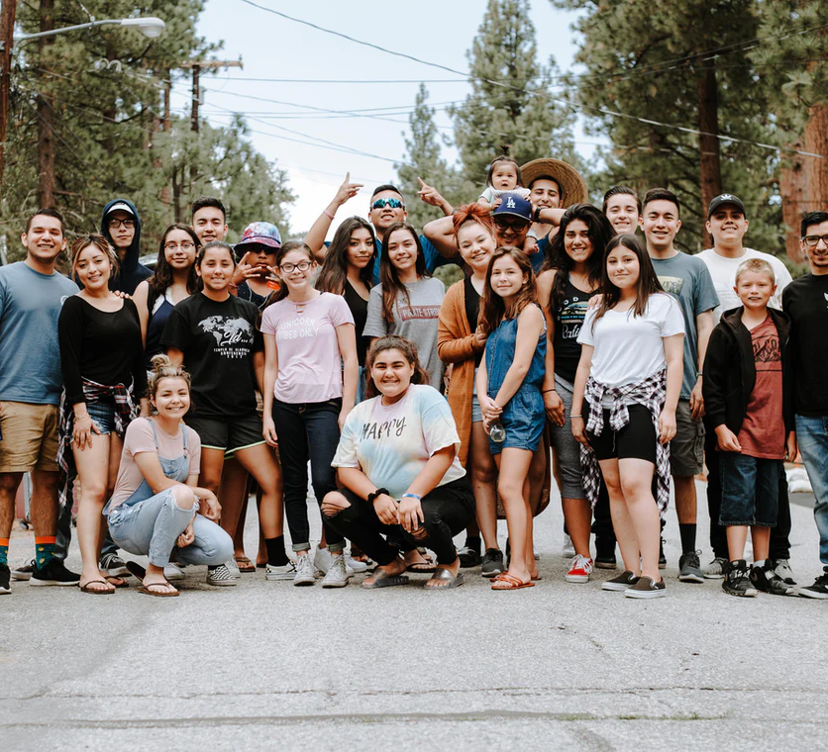
Leaders Support the Parish’s Accompaniment Through These Three Actions:
Empowering the parish to accompany young disciples
Equipping Parents and Faith Companions
Transforming ministries to provide accompaniment
Notes:
To become a community who accompanies, leaders begin to take steps in this direction.
These are three important responses that leaders plan and implements to help the parish grow:
Empowering the parish to accompany young disciples
Equipping Parents and Faith Companions
Transforming ministry to provide accompaniment

Slide 25
The Parish Accompanies – Leaders Support Accompaniment
Leaders Collaborate and Form Partnerships
Notes:
Leaders Collaborate and Form Partnerships
Youth ministry leaders collaborate and form partnerships within the parish on behalf of youth and their families. They also collaborate and form partnerships in the wider community, the diocese, regionally, and nationally to provide the best ministry responses and accompaniment for youth and families.

Slide 26
The Parish Accompanies – Leaders Support Accompaniment
Leaders Empower Other Leaders
Notes:
Leaders Empower Other Leaders
Youth ministry leaders are stewards of the gifts of the parish community. They are constantly seeking out new leaders to involve in the accompaniment of youth and the implementation of ministry programs and strategies that serve youth and their families. They are committed to the ongoing formation and support for leaders in ministry with youth. This includes particular attention to the empowerment and formation of youth as leaders.

Slide 27
The Parish Accompanies – Leaders Support Accompaniment
Leaders Evaluate and Innovate
Notes:
Leaders Evaluate and Innovate
Youth ministry leaders provide for continuous evaluation and enhancement of ministry strategies and programs. This includes creating innovative responses to the emerging needs and opportunities for accompanying and serving youth and their families.

Slide 28
The Parish Accompanies – Leaders Support Accompaniment
Leaders Share a Vision, Inspire, and Support
Notes:
Leaders Share a Vision, Inspire, and Support
Youth ministry leaders support the parish and wider community in accompanying and serving youth and their families by sharing a vision for ministry with youth and families and providing inspiration and support for the members of the parish community as they accompany young disciples.

Slide 29
Who is Responsible for Accompaniment?
Parish
Coordinator of Youth Ministry
Youth Ministry Coordinating Team
Notes:
It is important to understand the broader mission of the parish and the role of its leaders to carry out the mission. From the time that the Church first established youth ministry, there has been much confusion in our communities on how to successfully implement the ministry. Youth ministry is often delegated to a single person (the youth minister or coordinator of youth ministry) or to a small group of people (the Youth Ministry Team.) In some places, this delegation is much like checking ministry with youth off the parish to do list. However, delegating youth ministry as a separate, stand-alone ministry leaves youth isolated from parish life. If a parish community wishes to truly accompany youth in faith, it must name and claim the responsibility for its ministry with them.
I ask you now to work in (pairs or groups of three to five people) to identify what the parish is responsible for. Knowing that the coordinator and the team are part of the parish, you could then identify what the Coordinator is responsible for. For example, your group might identify “praying for young people” as a responsibility of the parish, including the coordinator and team. You might identify, “creating an annual report about youth ministry” as a responsibility of the Youth Ministry Team.
I am distributing large sticky notes and sharpie markers to each group. You’ll notice that I have these headlines on the wall. This is where we will collect these ideas. Please write one idea per sticky note and assign it to the parish (everyone), Coordinator, or the team.
(Distribute large sticky notes and sharpie markers to the groups. Allow 12 minutes for groups to work, then instruct the groups to place the sticky notes on the wall. Read over the lists and engage the group in thinking through what belongs where. Ask participants if there are any items for coordinator or team that could be moved to the parish. Move things around as needed. For example, if the group placed “accompany youth – talk to youth about faith” as the role of the coordinator, you could suggest moving this to the listing for the Parish. After moving things, ask the participants what they noticed about this exercise and what does this remind us about leadership for youth ministry.)

Slide 30
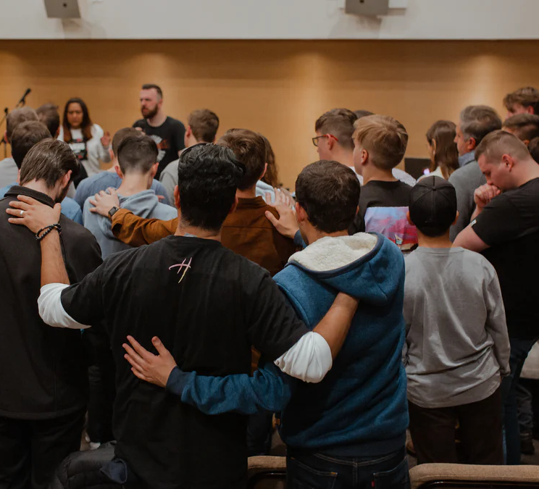
Tasks of Leadership in Parishes Who Accompany Youth
Parishes accompany youth on their journey toward holiness as missionary disciples.
Leaders support this engagement by:
Engaging Youth with the Parish Community
Empowering Parents and Faith Companions
Providing Ministries to Youth that Promote Accompaniment
Evaluating and Planning for Accompaniment
Notes:
This process helps to clarify the role of leaders – Parishes accompany youth – leaders support that accompaniment. Please turn to page 8 in your handouts for this description of the tasks that leaders do to help parishes accompany young disciples.
(Review the listing of tasks. Invite feedback and address questions from the participants.)
(Page 8 in handouts)

Slide 31
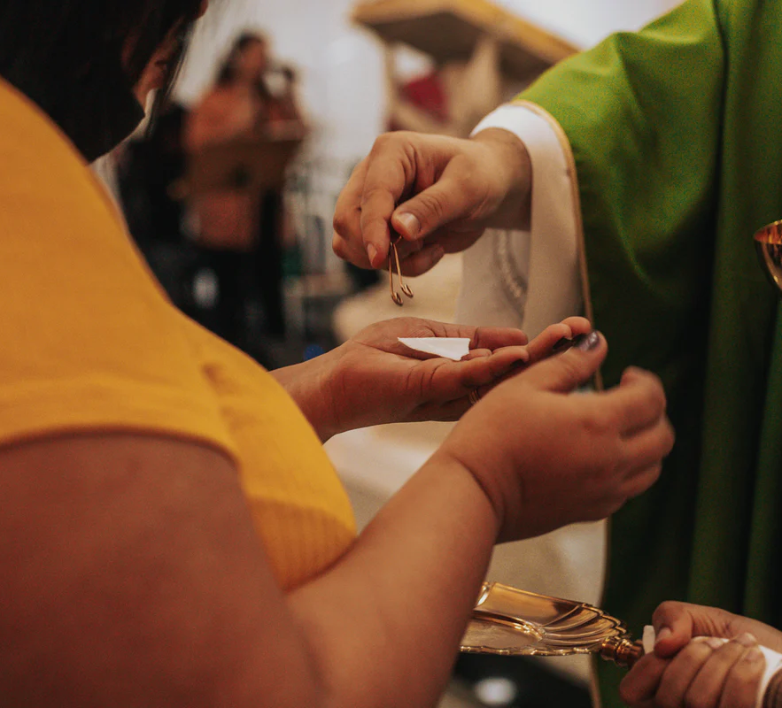
Parish Leaders Who Share in Leadership for Youth Ministry
Pastor
Notes:
We have identified the role of the parish and the roles for the coordinator and team. We have also named what leaders in youth ministry do. it is important to name that leadership goes beyond the Coordinator, Youth Ministry Team, and specific youth ministry volunteers. There are many other leaders in the parish whose pastoral ministry connects with youth.
(Advance animation.)
We know that the pastor is responsible for all of the souls within the boundaries of the parish, including young people. Besides the pastor, which leaders or leadership groups are connected to our parish’s ministry with youth?
(Record these individuals and leadership groups on the easel pad sheet that you posted. Start the list with “pastor.” Consider these individuals:
Pastor
Associate Pastors or Parochial Vicars
Deacon
Director of Religious Education
Pastoral Assistant for Worship and Liturgy
Pastoral Assistant for Initiation
Pastoral Assistant for Justice Ministries
Pastoral Assistant for Family Ministry
Pastoral Assistant for Adult Education
Coordinator for Young Adult Ministry
Coordinator for Sacramental Preparation (including baptism and marriage.)
Parochial School Principal
Parish Facilities Staff
Parish Administrator
Consider these groups:
Parish Council
Faith Formation Advisory Team
Worship Advisory Team
Justice and Service Advisory Team
Community Life Advisory Team

Slide 32
Leadership Role Description for the Coordinator of Youth Ministry
Position Overview:
The Coordinator of Youth Ministry facilitates the gifts of the community and supports the leadership team, ministry leaders, and the parish community as they accompany youth on their journey toward holiness as missionary disciples.
The Coordinator provides leadership for ministry that accompanies and engages youth.
The Coordinator facilitates the development of an accompanying ministry with young and older adolescents
The Coordinator promotes the formation of youth as missionary disciples.
The Coordinator acts as an advocate and link for youth.
The Coordinator recruits, prepares, and supports adult and youth leaders in youth ministry.
Notes:
With these things in mind, I would like to ask you to turn to page __ in your handouts. Let’s review together these suggestions for the Leadership Role for the Coordinator of Youth Ministry in a parish committed to accompaniment.
(Review the role description on page 9 in the handouts – ask the participants if they have questions or comments. Invite the participants to identify anything not on the list that could be added for their parish.)
Leadership Role Description for the Coordinator of Youth Ministry
Position Overview: The Coordinator of Youth Ministry facilitates the gifts of the community and supports the leadership team, ministry leaders, and the parish community as they accompany youth on their journey toward holiness as missionary disciples.
The Coordinator provides leadership for ministry that accompanies and engages youth.
implementing the ongoing training, resourcing, and support for parents and faith companions for young people.
developing initiatives that support the engagement of youth with the parish community and the inclusion of youth in parish life, including leadership and ministry roles.
developing ministry programs and strategies that support accompaniment, serve youth and their families, and engage youth in mission
The Coordinator facilitates the development of an accompanying ministry with young and older adolescents
leading the coordinating team in planning and coordinating programs and services for youth and their families
facilitating the planning, implementation, and evaluation of a plan for accompaniment of youth and the development of ministry responses that engage youth and their families
establishing a collaborative relationship with members of the pastoral staff and parish leaders
developing and supervising the program budget
assuring that legal and moral responsibilities are provided for within the context of the parish program, including developing and implementing plans for promoting a safe environment
The Coordinator promotes the formation of youth as missionary disciples.
developing and implementing evangelization and outreach programs, paying particular attention to underserved youth and families on the peripheries of the parish community
developing and implementing catechetical programs and sacrament preparation
promoting active youth worship including inclusive and participative liturgy and prayer opportunities
engaging youth in the mission of the Church, including empowerment for service, leadership, and ministry roles
providing for the accompaniment of youth that sustains their experiences of encounter and leads to discernment of their vocation
The Coordinator acts as an advocate and link for youth.
Identifying and interpreting the needs of youth to the parish staff, parish leaders, and the community
facilitating the development of community among young people, their families, their parish, and the local community
supporting families in their role of sharing faith and accompanying young disciples
promoting the pastoral care of youth and their families
The Coordinator recruits, prepares, and supports adult and youth leaders in youth ministry.
creating a leadership system for inviting, preparing, supporting, and supervising leaders
promoting the spiritual formation of youth and adult leaders
developing job descriptions and recruitment processes
facilitating the training and support of leaders
providing feedback on leadership performance and continuous support for leaders

Slide 33
Process for the Coordinator Role
What are some personal qualities we should seek in the Coordinator of Youth Ministry?
Who should take on the role of Youth Ministry Coordinator for Our Parish?
A volunteer
A part-time or full-time staff person
Assign the position to one of our existing staff
Who would supervise this position?
What background, experience and skills would be helpful?
Where could we look, who could we talk to in searching for this position?
What support should we provide?
Notes:
This discussion is a brainstorm exercise that will assist parish leadership in making decisions about the role of the Coordinator.
(Ask the participants to turn to page 10 of the handouts and discuss these questions. Ask someone to record the discussion responses.)

Slide 34
Leadership Role Description for the Youth Ministry Coordinating Team
Role Overview: The Youth Ministry Coordinating team works on behalf of the parish community to support youth on their journey toward holiness as missionary disciples.
The Youth Ministry Coordinating Team shares leadership in overseeing the parish’s ministry to accompany youth.
The Youth Ministry Coordinating Team facilitates the development of an accompanying ministry with young and older adolescents.
The Youth Ministry Coordinating Team promotes the formation of youth as missionary disciples.
Notes:
With these things in mind, I would like to ask you to turn to page __ in your handouts. Let’s review together these suggestions for the Leadership Role for the Coordinator of Youth Ministry in a parish committed to accompaniment.
(Review the role description on page 11 of the handouts – ask the participants if they have questions or comments. Invite the participants to identify anything not on the list that could be added for their parish.)
Leadership Role Description for the Youth Ministry Coordinating Team
Role Overview: The Youth Ministry Coordinating team works on behalf of the parish community to support youth on their journey toward holiness as missionary disciples.
The Youth Ministry Coordinating Team shares leadership in overseeing the parish’s ministry to accompany youth.
Providing vision, goals, and directions for all aspects of youth ministry, including
implementing ongoing training, resourcing, and support for parents and faith companions for young people.
developing initiatives that support the engagement of youth with the parish community and the inclusion of youth in parish life, including leadership and ministry roles.
developing ministry programs and strategies that support accompaniment, serve youth and their families, and engage youth in mission
Coordinating schedules and programs for youth ministry
Planning for communication and engagement with youth and families.
Making recommendations for resources, budget, and facility usage regarding youth ministry
Assuring adequate recruitment, training, and support for leadership in youth ministry
Establishing and updating any policies and/or procedures necessary for effective implementation of youth ministry
Providing regular feedback to the parish staff, parish council, and leadership groups regarding needs, recommendations, and accomplishments of youth ministry
Advocating for the needs of youth and families within the parish and wider community
The Youth Ministry Coordinating Team facilitates the development of an accompanying ministry with young and older adolescents
listening to youth and families and assessing needs of youth, paying particular attention to underserved youth and those on the peripheries of the parish.
planning, implementing and evaluating plans for the accompaniment of youth and the development of ministry responses that engage youth and their families.
The Youth Ministry Coordinating Team promotes the formation of youth as missionary disciples.
providing for the accompaniment of youth that sustains their experiences of encounter and leads to discernment of their vocation
developing and implementing evangelization and outreach programs, paying particular attention to underserved youth and families on the peripheries of the parish community
promoting the pastoral care of youth and their families
developing and implementing catechetical programs and sacrament preparation
promoting active youth worship including inclusive and participative liturgy and prayer opportunities
engaging youth in the mission of the Church, including empowerment for service, leadership, and ministry roles

Slide 35
Process for the Role of the Youth Ministry Coordinating Team
What are some personal qualities we should seek in members of the Youth Ministry Coordinating Team?
What background, experience and skills would be helpful?
Where could we look, who could we talk to in searching for members of this team?
What support should we provide?
Notes:
This discussion is a brainstorm exercise that will assist parish leadership in making decisions about the role of the Youth Ministry Coordinating Team
(Ask the participants to turn to page 12 of the handouts and discuss these questions. Ask someone to record the discussion responses.)

Slide 36
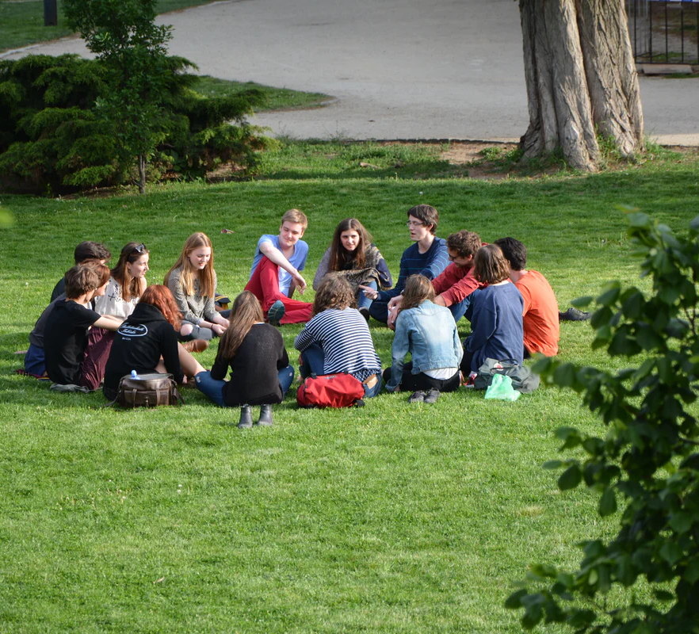
Conclusion – Parishes Accompany Leaders Support Accompaniment
The members of the parish and leaders for youth ministry are co-responsible in the Church’s mission with young people.
Youth ministry…should involve a “journeying together” that values “the charisms that the Spirit bestows in accordance with the vocation and role of each of the Church’s members, through a process of co-responsibility...”
Christus Vivit, # 206
Notes:
(Check-in with participants to see if there are remaining questions. Let them know that the follow-through for this conversation will include work with parish leadership in planning for the parish’s ministry with youth and the leadership needed to support it. Provide concluding comments.)
In this conversation, we have explored the role of the parish and the role of leaders for youth ministry, inspired by the work of the Synod on Young People and Pope Francis’s exhortation, Christus Vivit. Through this exploration, we see that parishes accompany young members working in tandem with families. Youth Ministry leaders support this accompaniment by engaging youth with the parish, supporting parents and faith companions, and providing ministries that provide for accompanying relationships. This effort requires shared responsibility:
Youth ministry…should involve a “journeying together” that values “the charisms that the Spirit bestows in accordance with the vocation and role of each of the Church’s members, through a process of co-responsibility...”
Christus Vivit, # 206
(Announce the next steps in this process. Lead the participants in a closing prayer.)
Let us close in prayer.
In the name of the Father, the Son, and the Holy Spirit
Loving God,
You call us to love young people in Christ’s name and accompany them to active discipleship.
We pray now for all who are leaders in ministry with youth. We know that you give us every good gift.
We pray now for the blessings that leaders will need to share your Good News with young people.
(Ask each person to use one or a few words to name a gift or blessing that they ask God to give leaders in youth ministry. Provide this concluding prayer:)
We pray now for these blessings. Open our hands to share blessings with each other and open our hearts to receive the gifts that you give us.
We ask this with trust and confidence in the name of Jesus who accompanies us.
All: Amen

