Slide 1
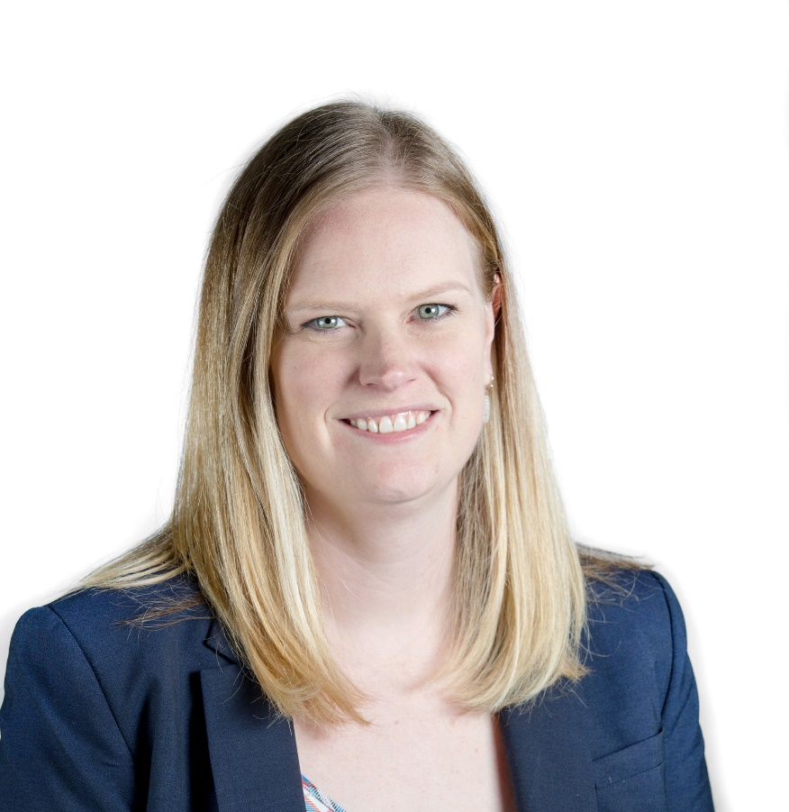


Catholic Scouting is Youth Ministry
presented by
Alison Tate
Catholic Scouts

Slide 2

Join NFCYM to develop your skills with training and resources, be ‘in the know’ on all things youth ministry and connect with ministry peers in a new way. But, most importantly, you can help bring more young people to Christ throughout the United States.
Ways to Get Involved
Membership
Webinars
  Monthly Webinars
  Momentum
Programs
  NDDI
  First Things in Youth Ministry
  Strong Catholic Families
  NCCGSCF
Engage with NFCYM
Visit the Resource Library
Events
  Exchange
  NCYC
5-Year Strategy Project Teams
Ministry Networks
Donate
Become a member today!
To learn more, visit nfcym.org/membership-information/

Slide 3
Navigating TikTok with Teens: How Ministers can Support Parents
Tuesday, June 13
2:00 pm ET / 11:00 am PT
A webinar co-hosted by NFCYM and Axis Ministries, aimed at helping ministers support parents in navigating the world of TikTok with their teenage children. With the increasing prevalence of social media in the lives of young people, it is essential for parents to understand and guide their children through possibilities and pitfalls. In this webinar, youth ministers will learn practical tips to help parents engage with their teen’s use of TikTok and facilitate open and honest conversations around Christ-centered digital citizenship and online safety.
June
Webinar
Insert photo
Register here: https://nfcym-org.zoom.us/webinar/register/WN_5LQGiSlCTkWxatM0z6v3uA#/registration

Slide 4
Attention all first-year youth ministry leaders! Sign up now for our Summer Cohorts of "First Things in Youth Ministry." This program is designed specifically for those new to the role and will provide valuable insights and skills to help you succeed.
Join a cohort of fellow leaders to build relationships and grow your professional network. Don't miss out on this opportunity to take your ministry to the next level!
First Things
In
Youth Ministry
Register here: https://nfcym.org/first-things-registration/

Slide 5
NCYC
November 16-18, 2023 in Indianapolis, IN
This year’s theme is Fully Alive, inspired by Genesis 1:23-27; God created mankind in His image; in the image of God, He created them. The theme, Fully Alive, explores the mystery of our creation in the image of God. When we are fully alive, we are the pinnacle of creation, vibrant and intellectual while also full of faith! It brings us to worship and to go out as stewards of our world, caring for our creation and our brothers and sisters around us. To be fully alive is to be like Christ.
Items to note:
New “Fully Alive” promo video, View Here >
Next price increase will take place on July 1. View Pricing >
Check out our informational blogs at ncyc.us
NCYC 2023

